Slide 1
Understand of Chromium OS
Alan Zhang

Slide 2
General Chromium OS Information
Quick Start guide - http://www.chromium.org/chromium-os/quick-start-guide
Chromium OS developer guide - http://www.chromium.org/chromium-os/developer-guide
Chromium OS device page to access all other device information - http://www.chromium.org/chromium-os/developer-information-for-chrome-os-devices
Chromium OS Board Porting Guide: https://www.chromium.org/chromium-os/how-tos-and-troubleshooting/chromiumos-board-porting-guide
List of branches of Chromium OS - https://chromium.googlesource.com/chromiumos/manifest.git/+refs
Add kernel driver:
Locate used kernel via "cros_workon --board xxx --list all" to locate used kernel, then enable driver in kernel config, then "cros_workon start ..."
Add userspace packages:
Suggested reading: Gentoo Development Guide - Ebuild Writing (https://devmanual.gentoo.org/ebuild-writing/)
Suggested reading: Chromium OS Portage Build FAQ (http://www.chromium.org/chromium-os/how-tos-and-troubleshooting/portage-build-faq)
Notes:
Reference:
http://www.nexedi.com/blog/blog-My.First.Fully.Free.Laptop
https://www.reddit.com/r/Crostini/comments/8ayrnl/creating_other_lxc_containers/
https://wiki.ith.intel.com/display/ChromeOS/Technical+training

Slide 3
Background of Portage
Portage is a package management system used by Gentoo Linux to to install, uninstall and maintain software on your system from the source code.
The Portage system consists of:
Portage tree which is a collection of ebuilds, that is a local copy (unzipped, and located in /usr/portage/) of the central ebuild repository, this default Portage tree can be sync'ed from official site via "emerge --sync" command that will sync the local Portage tree with the upstream Portage tree. Whenever you install software on your system with the emerge command, the Portage tree is searched. If a matching package name is found, its dependencies are calculated, the source code for the package and its dependencies are downloaded and then they're all compiled and installed onto your system.
Portage 树有四层结点。根结点便是 /usr/portage 目录，第 2 层结点是软件包所属分类目录，第 3 层结点是软件包的名称目录，叶子结点则是 ebuild 文件以及其他辅助性文件或目录。以 gnome-shell-3.12.2.ebuild 文件为例，它在 Portage 树中的完整路径是 /usr/portage/gnome-base/gnome-shell/gnome-shell-3.12.2.ebuild。
Ebuild: a specialized BASH script to give a set of instructions to emerge as an interface to the Portage software management system. Each version of each application or package in the Portage repository has a specific ebuild script written for it.
Eclass: An eclass is a collection of code which can be used by more than one ebuild. Three kinds of eclass:
Those which provide common functions which are used by many ebuilds (for example, eutils, versionator, cvs, bash-completion)
Those which provide a basic build system for many similar packages (for example, vim-plugin, kde)
Those which handle one or a small number of packages with complex build systems (for example, vim, toolchain, kernel-2)
emerge command: Executes the instructions in ebuilds (special scripts) in a sandbox environment; The default building directory is <cr>/build/$BOARD/packages/ in Chromium OS building. So generally, you can check the latest building inside this directory.
The Portage configuration files;
The third-party Portage / emerge tools.
Notes:
An eclass is roughly the equivalent of a library or header for an ebuild. Eclass is written in Bash just like ebuilds, and can be included in ebuilds file to share common codes. One example of an eclass specific to Chromium OS is cros_workon.
emerge acts as package manager like “apt” in ubuntu, but in Chromium OS build system, i.e. the Portage. For example, emerge-armgeneric vim, to bring vim into ARM target filesystem. With option “--unmerge”will remove a package from the target filesystem.
make.conf - custom settings for Portage, Key variables defined in /etc/make.conf
DISTDIR变量定义了Portage将会把下载的源码存放到哪个路径。默认值是/usr/portage/distfiles.
Portage files Reference: https://wiki.gentoo.org/wiki/Handbook:AMD64/Portage/Files
http://jasonblog.github.io/note/design_pattern/index.html

Slide 4
Equery
Equery can be used to collect a variaty of information from Portage. Some common usages are:
emerge-$BOARD --search kernel: Search 'kernel' packages in current codebase
equery belongs <file>: tells you what is package that the specified file come from
equery which <package>: tells you which ebuild is used for the spcified package
equery depends <package>: tells you what pakages are dependent on a package
equery files <package>: tells you what files installed belonging to a particular package
equery uses <package>: tells you what USE flags are enabled for a package
equery-$BOARD g <package-name>: Show the dependency graph for a package
equery --quiet list '*': List all possible installed packages that can be enabled via "emerge" command. Most of them are NOT cros_workon categrory
equery list '*' --format '$name' | xargs -n1 --replace emerge --search '%^{}$' 2>/dev/null | egrep -e "^[*]|Description" | sed \ -e "s/Description://" | awk 'BEGIN {RS="*";FS="\n"} { printf "%-38s %s\n",$1, $2 }'
USE=“debug” CFLAGS=“-g –O0” FEATURES=“nostrip noclean –splitdebug” emerge-amd_x86-generic –a <package_name> // Build a specified package w/ DEBUG
Notes:
Reference: https://virtguru.wordpress.com/2010/09/22/12minutes-chromium-os-internals-installed-packages-and-their-sizes-on-defaut-devel-image/

Slide 5
Overlay Mechanism in Portage Tree
Portage 树支持一种被称为 Overlay 的技术。简单来说，就是我们可以另行建立一棵新的 Portage 树，这棵树的规模虽然比官方的 Portage 树小很多，但是 Portage 树的管理系统可以将这可新的 Portage 树与官方 Portage 树『合并』。如果新的 Portage 树中某些结点与官方的 Portage 树存在重叠，那么 Portage 树的管理系统会以前者覆盖后者，因此我们新建的 Portage 树通常被直呼为『Overlay』。
Notes:
Reference:
初探 ebuild: https://segmentfault.com/a/1190000003819421

Slide 6
Overlays in Chromium OS
Notes:
There are multiple potential overlays locations, depend on if overlay contents are public, private, and/or a variant of a base board.
The locations in order of inclusion are:
* src/overlays/overlay-<board>
* src/overlays/overlay-variant-<board>-variant
* src/private-overlays/overlay-<board>-private
* src/private-overlays/overlay-variant-<board>-<variant>-private
NOTE: All board overlays (including variants) should contain a make.conf. If this file exists it will be sourced in the order that the overlays and variants are listed above.
$willis : tells you what is up in the chroot env.

Slide 7
Work Directories in Chromium OS
Standard Set of Ebuilds | src/third_party/portage-stable/
Chromium OS portage overlay | src/third_party/chromiumos-overlay/, where most of the ebuild files for needed packages reside.
Chromium OS ebuilds | src/third_party/chromiumos-overlay/chromeos-base/
target profile (per-package unmask, USE flags, etc) | src/third_party/chromiumos-overlay/profiles/targets/chromeos/
host and per-target configs chromium os version (chromiumos/src/third_party/chromiumos-overlay/chromeos/config) | src/third_party/chromiumos-overlay/chromeos/config/
crossdev autoconf configs (in chroot) | /usr/share/crossdev/include/site/
board sysroot (in chroot) | /build/${BOARD}
Notes:
For example, src/third_party/chromiumos-overlay/virtual/target-os/target-os-1.ebuild is the base ebuild containing all the packages in Chrome OS. This ebuild lists all other top-level Chromium OS packages as explicit dependencies. Thus, all of Chromium OS is built when building this one package.
ex. emerge-x86-generic --getbinpkg --usepkg --with-bdeps y app-arch/tar that the parameters "--getbinpkg --usepkg --with-bdeps" only fetch binary packages from google server, not go through compiling.

Slide 8
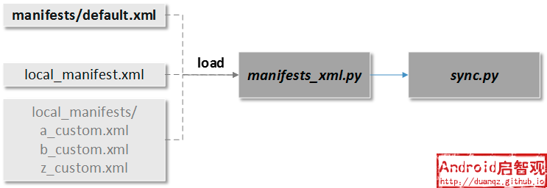
How to Add New Board Overlay
Levels and Types
For a new public board there are three levels to deal with:
Public (chromium.org)
Partner Private (google)
Internal Private (CPU Vendor)
Within each of the above levels, there are three types of overlays:
chipset
baseboard
board
Each level can have a mix of one, two, or all three types depending on the platform being added.
Step 1 - Board Name
The board name added to the following file: src/third_party/chromiumos-overlay/eclass/cros-board.eclass
Step 2 - Public Overlays
Chipset - created for the silicon (ex. src/overlays/chipset-$CHIP)
Baseboard - created for the lead vehicle (ex. src/overlays/baseboard-$BOARD)
Board - created for each of the boards based on the silicon, including the lead vehicle. This is the main build entry point (ex. src/overlays/overlay-$BOARD)
Notes:
Reference: http://duanqz.github.io/2016-04-15-Android-Local-Manifests-Practice
Local Manifest是对manifest.xml的一种扩展。
repo init，用于初始化repo环境，一个XML格式的manifest.xml文件会生成在本地新建的.repo/中，manifest.xml定义了本地代码的目录结构，以及从远程下载的代码路径。repo sync，用于下载Android源码，这需要解析manifest.xml文件，按照指示下构建本地源码目录。manifest.xml只是一个到.repo/manifests/default.xml的文件链接，这就是最基本的清单构成。清单文件是通过manifests这个git库托管起来的。

Slide 9
How to add private overlay for specific platform (1/2)
Assumption: chromium-os source pool, here is a short note to build image for your_platform_name
$ cd .repo
$ mkdir -p local_manifests
$ cd local_manifests
$ vim local_manifest.xml # includes the following lines:
<?xml version='1.0' encoding='UTF-8'?>
<manifest>
<remote name="Alias Name of My Remote Server" fetch="URL of this remote server. ex. https://chromium.xxxx.com" review="URL of this remote server. ex. https://chromium.xxxx.com"/>
<project name="chromeos/overlays/overlay-your_platform_name-private" path="src/private-overlays/overlay-your_platform_name-private" remote="Alias Name of My Remote Server"/>
</manifest>
Back to ToT, "cd ../..; repo sync"
Build packages and images # Refer to page 27
Examine built images
(cr) $ ./mount_gpt_image.sh --board=${BOARD} -f $(./get_latest_image.sh --board=${BOARD})
(cr) $ # Do something you'd like to check
(cr) $ ./mount_gpt_image.sh --board=${BOARD} -u # remember to umount
Note: If you built test image (./build_image.sh .... test ), do not use get_latest_image.sh script, append the path of chromiumos_test_image.bin directly

Slide 10
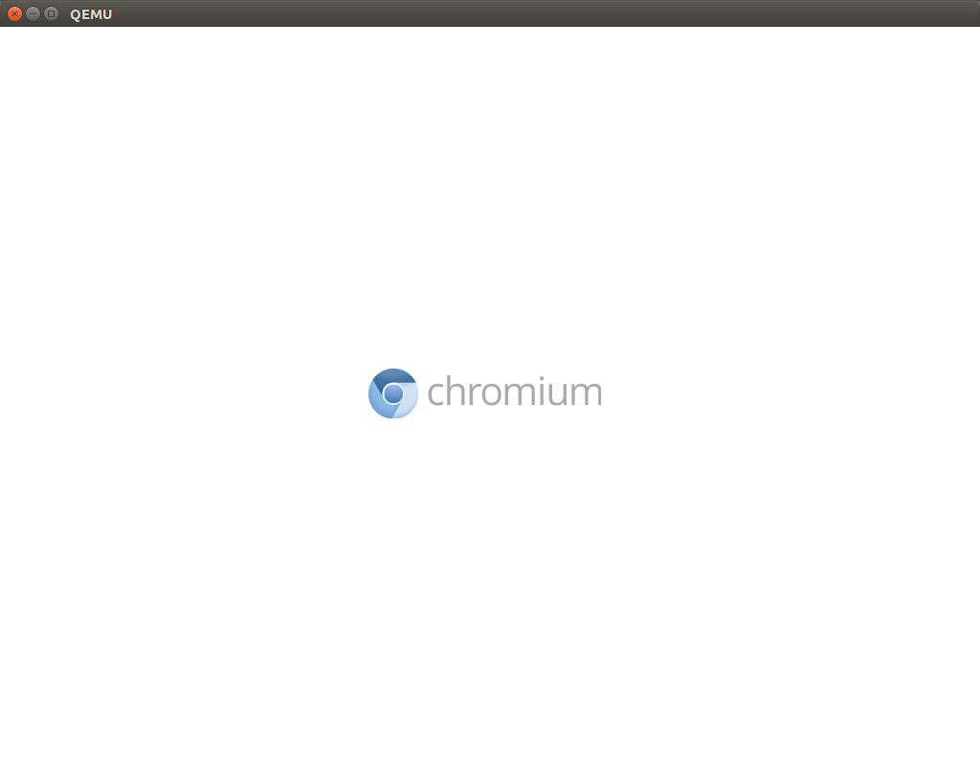
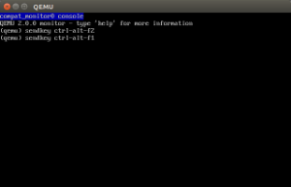
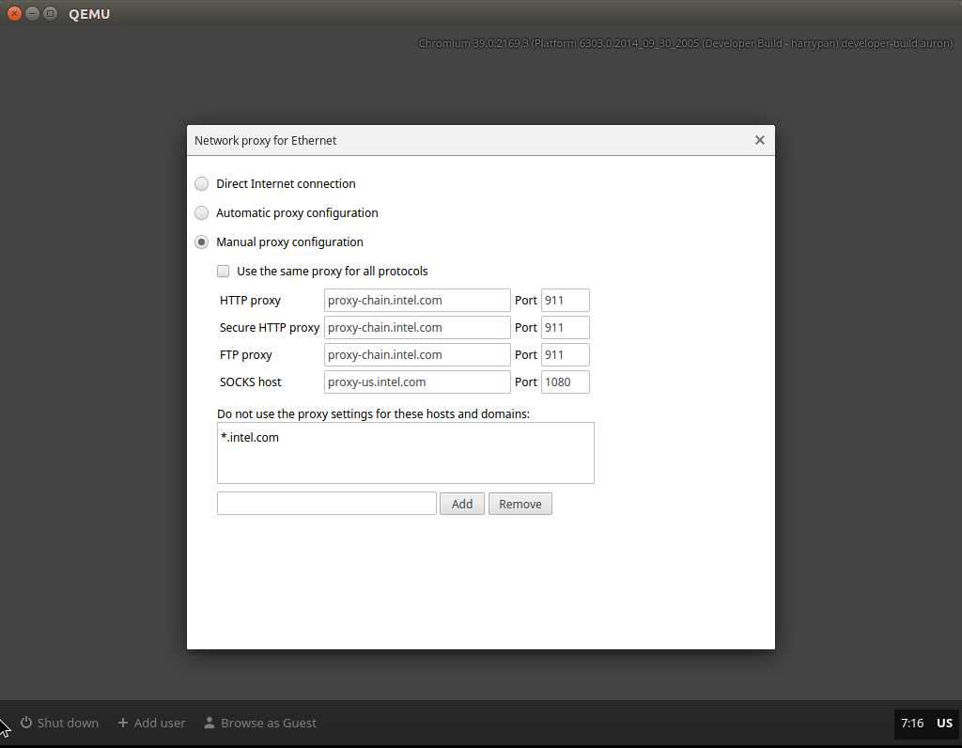
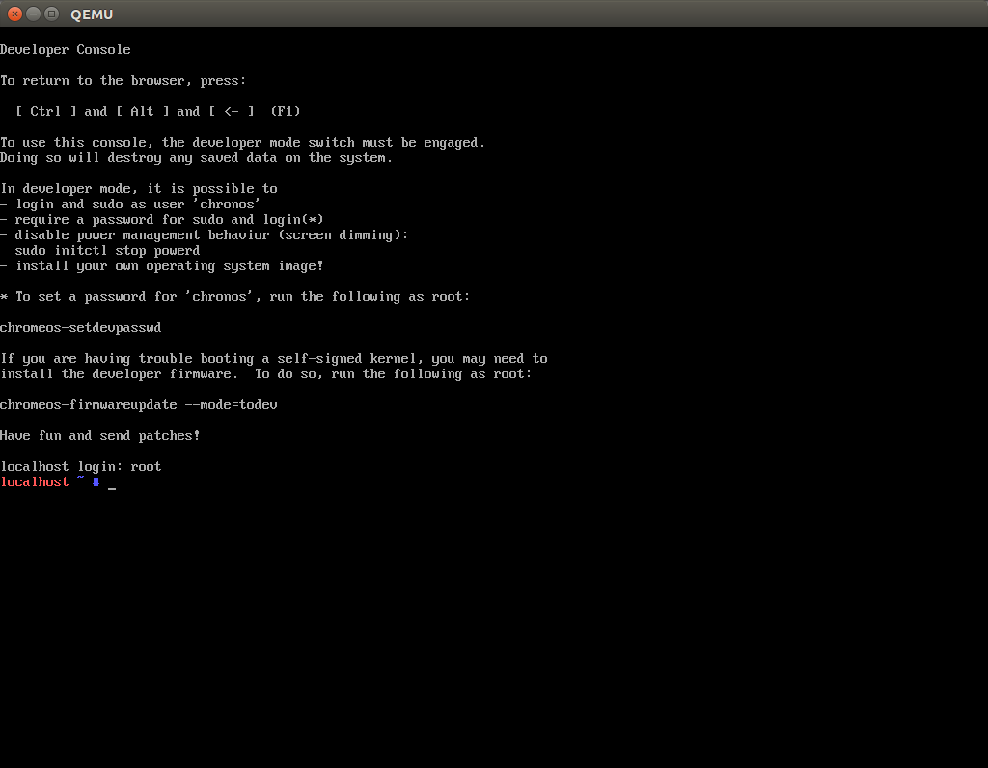
How to add private overlay for specific platform (2/2)
Test your images on QEMU (optional)
Assume you have QEMU at system-wide ($ sudo apt-get install qemu-kvm), and remember to turn on visualization in BIOS
Build image for QEMU (inside chroot)
(cr) $ ./image_to_vm.sh --from=../build/images/your_platform_name/latest --board=${BOARD}
Launch QEMU with image (outside chroot)
$ sudo kvm -m 2048 -hda src/build/images/auron/latest/chromiumos_qemu_image.bin -net nic,model=e1000 -net user
(cr) $ sudo qemu-system-x86_64 -enable-kvm -m 1024 -cpu Broadwell -net nic,model=e1000 -net user -hda /mnt/host/source/src/build/images/fox_wtm2/latest/chromiumos_qemu_image.bin
Note: Unlike system-wised QEMU, the one in cros_sdk uses VNC server, hence you need to get a VNC viewer, you could use VNC Viewer app

Slide 11
Establish Private Overlay
假设在 /usr/local 目录中创建自己的 Overlay，约定俗成的方式是： mkdir –p /usr/local/portage
需要将 Overlay 路径告知 Portage 管理系统，即在 /etc/make.conf 文件中添加以下代码： PORTDIR_OVERLAY = “/usr/local/portage”
为了让我们的 Overlay 能够被 Portage 管理系统所接受，需要在 /usr/local/portage 中创建 metadata 子目录，并在该目录内添加内容为 masters = gentoo 的 layout.conf 文件[1]，即：
mkdir /usr/local/portage/metadata
echo “masters = gentoo” > /usr/local/portage/metadata/layout.conf
最后，还需要在 `/usr/local/portage 中创建 profiles 子目录，并在该目录内添加 repo_name 文件。我们可以在这份文件中设置 Overlay 名称，只需将 Overlay 名称写入该文件即可。例如，我将我的 Overlay 命名为 garfileo：
echo “garfileo” > /usr/local/portage/profiles/repo_name
Notes:
A primary overlay contains:
* profiles/repo_name: Unique name
* profiles/base/make.defaults: Specifies "USE=xxx", i.e. USE="${USE} vulkan"
* make.conf: Defines build info
* toolchain.conf: Defines the toolchain
* There maybe also metadata/layout.conf: Defines the masters list for repositories which allows for disambiguation.

Slide 12
Ebuild Syntax Used in Overlays
Variables
Column1 | Column2
EAPI | A version defined in ebuilds and other package manager related files which inform the package manager about the file syntax and content. It is, in effect, the version of the package manager specification (PMS) that the file adheres to.
S | The source directory for your package; commonly ${WORKDIR}/${P}. Portage will default to this value so you may not have to set it!
SLOT | Portage handles different versions of the same installed programs. If you would want, say GCC 2.95 and GCC 3.2 installed at the same time, you would specify the SLOT in each ebuild. Here we would set the SLOT of GCC 2.95 to 2 while we would set the SLOT of GCC 3.2 to 3. Note: Using 0 as the SLOT value signifies that this package only has 1 SLOT setting (in other words, this package is not SLOTable).
LICENSE | This variable specifies what license the program is covered under, i.e. GPL-2, BSD, etc... This field must be set to a valid license (which is any license found in /usr/portage/license/). If the license does not already exist there, it must be added before the ebuild can be added to the portage tree. If the license does not allow redistribution, make sure you placeRESTRICT="nomirror"intheebuild.
KEYWORDS | This variable now supports a couple of different functions. First of all, this variable specifies what architecture the ebuild is meant for. Some example keywords include: x86, ppc, sparc, mips, alpha, arm, hppa, amd64 and ia64. See the profiles/arch.list file in the Portage tree for more details. Obviously, you would set this to reflect the architecture of the target machine. Portage will not allow an x86 machine to build anything but x86, as specified by the KEYWORDS variable. Packages that do not support the native architecture are automatically masked by Portage. If the KEYWORDS flag has a preceding ~, then that indicates that the particular ebuild works, but needs to be tested in several environments before being moved to the stable profile with the given keyword. If the KEYWORDS flag has a preceding -,thenthepackagedoesnotworkwiththegivenkeyword.IfthereisnothingleadingKEYWORDS,thenthepackageisconsideredstable.YoucanallowinstallationofthesedifferenttypesofpackagesthroughtheACCEPT_KEYWORDSvariableinmake.conf.
DESCRIPTION | A short, one line description of your package.
IUSE | This is set to whatever USE variables your package utilizes. Remember that KEYWORDS should not be listed in here!
DEPEND | The package's build dependencies are listed here. See the section Package Dependencies for more details on proper syntax.
RDEPEND | The package's runtime dependencies are listed here. Once again, see Package Dependencies for more details.
Column1 | Column2
src_install | Use this function to install the package to an image in D. If your package uses automake, you can do this simply with emakeDESTDIR="${D}"install.MakesureyourpackageinstallsallitsfilesusingDastheroot!TheinitialworkingdirectoryisS.

Slide 13
Hello World! for EBuild
假设在 app-misc 这个分类中有一个名为 hello-world 的软件包，现在我们要为这个软件包的 1.0 版的安装写一份 ebuild 文件。 注意：软件包的分类名并不是随意的，它必须要与 /usr/portage 中的某个子目录名一致。
首先在 Overlay 中建立软件包所在的分支：mkdir –p /usr/local/portage/app-misc/hello-world
可从 /usr/portage/header.txt 文件中获得 ebuild 文件默认的文件头，即：
# Copyright 1999-2014 Gentoo Foundation
# Distributed under the terms of the GNU ......
可以直接将 /usr/portage/header.txt 文件复制为 hello-world-1.0.ebuild 文件，这样便可获得一个含有上述内容的空 ebuild 文件。ebuild 文件的名称必须符合 Portage 所认可的格式，即：软件包名称-版本号.ebuild。这一点很重要。
cp /usr/portage/header.txt /usr/local/portage/app-misc/hello-world/hello-world-1.0.ebuild
为这份ebuild文件增加以下内容: SLOT=“0”
接下来就是在这份文件上签名:
cd /usr/local/portage/app-misc/hello-world
ebuild ./hello-world-1.0.ebuild manifest // Manifest will be generated
继续向这份ebuild加入一些内容，
EAPI=“5” // Portage系统已经为我们编写了许多有用的bash函数，设为5表示目前最新的bash函数。
SLOT=“0” // 这个软件包的简述
DESCRIPTION=“A classical example …” // 项目主页
HOMEPAGE=http://wiki.Gentoo.org/index.html // 项目主页
LICENSE=“MIT” // LGPL, MIT, GPL V2 …
KEYWORDS=“~alpha ~amd ~arm ~hppa ~ia64 ~ppc ~ppc64 ~s390 ~x86”
一旦改动ebuild文件内容，那么必须重新生产Manifest文件: ebuild ./hello-world-1.0.ebuild manifest
使用emerge命令安装这个目前依然是子虚乌有的软件包: emerge –avt hello-world
Notes:
Reference: https://segmentfault.com/a/1190000003819421
EAPI：Portage 系统已经为我们编写了许多有用的 Bash 函数，将 EAPI 的值设为 5 表示我们要用目前最新的 Bash 函数。这个变量必须要在 ebuild 文件头之后进行设定。
DESCRIPTION：这个变量存储了 hello-world 这个软件包的简介信息。
HOMEPAGE：定义了 hello-world 这个软件包的项目主页。
LICENSE：定义了 hello-world 这个软件包所使用的许可证，例如 LGPL，GPL V2，GPL V3，MIT 等。
KEYWORDS：如果你期望 hello-world 这个软件包能够安装在你的机器上，那么 KEYWORDS 变量的值必须要包含你在 /etc/make.conf 中所设定的 ACCEPT_KEYWORDS 值。

Slide 14
Real “Hello World” Example
需要在hello-world-1.0.ebuild文件中添加: SRC_URI=http://xxxx/hello-world-1.0.tar.gz
重新生成Manifest是，ebuild.sh会自动下载源码到/usr/portage/distfiles中，并为这个源码也生成一个数字签名存储在Manifest文件中。
假设hello-world-1.0.tar.gz中只有一份bash脚本hello-world，那么没有编译需要，直接copy即可：
src_install() {
dobin hello-world
}
src_install是ebuild.sh能够识别并执行的函数名。该操作把hello-world拷贝到/usr/bin.
约定的内定义函数是以下面的次序执行的:

Slide 15
depot_tools
Chromium uses a package of scripts, the depot_tools, to manage interaction with the Chromium source code repository and the Chromium development process. It contains the following utilities:
gclient: Meta-checkout tool managing both subversion and git checkouts. It is similar to repo tool except that it works on Linux, OS X, and Windows and supports both svn and git. On the other hand, gclient doesn't integrate any code review functionality.
gcl: Rietveld code review tool for subversion. The gcl tool runs presubmit scripts.
git-cl: Rietveld code review tool for git. The git-cl tool runs presubmit scripts.
hammer: (Obsolete) Wrapper script for building Chromium with the SCons software construction tool.
svn [Windows only]: subversion client for Chromium development. (Executable Subversion binaries are included in the depot_tools on Windows systems as a convenience, so that working with Chromium source code does not require a separate Subversion download.)
drover: Quickly revert svn commits.
cpplint.py: Checks for C++ style compliance.
presubmit_support.py: Runs PRESUBMIT.py presubmit checks.
repo: The repo tool.
trychange.py: Try server tool. It is wrapped by gcl try and git-try.
git-try: Try change tool for git users
wtf: Displays the active git branches in a chromium os checkout.
weekly: Displays the log of checkins for a particular developer since a particular date for git checkouts.
git-gs: Wrapper for git grep with relevant source types.
zsh-goodies: Completion for zsh users.
Notes:
http://dev.chromium.org/developers/how-tos/depottools

Slide 16
GYP, GN and Ninja (1/2)
Chromium的编译过程中用到了GYP，GN和Ninja这三个构建工具，GYP是一个在不同平台构建项目的工具，GN是GYP的升级版，Ninja是一个小型追求速度的构建系统。
GYP (Generate Your Projects): 目的是为了支持更大的项目编译在不同的平台，比如Mac，Windows，Linux，它可以生成Xcode工程，Visual Studio工程，Ninja编译文件和Mackefiles。
GYP结构: GYP的输入是.gyp和.gypi文件，.gypi文件是用于.gyp文件include使用的。.gyp文件就是符合特定格式的json文件。
GN (Generate Ninja): 是Chromium Project用来取代GYP的新工具，由于GN是用C++编写，比起用 python写的GYP快了很多，GN新的DSL的语法也被认为是比较好写以及维护的。
GN的使用: 在source project的根目录新增一个建立BUILD.gn，.gn所在的目录会被GN工具认定是project的source root，.gn的基本内容就是用buildconfig来指定build config的位置，其中//build/BUILDCONFIG.gn用来指定相对于source root的路径。
buildconfig = "//build/BUILDCONFIG.gn"
executable("hello") {
sources = [
"main.cpp",
]
}
建立build/BUILDCONFIG.gn. 根据前面的设定，需要在build/下再新增一个BUILDCONFIG.gn，
set_default_toolchain("//build/toolchains:gcc")
cflags_cc = [ "-std=c++11" ]
建立build/toolchains/BUILD.gn, 因为GN没有内建的toolchain规则，toolchain里的各种tool例如 cc,cxx,link等必须自己指定.
编译: 先用gn gen指定在out/目录里面生成ninja。
gn gen out
ninja -C out
以后所有修改gn设定的话，也不用重新执行gn，ninja会自动更新设置.
GYP Example:
{
'targets': [
{
'target_name': 'foo',
'type': 'executable',
'sources': [
'independent.cc',
'specific_win.cc',
],
},
],
},
Notes:
Reference:
http://www.alonemonkey.com/2016/06/15/gn-gyp-ninja/

Slide 17
GYP, GN and Ninja (2/2)
Ninja是一个追求速度的构建系统，相比别的构建系统，Ninja的特点是快和简洁，仅保留最少的特性来提高编译速度。Ninja使用build.ninja文件来定义构建规则，和Makefile里的元编程不同，build.ninja几乎是完全静态的，动态生成依赖其他工具，如gyp或者CMake。
build.ninja
build.ninja相当于ninja的makefile，一个简单的build.ninja文件如下，分为rule和dependency两部分。
ninja命令的使用如下：
Compile: ninja
Help: ninja -h
# Example build.ninja
cc=gcc
cflags= -g -c
rule cc
command = $cc $cflags $in -o $out
rule link
command = $cc $in -o $out
rule cleanup
command = rm -rf *.exe *.o
#part dependency
build func.o : cc func.c
build main.o : cc main.c
build app.exe : link main.o func.o
build all: phony || app.exe
build clean: cleanup
Notes:
Reference:
http://www.alonemonkey.com/2016/06/15/gn-gyp-ninja/

Slide 18
cros_workon
cros_workon is a bash script that is used to select which portage packages you intent to work on.
The “cros_workon start” command will:
Use the -9999 ebuild for a package;
Build from local sources.
The “cros_workon stop” command will:
Revert to the latest stable ebuild;
Use prebuilt binaries when possible.
“cros_workon info, list and list-all” commands are useful.
When using cros_workon, two new commands are used instead:
repo: Usually run outside the chroot.
It's used to check out and sync your repositories and manage the tracking branches for git.
src/scrips/cros_workon: Always run inside the chroot.
It's used to unmask a package ebuild so that
1) repo will be prepared to sync a local copy of the source, and
2) build_packages will use the local source instead of the stable version.
Notes:
Reference: https://www.chromium.org/chromium-os/developer-guide/developer-workflow
Ex.
cros_workon --board=${BOARD} --all list
Will list all packages that comply to the standards as following:
The ebuild for the package lives in the src/third_party/chromiumos-overlay or src/overlays/overlay-${BOARD} directories.
There is an ebuild for the package that ends with 9999.ebuild.
The ebuild inherits from the cros-workon class.
The ebuild has a KEYWORDS in the ebuild containing this architecture name (like "x86").

Slide 19
What is a cros_workon package, and non cros_workon packages?
cros_workon package
If an ebuild inherits cros_workon it is a cros_workon package.
If you need to modify a cros_workon ebuild you must modify the -9999 version of the ebuild.
When the change is submitted the builders will automatically up-rev the current stable ebuild and replace it with the contents of the -9999 ebuild.
Non cros_workon packages
The package's ebuild file DOES NOT contain “inherit cros_workon” statement
If so, “cros_workon” commands DO NOT work on this package.
If you need to change an ebuild for a non cros_workon package then when submitting the change you will need to manually up-rev the ebuild.
For example, git mv arbitrary-0.0.1-r3 arbitrary-0.0.1-r4
Pre-built
The locations of the pre-builts is kept in : chromeos-partner-overlay/chromeos/binhost/target
Notes:
cros_workon --board=${BOARD} start ${PACKAGE_NAME}
This command:
Indicates that you'd like to build the 9999 version of the ebuild instead of the stable, committed version.
Indicates that you'd like to build from source every time.
If you specified that you wanted the minilayout when you did your repo init, this command adds a clause to your .repo/local_manifest.xml to tell repo to sync down the source code for this package next time you do a repo sync.
After running cros_workon, sync down the sources via “repo sync” command executed from the outside of chroot, i.e. the ToT.
cros_workon --board=${BOARD} --all info | grep platform/ec
This command is to find out which ebuilds use for this source code from a specific directory, the command output are: chromeos-base/ec-utils chromiumos/platform/ec src/platform/ec
The name of the ebuild is chromeos-base/ec-utils
The path to the git repository on the server is chromiumos/platform/ec
The path to the source code on your system is src/platform/ec
equery-${BOARD} which ${PACKAGE_NAME}
This command finds out which ebuild file used for this specified package. Ex. platform/ec.

Slide 20
Build Chromium OS
mkdir -p ~/workspace/chromiumos; cd ~/workspace/chromiumos
$repo init -u http://git.chromium.org/git/manifest -m minilayout.xml
$repo sync
$cd src/scripts
$./make_chroot
To simplify dependencies, development is done inside a chroot. chroot 處於 ${HOME}/chromiumos/chroot。其中可以找到像 /usr/bin 和 /etc 這樣的系統目錄。這些對 chroot 是本地目錄，與您機器上的系統目錄相獨立。
$./enter_chroot.sh
To enter the chroot in order to do development.
Or ./enter_chroot.sh --chrome_root=$(PATH/TO/CHROMIUM-BROWSER/SRC)
Or cros_sdk [--enter] # If existed chroot image file, it will mount chroot image, and enter it. 進入 chroot 時，會在 chroot 中裝載“~/trunk”目錄，它指向的就是 Chromium OS 主目錄 ${HOME}/chromiumos。
(cr)$ ./setup_board --board=x86-generic –default --job 4 [--accept_licenses=Google-TOS]
Run setup_board in order to install the toolchain (gcc/glibc) for the target you wish to work on. setup_board also creates the initial SYSROOT the target, 這將使用 /build/${BOARD} 的默認 sysroot 配置目標 board。
(cr)$./enable_localaccount.sh USERNAME
The local user account allows login with no password even if you can not connect to the Internet.
(cr)$./set_shared_user_password.sh
Need to set up the password for the shared "chronos" user, default password: test0000. The encrypted password will be stored in ./shared_user_password.txt.
(cr)$ ./build_packages --board="x86-generic" --jobs=4
By default, build_packages will build the stable version of a package (i.e. from committed git sources) unless you are working on a package. If you are working on a package, build_packages will build using your local sources.
(cr)$ ./build_image --noenable_rootfs_verification
Or : USE='chrome_media' ./build_packages --board=amd64-generic --withautotest && USE='chrome_media' ./build_image --board=amd64-generic --boot_args "sched_debug ignore_loglevel debug verbose i915.preliminary_hw_support=1 console=ttyS2,115200n8" --noenable_rootfs_verification base dev test
Notes:
Reference: http://l.lidian.info/zh-hant/Chromium_OS/developer_guide
首次執行 build_packages 將下載約 1.7GB 的源碼包與 1.3GB 的二進制程序包。更多關於 build_packages 到底做了什麼的信息請參看這裡。總之它會嘗試下載現有程序包來避免進行編譯（並將它們放在 /build/${BOARD}/packages 以備後續使用）。如果沒有程序包可下載，則會下載源碼包(並將它們放在 /var/lib/portage/distfiles-target）並編譯它們。
通常，build_packages 將編譯穩定版的軟件包（如根據已 commit 的 git 源），除非您在開發軟件包（帶 cros_workon）。 如果您在開發軟件包，build_packages 將使用您本地的源碼進行編譯。 關於cros_workon 的信息請參見下文。
邊注：--oldchromebinary 標記不是必需的，但在某些罕見的情況下（當 Chrome/Chromium 瀏覽器近期有修訂時）可以讓您的編譯更快，但代價是 Chrome/Chromium 的版本稍舊。 這在將來可能會成為默認選項。
邊注：即使有一些標記可優化編譯（如 --nowithdev、--nowithautotest 等），您也不應當使用它們（即使您不打算編譯開發/測試映像）。如果您使用了這些選項，還有些虛擬軟件包問題可能會導致一些難以調試的差異。
build_packages 步驟完成之後，您就可以通過在 ~/trunk/src/scripts 目錄中執行該命令創建映像文件了：
./build_image --board=${BOARD} --withdev --noenable_rootfs_verification
這將創建帶有可讓您自由修改 root 文件系統的開發工具的映像。 生成的映像不是安全的 Chromium OS 版本，但可以給您相對自由的訪問。 如果您想要更安全、加鎖版的 Chromium OS，可以去掉 --withdev 與 --noenable_rootfs_verification 選項。
build_image 所生成的映像位於 ~/trunk/src/build/images/${BOARD}/versionNum/（其中 versionNum 代表實際的版本號）。 為給定 board 生成的最新映像將被創建成符號鏈接 ~/trunk/src/build/images/${BOARD}/latest。

Slide 21
Examples of Use Cases
Flash bootable and installation Chromium OS Built Image
$./image_to_usb.sh --from=../build/images/x86/Version.BuiltDate&Time --to=/dev/USB-Node
Or cros flash usb:// ../build/images/reef/latest
“USB-Node” should be like “/dev/sdc” other than “/dev/sdc1”
Start working on specific package
$./cros_workon --board=${BOARD} start ${PACKAGE_NAME} : This marks the ebuild for the given package so that build_packages will use your local changes instead of the stable, committed version.
$ ./cros_workon --board=${BOARD} --all list : Check all the available packages; Special case : chromiumos-overlay is not in this list and cros_workon start/stop is not used.
Stop working on specific package
$ ./cros_workon --board=${BOARD} stop ${PACKAGE_NAME} : This tells the buildsystem to use stable pre-built version of the package. build_packages will now ignore your local repository. Stopping doesn't delete your local copy.
Autotest
$ ./cros_workon start autotest autotest-tests
$ repo sync
Tests consist of a build phase and run phase, where the first is executed by the ebuild, and the second by the run_remote_tests.sh" script. tests have to be built with emerge-${board} before they can be ran using run_remote_tests.sh.
Currently, tests are organized within these ebuilds : chromeos-base/autotest-tests
To see which tests are implemented by an ebuild, run the usual pretended emerge:
$ emerge-${board} -pv autotest-tests
All tests have a default state, either enabled (+) or disabled (-). The TESTS= variable is a USE_EXPAND.
There are two ways to use these.
(1) Non-Incremental --- Simply override the list by a new list
TESTS="platform_MiniJailPidNamespace platform_MiniJailPtraceDisabled" emerge-${board} -pv autotest-tests
(2) Incremental --- All USE_EXPAND flags are also accessible as USE flags, with the appropriate prefix, and can be used incrementally with +, -
USE="tests_platform_MiniJailPidNamespace tests_platform_MiniJailPtraceDisabled" emerge-${board} -pv autotest-tests
Notes:
https://www.chromium.org/chromium-os/developer-guide/developer-workflow
https://sites.google.com/a/chromium.org/dev/chromium-os/chromiumos-design-docs

Slide 22
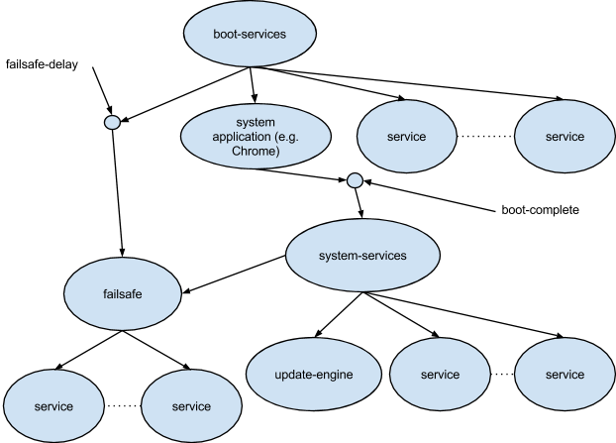
Chrome OS User-Land Boot Design
The design of user-land boot processes for Chrome OS based systems covers what happens after /sbin/init first starts execution, until all services in the system are ready.
Chrome OS Core uses Upstart for its /sbin/init package.
Chrome OS Boot divides into three sequential phases with four publicly defined Upstart events:
Upstart Event(s) | Phase | Description
startup | Basic Services | Initialization of basic services needed by the rest of the system.
started boot-services | System Application | Initialization of the system application and other services critical to the product’s UX
started system-services started failsafe | System Services | Initialization of all other services. The failsafe job is guaranteed to start even if the system application fails.

Slide 23
Sysv/UpStart/Systemd的区分
Linux系统目前存在的三种系统启动方式所对应的配置文件目录分别为：
SysVinit：/etc/init.d目录；
UpStart： /usr/share/upstart目录；
Systemd：/usr/lib/systemd目录；
根据init进程号1所对应的可执行文件来判断系统的启动方式
stat /proc/1/exe

Slide 24
Sysvinit
Sysvinit 用术语 runlevel 来定义"预订的运行模式"。Sysvinit 检查 '/etc/inittab' 文件中是否含有 'initdefault' 项。 这告诉 init 系统是否有一个默认运行模式。如果没有默认的运行模式，那么用户将进入系统控制台，手动决定进入何种运行模式。
sysvinit 需要读取/etc/inittab 文件。分析这个文件的内容，它获得以下一些配置信息：
系统需要进入的 runlevel
捕获组合键的定义
定义电源 fail/restore 脚本
启动 getty 和虚拟控制台
得到配置信息后，sysvinit 顺序地执行以下这些步骤，从而将系统初始化为预订的 runlevel X。
/etc/rc.d/rc.sysinit
/etc/rc.d/rc 和/etc/rc.d/rcX.d/ (X 代表运行级别 0-6)
/etc/rc.d/rc.local
X Display Manager（如果需要的话）
rc.sysinit 主要完成以下这些工作。
激活 udev 和 selinux
设置定义在/etc/sysctl.conf 中的内核参数
设置系统时钟
加载 keymaps
使能交换分区
设置主机名(hostname)
根分区检查和 remount
激活 RAID 和 LVM 设备
开启磁盘配额
检查并挂载所有文件系统
清除过期的 locks 和 PID 文件
rc.local 是 Linux 留给用户进行个性化设置的地方。

Slide 25
Sysvinit 的管理和控制功能
halt: 停止系统。
init: 这个就是 sysvinit 本身的 init 进程实体，以 pid1 身份运行，是所有用户进程的父进程。最主要的作用是在启动过程中使用/etc/inittab 文件创建进程。
killall5: 就是 SystemV 的 killall 命令。向除自己的会话(session)进程之外的其它进程发出信号，所以不能杀死当前使用的 shell。
last: 回溯/var/log/wtmp 文件(或者-f 选项指定的文件)，显示自从这个文件建立以来，所有用户的登录情况。
lastb: 作用和 last 差不多，默认情况下使用/var/log/btmp 文件，显示所有失败登录企图。
mesg: 控制其它用户对用户终端的访问。
pidof: 找出程序的进程识别号(pid)，输出到标准输出设备。
poweroff: 等于 shutdown -h –p，或者 telinit 0。关闭系统并切断电源。
reboot: 等于 shutdown –r 或者 telinit 6。重启系统。
runlevel: 读取系统的登录记录文件(一般是/var/run/utmp)把以前和当前的系统运行级输出到标准输出设备。
shutdown: 以一种安全的方式终止系统，所有正在登录的用户都会收到系统将要终止通知，并且不准新的登录。
sulogin: 当系统进入单用户模式时，被 init 调用。当接收到启动加载程序传递的-b 选项时，init 也会调用 sulogin。
telinit: 实际是 init 的一个连接，用来向 init 传送单字符参数和信号。
utmpdump: 以一种用户友好的格式向标准输出设备显示/var/run/utmp 文件的内容。
wall: 向所有有信息权限的登录用户发送消息。

Slide 26
Upstart
UpStart 基于事件驱动模型，UpStart 可以：
更快地启动系统
当新硬件被发现时动态启动服务
硬件被拔除时动态停止服务
这些特点使得 UpStart 可以很好地应用在桌面或者便携式系统中，处理这些系统中的动态硬件插拔特性。。
采用事件驱动机制也带来了一些其它有益的变化，比如加快了系统启动时间。
Upstart 概念和术语
UpStart 主要的概念是 job 和 event。Job 就是一个工作单元，用来完成一件工作，比如启动一个后台服务，或者运行一个配置命令。每个 Job 都等待一个或多个事件，一旦事件发生，upstart 就触发该 job 完成相应的工作。

Slide 27
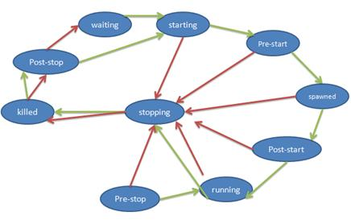
Upstart的Job概念
表 1.Upstart 中 Job 的可能状态
状态名 含义
Waiting 初始状态
Starting Job 即将开始
pre-start 执行 pre-start 段，即任务开始前应该完成的工作
Spawned 准备执行 script 或者 exec 段
post-start 执行 post-start 动作
Running interim state set after post-start section processed denoting job is running (But it may have no associated PID!)
pre-stop 执行 pre-stop 段
Stopping interim state set after pre-stop section processed
Killed 任务即将被停止
post-stop 执行 post-stop 段
Job 就是一个工作的单元，一个任务或者一个服务。可以理解为 sysvinit 中的一个服务脚本。有三种类型的工作：
task job：代表在一定时间内会执行完毕的任务，比如删除一个文件；
service job：代表后台服务进程，比如 apache httpd。这里进程一般不会退出，一旦开始运行就成为一个后台精灵进程，由 init 进程管理，如果这类进程退出，由 init 进程重新启动，它们只能由 init 进程发送信号停止。它们的停止一般也是由于所依赖的停止事件而触发的，不过 upstart 也提供命令行工具，让管理人员手动停止某个服务；
abstract job：仅由 upstart 内部使用，仅对理解 upstart 内部机理有所帮助。
Job 生命周期

Slide 28
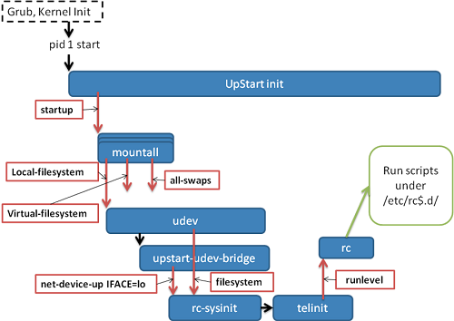
Upstart的Event概念
系统上电后运行 GRUB 载入内核。内核执行硬件初始化和内核自身初始化。在内核初始化的最后，内核将启动 pid 为 1 的 init 进程，即 UpStart 进程。
Upstart 进程在执行了一些自身的初始化工作后，立即发出"startup"事件。上图中用红色方框加红色箭头表示事件，可以在左上方看到"startup"事件。
所有依赖于"startup"事件的工作被触发，其中最重要的是 mountall。mountall 任务负责挂载系统中需要使用的文件系统，完成相应工作后，mountall 任务会发出以下事件：local-filesystem，virtual-filesystem，all-swaps，
其中 virtual-filesystem 事件触发 udev 任务开始工作。任务 udev 触发 upstart-udev-bridge 的工作。Upstart-udev-bridge 会发出 net-device-up IFACE=lo 事件，表示本地回环 IP 网络已经准备就绪。同时，任务 mountall 继续执行，最终会发出 filesystem 事件。
事件在 upstart 中以通知消息的形式具体存在。一旦某个事件发生了，Upstart 就向整个系统发送一个消息。
Event 可以分为三类: signal，methods 或者 hooks。
Signals: 事件是非阻塞的，异步的。发送一个信号之后控制权立即返回。
Methods: 事件是阻塞的，同步的。
Hooks: 事件是阻塞的，同步的。它介于 Signals 和 Methods 之间，调用发出 Hooks 事件的进程必须等待事件完成才可以得到控制权，但不检查事件是否成功。
Job 和 Event 的相互协作
系统初始化时，init 进程开始运行，init 进程自身会发出不同的事件，这些最初的事件会触发一些Job运行。每个Job运行过程中会释放不同的事件，这些事件又将触发新的Job运行。如此反复，直到整个系统正常运行起来。
Job配置文件: 工作配置文件存放在/etc/init 下面，是以.conf 作为文件后缀的文件。
UpStart 还可以用于管理用户会话的初始化。
Notes:
Upstart Reference: https://www.ibm.com/developerworks/cn/linux/1407_liuming_init2/index.html

Slide 29
Systemd
Systemd 提供了比 UpStart 更激进的并行启动能力，采用了 socket / D-Bus activation 等技术启动服务。
Systemd 采用 Linux 的 Cgroup 特性跟踪和管理进程的生命周期
Systemd 的基本概念
Notes:
Systemd Reference: https://www.ibm.com/developerworks/cn/linux/1407_liuming_init3/index.html

Slide 30
Chrome Web Apps
Apps
hosted app
packaged app
Themes
Extensions
Remote Desktop Capabilities - Chromoting
GPU Accelerated Compositing – WebGL
WebGL is a cross-platform, royalty-free API used to create 3D graphics in a Web browser. Based on OpenGL ES 2.0, WebGL uses the OpenGL shading language, GLSL, and offers the familiarity of the standard OpenGL API.
Chromium must be launched from the command line in order to enable WebGL.
Linux : ./chrome --enable-webgl
Mac OS X : ./Chromium.app/Contents/MacOS/Chromium --enable-webgl
Windows : No command line options needed.

Slide 31
Firmware
Functionalities
System recovery
Verified boot
Fast boot

Slide 32
Verified Boot
Notes:
https://www.coreboot.org/images/c/ce/Verified_Boot_-_Surviving_in_the_Internet_of_Insecure_Things.pdf

Slide 33
淺談 Malicious Engine https://v2bv.net/2017/intel-me
什麼是 ME？
Intel ME 是 Intel Management Engine 的簡稱。
Intel ME 是一個擁有從底層控制硬件能力的、獨立與處理器和操作系統的框架，它對於操作系統也是隱形的。簡單點說就是擁有極高的權限。其中 Intel Active Management Technology（英特爾主動管理技術）是運行與 ME 框架上的應用的一個例子。
Intel ME 被搭載在幾乎所有的 2006 年之後上市出售的 intel 平臺上。硬件部分整合在 CPU 或是主板芯片組內；軟件（固件）部分一般與 BIOS 共存在一個 ROM 芯片中（如果把 ROM 的內容提取出來的話，會發現 ME 固件往往比 BIOS 本身以及 GBE 固件加在一起還大）。
在 Linux 平臺上可以使用 intelmetool 來查看 ME 的狀態。
Notes:
Reference :
For ME firmware: https://v2bv.net/2017/intel-me

Slide 34

Open Source Coreboot + FSP MR5 Integration Instructions (1/12)
Git clone the latest coreboot package at https://github.com/coreboot/coreboot.
Download the latest Leaf Hill Binary Image. You will need this to extract the Descriptor Region binary using FIT. The whole image will also be used for extracting the IFWI blobs during the Stitch process: https://firmware.intel.com/projects/minnowboard3.
You will also need the VBT binary image. You can take this from APL_CB_MR4 source package: ./Apollo_Lake_CB_MR4/APOLLOLAKE_CB_MR3_001_28-APR-2017/intel/fsp/mainboard/leafhill/vbt.dat
Download the latest FSP binary from this website: https://github.com/IntelFsp/FSP/tree/ApolloLake, or if you have access to the FSP source repository, then git clone the package and build a Release FSP.
Spilt the FSP.fd into its three core components using the SplitFspBin.py tool: FSP_T, FSP_S, and FSP_M.
Important Note: The FSP_T will not be used on the build. Only the FSP_S and FSP_M are important.

Slide 35
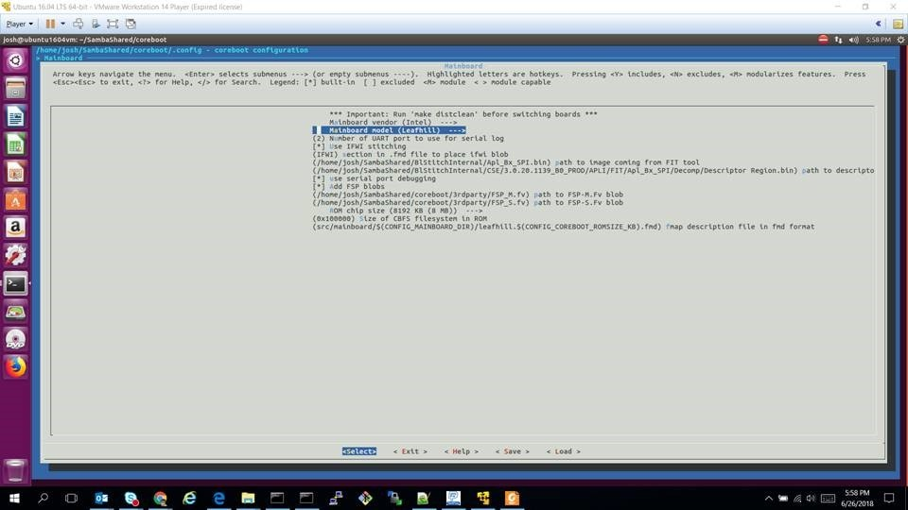
Open Source Coreboot + FSP MR5 Integration Instructions (2/12)
On make menuconfig, select Leafhill (.../src/mainboard/intel/) as the target board.

Slide 36
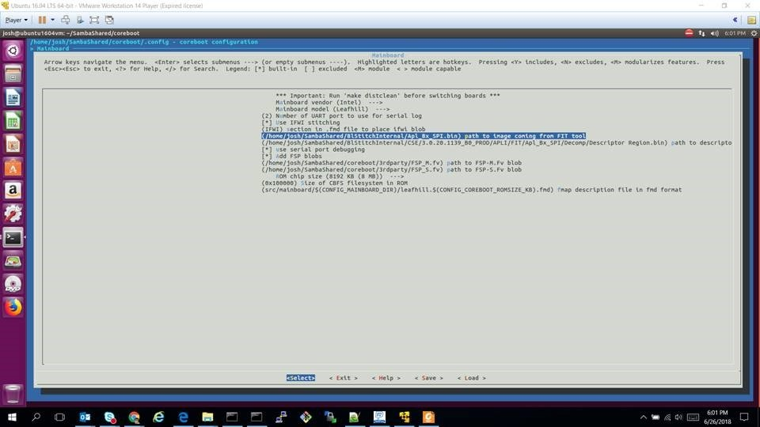
Open Source Coreboot + FSP MR5 Integration Instructions (3/12)
On the IFWI section, place the path of your Descriptor Region binary and Leaf Hill Binary Image

Slide 37
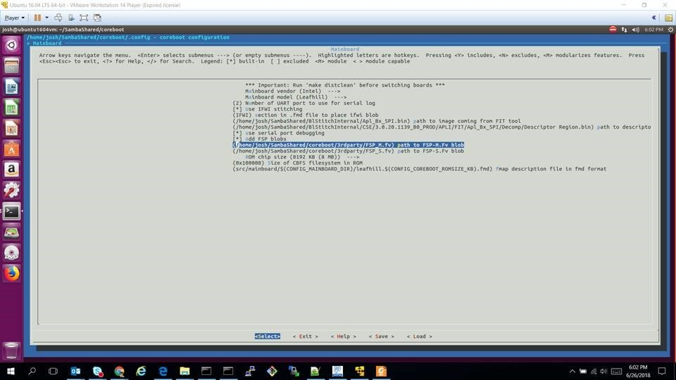
Open Source Coreboot + FSP MR5 Integration Instructions (4/12)
On the FSP blobs, place the path to your FSP_M and FSP_S.

Slide 38
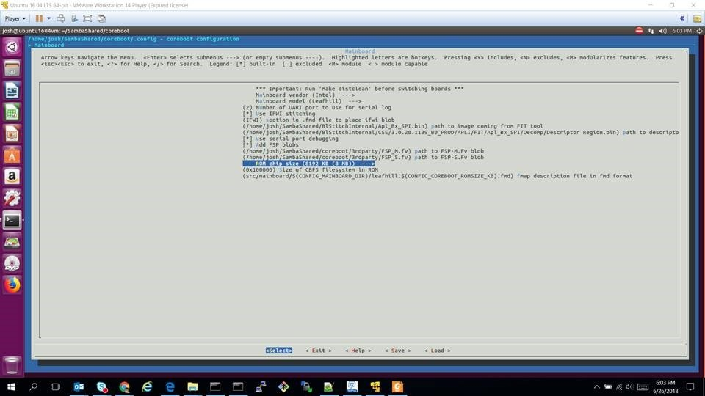
Open Source Coreboot + FSP MR5 Integration Instructions (6/12)
Make sure to select 8MB ROM size.

Slide 39
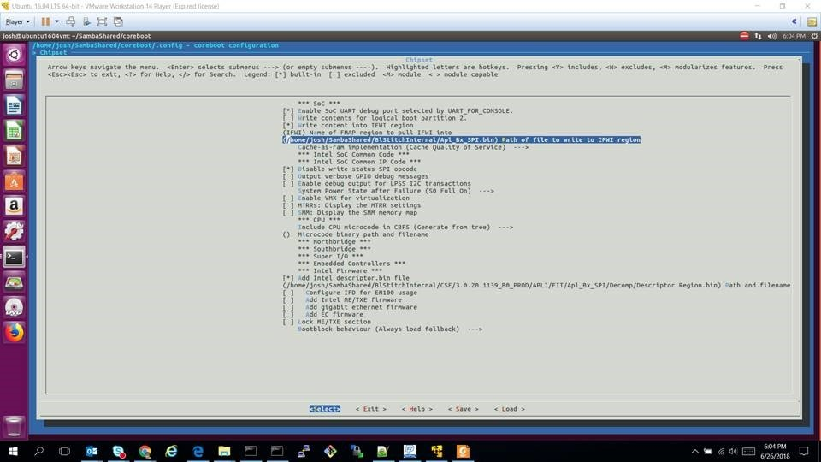
Open Source Coreboot + FSP MR5 Integration Instructions (7/12)
On Chipset configuration, make sure that the IFWI path is the same as the one declared earlier. Make sure that the Cache-as-ram implementation is selected as “Cache Quality of Service”.

Slide 40
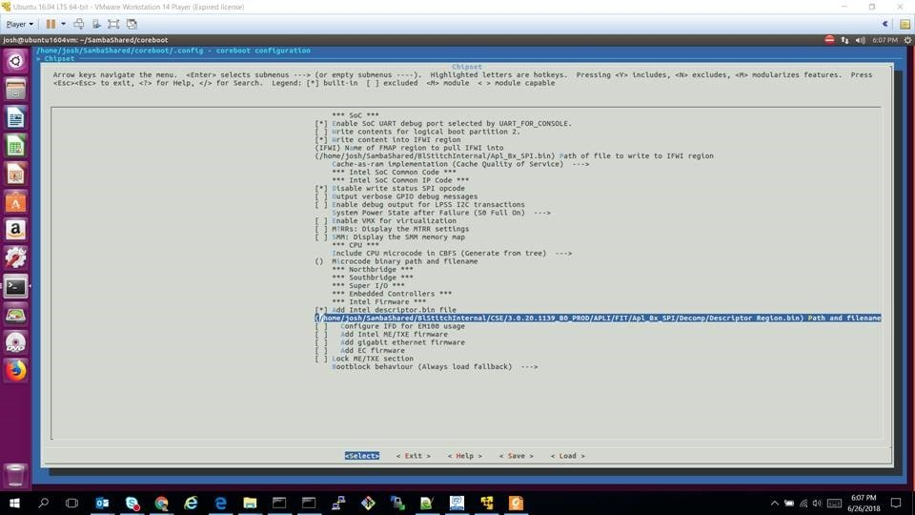
Open Source Coreboot + FSP MR5 Integration Instructions (8/12)
Make sure that the Descriptor binary file is the same as declared earlier

Slide 41
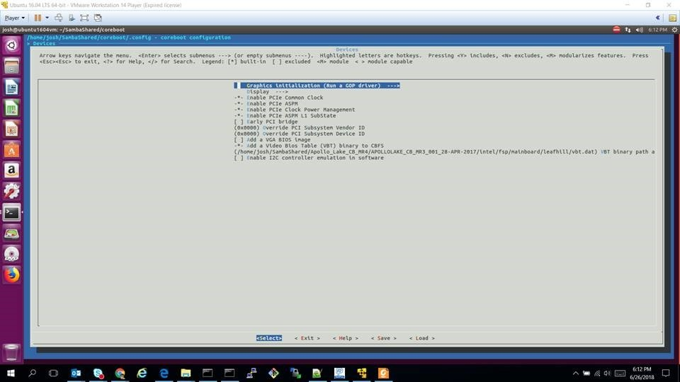
Open Source Coreboot + FSP MR5 Integration Instructions (9/12)
On the Devices configuration, make sure to select “Run a GOP driver” in Graphics initialization.

Slide 42
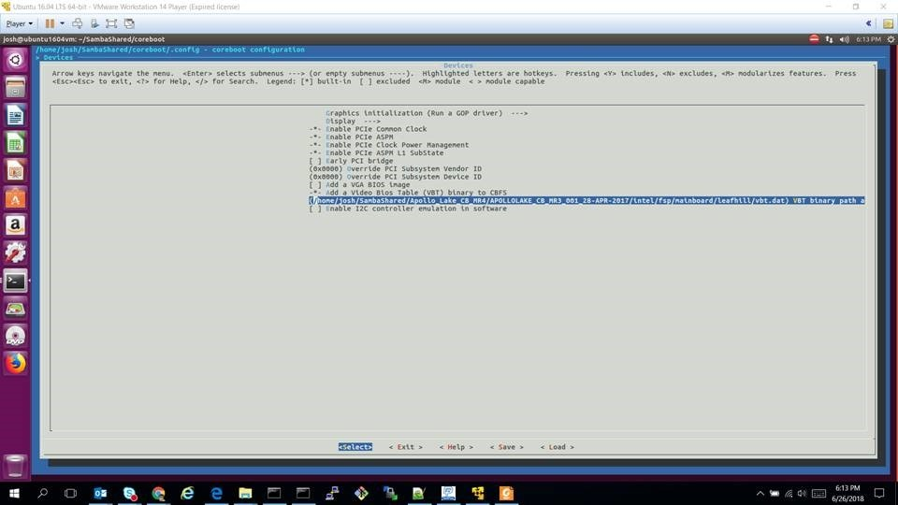
Open Source Coreboot + FSP MR5 Integration Instructions (10/12)
Obtain a VBT binary and place it under “Add a Video Bios Table (VBT) binary to CBFS”. In this example, it was taken from APL_CB_MR4.

Slide 43
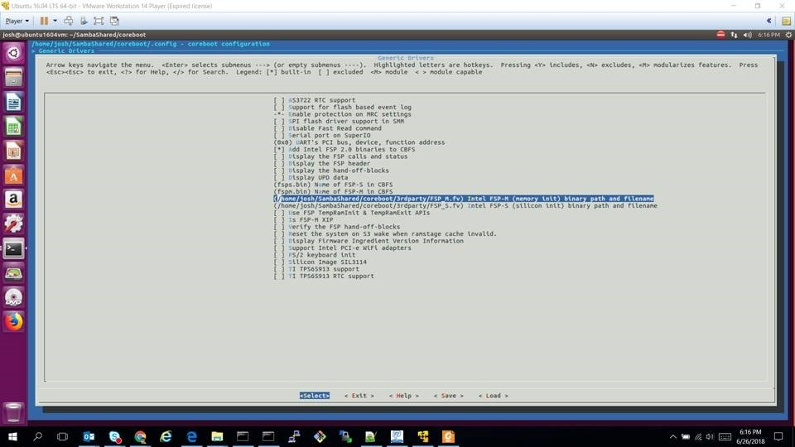
Open Source Coreboot + FSP MR5 Integration Instructions (11/12)
In Generic Drivers configuration, make sure that the paths of FSP_S and FSP_M are correct.

Slide 44
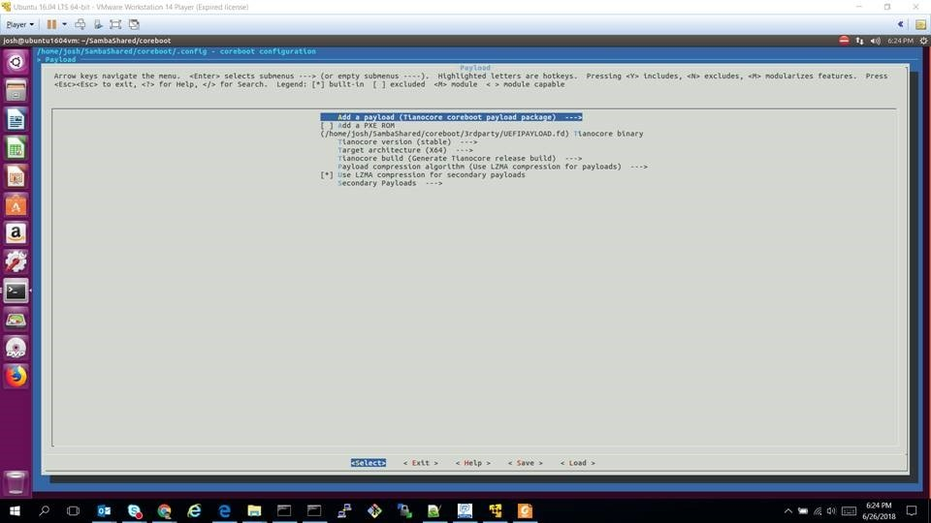
Open Source Coreboot + FSP MR5 Integration Instructions (12/12)
On the Payload configuration, select “Tianocore coreboot payload package” in Add a payload, Build your coreboot image and flash to a Leaf Hill CRB.
Notes:
diff --git
a/src/mainboard/intel/leafhill/brd_gpio.h
b/src/mainboard/intel/leafhill/brd_gpio.h
index 18d130b..ca99f11 100644
---
a/src/mainboard/intel/leafhill/brd_gpio.h
+++
b/src/mainboard/intel/leafhill/brd_gpio.h
@@
-46,4
+46,9
@@ static
const
struct
pad_config
gpio_table[]
= {
PAD_CFG_NF(SMB_CLK,
NATIVE,
DEEP,
NF1),
PAD_CFG_NF(SMB_DATA,
NATIVE,
DEEP,
NF1),
+
+#ifdef
CONFIG_BOARD_INTEL_LEAFHILL
+ ///
Added
feature
to enable
USB power
for USB
devices,
specifically
keyboard
and
mouse.
+ PAD_CFG_GPO_IOSSTATE_IOSTERM(GPIO_23, 1,
DEEP,
DN_20K, TxLASTRxE,
SAME),
///
Feature:
LB USB
Power
in LFH
+#endif
};

Slide 45
In Linux GPIO framework, there are 2 modules for GPIO function. One is pinctrl module that defines the PAD usage per ACPI "INT3452" table's definition, the other is GPIOLIB that provides gpio_xxx kernel layer APIs to other program. In your Apollo Lake platform, the logic is the following:
1. Coreboot phase
File: src/mainboard/google/reef/variants/coral/gpio.c, that is the Pad configuration in ramstage.
PAD_CFG_GPI_APIC_LOW(GPIO_21, NONE, DEEP), /* Touch IRQ */
File: src/mainboard/google/reef/variants/coral/devicetree.cb
register "hid" = ""ELAN0001""
register "desc" = ""ELAN Touchscreen""
register "irq" = "ACPI_IRQ_EDGE_LOW(GPIO_21_IRQ)"
2. Linux pinctrl module phase
static const struct intel_pinctrl_soc_data bxt_north_soc_data = {
.uid = "1",
.pins = bxt_north_pins,
.npins = ARRAY_SIZE(bxt_north_pins),
.groups = bxt_north_groups,
.ngroups = ARRAY_SIZE(bxt_north_groups),
.functions = bxt_north_functions,
.nfunctions = ARRAY_SIZE(bxt_north_functions),
.communities = bxt_north_communities,
.ncommunities = ARRAY_SIZE(bxt_north_communities),
}; /* PINCTRL_PIN(21, "GPIO_21"), is defined */
Define "INT3452" ACPI label that will be probed by ACPI driver, so the PIN configuration will be settled down.
3. GPIOLIB module
Pls reference kernel/Documentation/gpio/board.txt to understand the kernel level GPIO APIs that are very few, and used by other Linux kernel drivers. The export to userspace manipulation interface are :
/sys/class/gpio# echo 44 > export
/sys/class/gpio/gpio44# echo out > direction
/sys/class/gpio/gpio44# cat direction
/sys/class/gpio/gpio44# echo 1 > value
/sys/class/gpio/gpio44# cat value
/sys/class/gpio# echo 44 > unexport

Slide 46
Build Firmware of Coreboot, and EC for Carol
Sync coreboot code
export REPO_HOST_PORT_INFO="chromium.XXXXXXX.com 418"
mkdir ~/workspace/ldev-consolidated_01
cd ~/workspace/ldev-consolidated_01
repo init -u ssh://chromium.XXXXXXX.com/chromiumos/manifest-mirror.git
repo sync
Build coreboot with Intel FSP
cros_sdk --enter
./setup_board --board=carol
cros_workon-carol start coreboot depthcharge libpayload vboot_reference chromeos-bootimage chromeos-mrc
# FSP build
USE="fsp_src" emerge-carol sys-boot/chromeos-mrc
# Coreboot build
emerge-carol coreboot coreboot-private-files-carol depthcharge libpayload vboot_reference chromeos-bootimage
NOTE: There can be build errors if the error is because of the missing file "ec.RW.bin"
sudo touch /build/carol/firmware/ec.RW.bin; sudo touch /build/carol/firmware/ec.RW.bin, and re-run the emerge step.
your output image is /build/carol/firmware/image.*.bin. Flashing the image.bin under /build/carol/firmware directory on to SPI via dediprog.
Build EC Firmware
cros_workon-carol start chromeos-ec
emerge-carol chromeos-ec
Notes:
Skylake FSP to coreboot integration overview: https://www.youtube.com/watch?v=SpL8LbquSVs&t=4s
Port Coreboot to a new board: https://www.youtube.com/watch?v=8wPskpLHFIo&t=17s
Port Coreboot to x86 platform: https://www.youtube.com/watch?v=HKJNJh6JW_Y&t=31s
Depthcharge: The Chromium OS Bootloader: https://www.youtube.com/watch?v=6ZKeDGI75vw&t=369s
Chrome OS Embedded Controller: https://www.youtube.com/watch?v=Ie7LRGgCXC8
Summit:
https://www.chromium.org/chromium-os/2014-firmware-summit

Slide 47
Battery Configuration in EC
In EC source, you can find the battery parameters in board/battery.c
ex: voltage_max/voltage_normal/voltage_min.
Refer board/$BOARD/battery.c to support multiple batteries, but it has to rebuild EC firmware.
EC uses voltage_min in battery_too_low function, so if your new reactive project uses a new battery with lower voltage_min, the parameters MUST BE calibrated.
In <cr>/usr/share/power_manager/board_specific/low_battery_shutdown_percent, powerd uses this parameter to decide when to shutdown.

Slide 48
Debug EC Firmware
Google implements a software sync feature for EC. The idea is that Coreboot keeps a copy of EC RW FW. If Coreboot finds the EC version is different than that it has, Coreboot will overwrite the EC RW partition. You can disable it by setting 0x239 to the gbb flag. Refer to http://www.chromium.org/chromium-os/ec-development#TOC-Preventing-the-RW-EC-firmware-from-being-overwritten-by-Software-Sync-at-boot for more information
$ /usr/share/vboot/bin/set_gbb_flags.sh 0x239
$ reboot

Slide 49
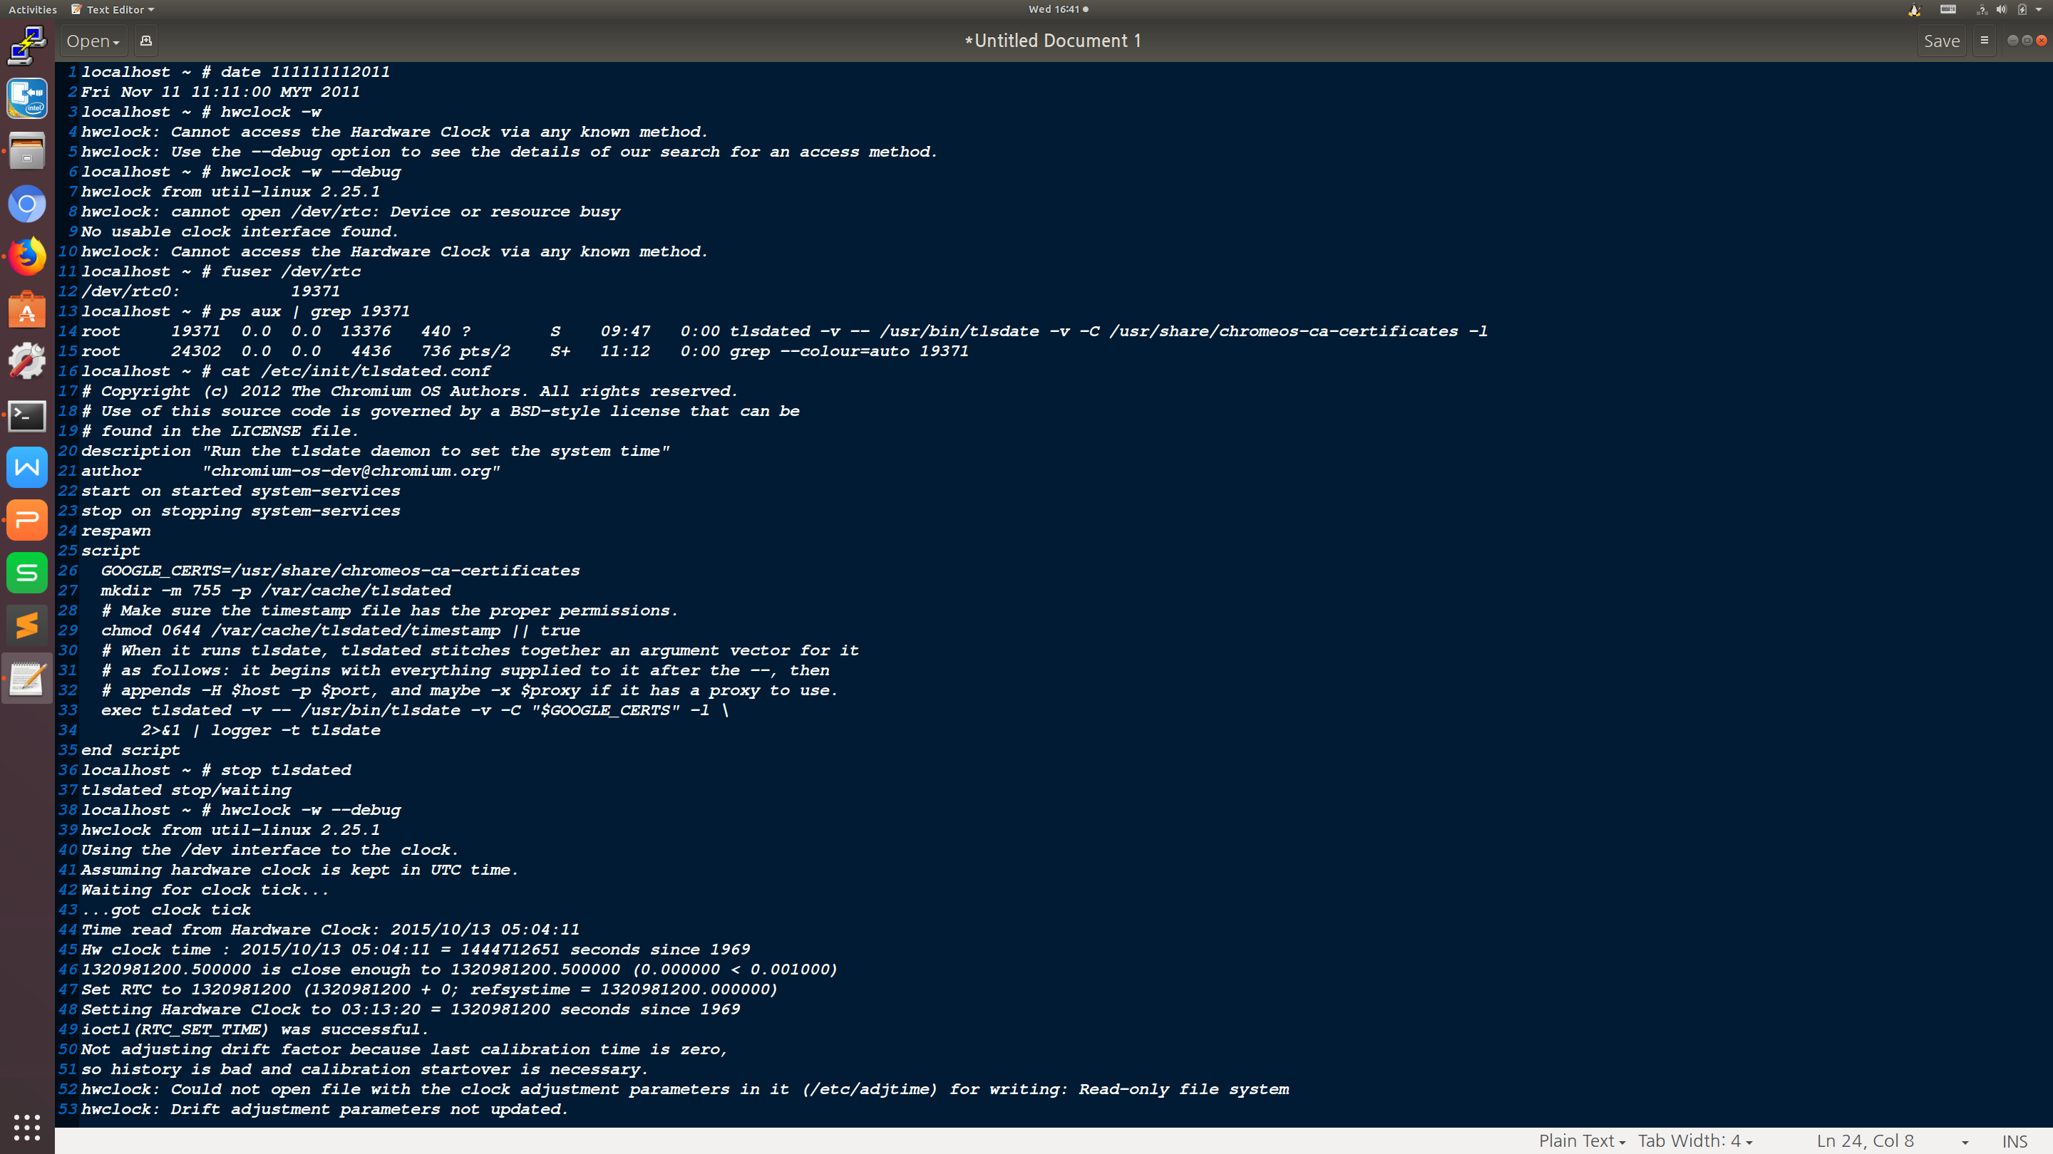
How to Change Date Time inside Chromium OS

Slide 50
How to share files for inside and outside chroot
The cros_sdk command supports mounting additional directories into your chroot environment. This can be used to share editor configurations, a directory full of recovery images, etc.
You can create a src/scripts/.local_mounts file listing all the directories (outside of the chroot) that you'd like to access inside the chroot. For example:
# source(path outside chroot) destination(path inside chroot)
/usr/share/vim/google
/home/YOURID/Downloads /Downloads
Each line of .local_mounts refers to a directory you'd like to mount, and where you'd like it mounted. For security and safety reasons, all directories mounted via .local_mounts will be read-only.
Reference: http://dev.chromium.org/chromium-os/tips-and-tricks-for-chromium-os-developers

Slide 51
General Development Tasks on Chromium OS
Repo chromium os codebase
Install depot_tools and repo sync init and sync chromium codebase
cros_sdk # Bring you to the chroot environment
(cr) $ export BOARD=your_platform_name
(cr) $ ./setup_board --board=your_platform_name --nousepkg
(cr) $ ./build_packages --board=your_platform_name --nousepkg
(cr) $ ./build_image --board=your_platform_name --noenable_rootfs_verification test --boot_args='earlyprintk=serial,ttyS0,115200 console=ttyS0,115200 loglevel=8'
Updating your device using USB
(cr) $ ./image_to_usb.sh --board=your_platform_name --to=/dev/sdd --from=../build/images/your_platform_name/Chromium...
Or: (cr) $ cros flash usb:// /path/to/*image.bin
Boot from USB
Option 1: On the device, goto recovery mode by pressing Esc + Refresh (aka the third function key from left) + Power and then insert your USB drive
Option 2: While booting up, if you are in developer mode, it displays a screen with red text that you are in developer mode and press Ctrl+U to boot from USB. Press Ctrl+U
Enter dev shell
Option 1: After booting completes, press Ctrl + Alt + F2 to go to the dev shell (Note, this was broken in some releases)
Option 2: Login as guest if you have not set up any account yet, else login with your account. Launch browser, press Ctrl+Alt + T, you get a chrome shell. Type shell to get a dev shell
Login with chronos or root and run the following command. (If built in test mode, as of now the pwd is test0000.)
$ sudo chromeos-install --dst /dev/mmcblk0
Notes:
Reference:
https://www.chromium.org/chromium-os/how-tos-and-troubleshooting/portage-build-faq

Slide 52
Bluetooth Kernel Debugging
Kernel Configuration
In order to use the Dynamic Debugging, the CONFIG_DYNAMIC_DEBUG must be set in the kernel configuration.
All BCP release kernel enabled this feature by default.
Enable logging
With Dynamic Debug feature, you can enable the kernel logging in various way and here are examples:
Enable by module
// Enable bluetooth module
$ sudo echo -n 'module bluetooth +pfm' > /sys/kernel/debug/dynamic_debug/control
// Enable btusb module
$ sudo echo -n 'module btusb +pfm' > /sys/kernel/debug/dynamic_debug/control
// Enable btintel module
$ sudo echo -n 'module btintel +pfm' > /sys/kernel/debug/dynamic_debug/control
Enable by filename
// enable btusb.c
$ sudo echo -n 'file btusb.c +pfm' > /sys/kernel/debug/dynamic_debug/control
// enable hci_core.c
$ sudo echo -n 'file hci_core.c +pfm' > /sys/kernel/debug/dynamic_debug/control
Another log messages
dmesg
syslog: $ tail -f /var/log/syslog
Notes:
Debug Messages during Boot Process: https://www.kernel.org/doc/html/v4.15/admin-guide/dynamic-debug-howto.html#debug-messages-during-boot-process

Slide 53
How to Configure Bluetooth Device ID
First identify the appropriate overlay for the board or variant, this is usually in
src/overlays/overlay-$BOARD but for devices still in development this may be in
src/private-overlays/overlay-$BOARD-private within the Chrome OS internal checkout.
The overlay should contain a "bsp" package, in chromeos-base/chromeos-bsp-$BOARD, with an
accompanying files directory. Do not mistake this for the "chromeos-bsp-$BOARD-private" overlay,
which does not generally have accompanying files.
Add a file called main.conf to the files directory containing the following:
[General]
DeviceID = bluetooth:00E0:XXXX:0400
Modify the ebuild file for the bsp package, adding to the src_install section:
# Install Bluetooth ID override.
insinto "/etc/bluetooth"
doins "${FILESDIR}/main.conf"
Don't forget to rename the ebuild symlink to increase the revision number.
Run "bt_console" from the crosh shell and use the show command to show information about the local adapter. At this step you can also verify that the information in the local adapter is correct. The output from show, in addition to the Bluetooth address, should contain the line:
Modalias: bluetooth:v00E0p XXXX d0400

Slide 54
How to Add New Driver into Chromium Build System
1. Prepare a simple driver
~/chromiumos/src/third_party/kernel/v3.10/drivers
2. Add the hello config to chrome build system
~/chromiumos/src/third_party/chromiumos-overlay/eclass
3. Modify the customized YourPlatformName config
~/chromiumos/src/overlays/overlay-YourPlatformName
4. Make & update kernel
emerge-YourPlatformName chromeos-kernel-3_10 && update_kernel.sh --remote=$IP
5. For debug, use "dmesg | grep Hello"

Slide 55
Build Chromium OS with SEP and SoCWatch Tools
SEP and SoCWatch are power and performance analysis tools.
SEP provides extensive power monitoring on a platform
SoCWatch is a command line tool which can be used to measure system behaviors that impacts power consumption including (but not limited to)
C/P/D/S-state residencies
Thermals
Energy consumption
Bandwidth
Wakeups
Build a ChromeOS Image with SoCWatch
With the build_image command, you will need to disable LSM module_locking and loadpin by modifying kernel boot arguments as in the below example: ~/trunk/src/scripts $ ./build_image --board=${BOARD} --noenable_rootfs_verification --boot_args='lsm.module_locking=0 loadpin.enabled=0' test
Installing SEP
Run below command on development system where you built the ChromeOS image. Make sure you are in the chroot directory: <cr>$ ./start_devserver
On the DUT run following commands to pull down SEP explicitly. "gmerge" runs on your DUT and contacts your development machine to build packages.
crosh> shell
$ sudo bash
# gmerge sep --accept_stable
You may run out of space on the / partition. The workaround would be to symlink /opt/sep to /usr/local/opt/sep, then rerun the above commands.
crosh> shell
$ sudo bash
# ln -s /opt/sep /usr/local/opt/sept

Slide 56
Vital Product Data (VPD)
Region in Read-Only and Read-Write flash
RO_VPD
Serial Number
Initial Locale
Initial Time Zone
Keyboard Layout
RW_VPD
Activation Date
Registration Codes
Tool: vpd
Display contents of read-only VPD
# vpd -i RO_VPD -l
Display contents of read-write VPD
# vpd -i RW_VPD -l
Erase and reformat read-only VPD
# vpd -i RO_VPD -O
Add serial number to read-only VPD
# vpd -i RO_VPD -s serial_number=1234567890
Read back serial number value
# vpd -i RO_VPD -g serial_number

Slide 57
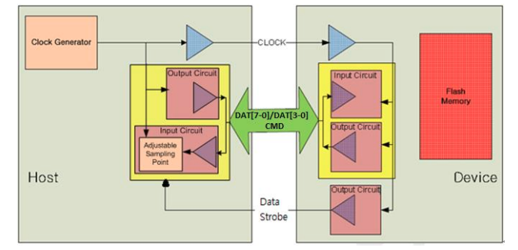
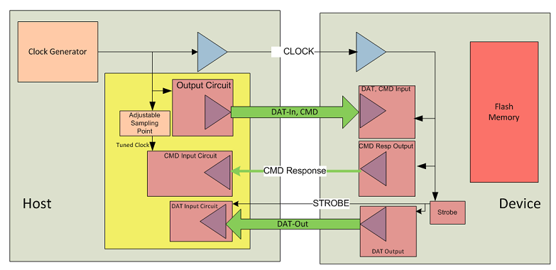
Examine eMMc in Chromium Runtime Env
Device info
Inside Chromium OS runtime environment, review the eMMC device information via /var/log/storage_info.txt
CL Reference: https://chromium-review.googlesource.com/c/chromiumos/platform/depthcharge/+/238101
Host info - cat /sys/kernel/debug/mmc0/
Throughput
Read: hdparm -Tt --direct /dev/mmcblk0
Write:
localhost ~ # cd /mnt/stateful_partition
localhost ~ # temp=`uuidgen`; dd if=/dev/zero of=${temp} conv=fdatasync bs=4k count=100k; rm ${temp}

Slide 58
How-To Chromium OS Kernel Tracing
# cd /sys/kernel/debug/tracing
# echo function > current_tracer
# cat trace # this dumps current trace buffer
# echo nop > current_tracer
There is one tip you can dump the trace buffer while panic, along with Oops message, either using sysctl or /proc
# cd /proc/sys/kernel
# echo 1 > ftrace_dump_on_oops
Notes:
Reference:
https://lwn.net/Articles/365835/
https://lwn.net/Articles/366796/

Slide 59
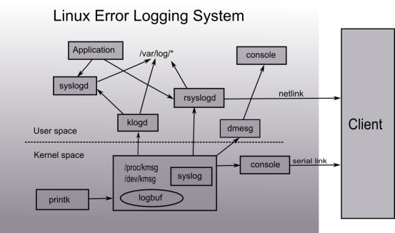
Error Logging System in Linux
Printk, organizes the data string as the format you want
Logbuf, buffers the logs temporarily
Syslog, manages the logbuf and provides some ioctrl function, is a system call interface too.
/proc/kmsg&/dev/kmsg, interfaces in file system, are most used by user space services to get log messages or write some data info to logbuf
Console, displays the log information, or acts as a shadow of other monitor device
Klogd&syslogd, is an couple of daemon services and charge of restoring log messages
Rsyslogd, is an enhanced version klogd and syslogd. Only one of the two categories is selected.
Dmesg, is a tool to display the log messages, sometimes has a tiny difference to klogd&syslogd or rsyslogd
/var/log/*, are several kinds of log files for different purpose
Notes:
Reference:
https://wiki.ith.intel.com/display/CTSNMPDBG/Debugging+Technologies+in+Linux#DebuggingTechnologiesinLinux-_Toc336521078

Slide 60
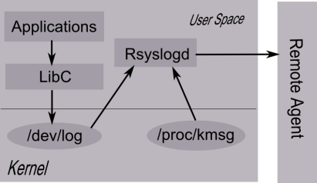
Daemon Services in User Space
This subsystem has the following key components:
LibC, provides the write entry for applications. The entry has similar format as printk
syslog (priority, format, …);
Where priority has two parts, one is severity, which occupies 3 bits and has the same meaning as the severity of printk; another part is facility code, which means which function part the message comes from, and takes other remaining bits. Some facility code examples are as the following
/* facility codes */
#defineLOG_KERN(0<<3)/* kernel messages */
#defineLOG_USER(1<<3)/* random user-level messages */
#defineLOG_MAIL(2<<3)/* mail system */
#defineLOG_DAEMON(3<<3)/* system daemons */
/dev/log, is a socket interface. All log messages from user spaces go through this socket and reach rsyslog daemon service except some messages you write to /dev/kmsg.
Rsyslogd, is the daemon service, which listens the /dev/log socket and /proc/kmsg, and then routes the log messages to right positions according to the priority code and configure files.
There are some pieces of rules from the configure file /etc/rsyslog.d/50-default.conf
Notes:
Reference:
http://www.linuxforu.com/2011/01/understanding-a-kernel-oops/
http://article.gmane.org/gmane.linux.kernel/624292
http://lkml.indiana.edu/hypermail/linux/kernel/0303.1/0009.html
http://kernel.org/pub/linux/kernel/people/jwessel/kdb
http://www.linuxfordevices.com/c/a/Linux-For-Devices-Articles/Inside-the-kernel-debugger-KDB/kernel-device-drivers-rmll2010.pdf
kgdb_kdb_modesetting.ppt
http://www.redbooks.ibm.com/redbooks/pdfs/sg244641.pdf

Slide 61
Enable "dev_dbg" in Chromium OS Kernel Driver Debug
The simplest way to receive dev_dbg messages to do following steps:
provide debug key into bootargs kernel parameters
append #define DEBUG at the first line of the driver file - if the driver is a single file and is using a common Makefile, or append -DDEBUG inside the CC build options if the driver contains of multiple source files and as usually has it's own Makefile
upon the kernel booted and the prompt appear to enable debug level messages by executing either dmesg -n 8 or echo 8 > /proc/sys/kernel/printk
mount the debug filesystem manually by executing the following command or add the this under your /etc/fstab to make the mount go automatic when you reboot:
mount -t debugfs none /sys/kernel/debug
Once done, do:
ls /sys/kernel/debug

Slide 62
Chromium OS Performance Tuning
Ftrace is the famous Linux kernel profiling tool. UXTune is based on Ftrace.
Mount the debugfs filesystem
mount -t debugfs none /sys/kernel/debug
Enter the ftrace the working directory
cd /sys/kernel/debug/tracing
Start to capture data using the "function" tracer
echo 0 > /sys/kernel/debug/tracing/tracing_enabled
echo 1 > /proc/sys/kernel/ftrace_enabled
echo function > /sys/kernel/debug/tracing/current_tracer
echo 1 > /sys/kernel/debug/tracing/tracing_on
echo 1 > /sys/kernel/debug/tracing/tracing_enabled
... your work ...
Start to capture data using the "function graph" tracer
echo function_graph > /sys/kernel/debug/tracing/current_tracer
Stop and view data
echo 0 > /sys/kernel/debug/tracing/tracing_enabled
cat /sys/kernel/debug/tracing/trace > data.file
vi data.file
Examples by the "function graph" tracer
# tracer: function_graph
#
# CPU DURATION FUNCTION CALLS
# | | | | | | |
1) 2.964 us | sub_preempt_count();
1) 1.893 us | add_preempt_count();
1) 1.853 us | sub_preempt_count();
1) 1.883 us | add_preempt_count();
1) 1.833 us | sub_preempt_count();
1) 1.853 us | add_preempt_count();
1) 1.863 us | sub_preempt_count();
1) 1.803 us | add_preempt_count();
1) 1.863 us | sub_preempt_count();
1) 1.923 us | add_preempt_count();
1) 1.843 us | sub_preempt_count();
1) | add_preempt_count() {
1) ==========> |
1) | smp_apic_timer_interrupt() {
1) | apic_write() {
1) 2.414 us | native_apic_mem_write();
1) 6.420 us | }
1) | irq_enter() {
1) 1.913 us | rcu_irq_enter();
1) 1.773 us | idle_cpu();
1) 1.843 us | add_preempt_count();

Slide 63
Script to reset TPM
The script need to run under "recovery mode".
#!/bin/sh
#
stop tcsd
tpmc ppon
tpmc clear
tpmc enable
tpmc activate
tpmc write 0x1007 2 0 1 0 1 0 0 0 0 0x4f
tpmc write 0x1008 2 4c 57 52 47 1 0 1 0 0 0 0 0x55

Slide 64
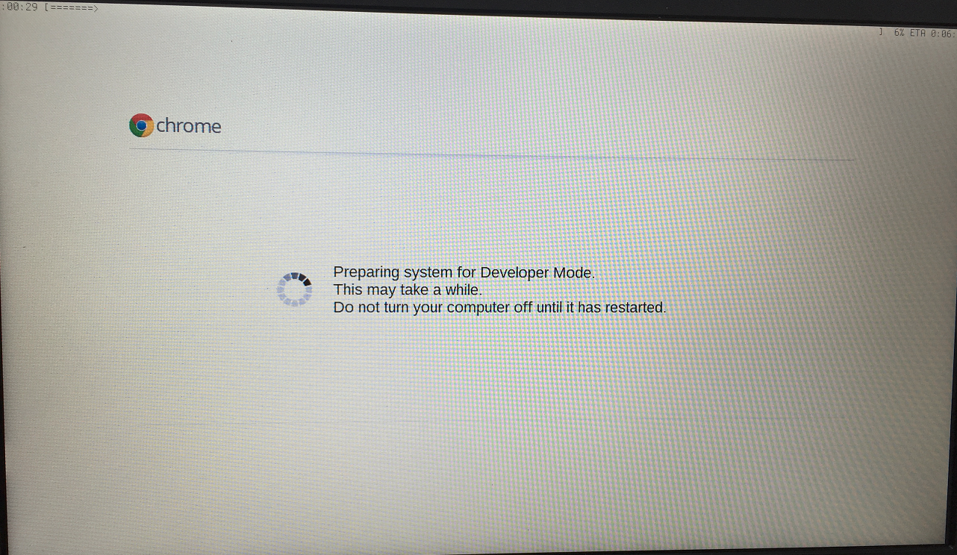
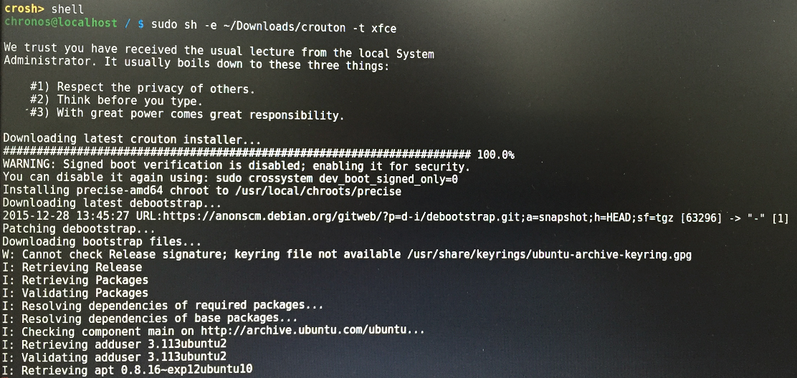
How to use Crouton to run Ubuntu inside Chromium OS
Step 1. Enabling Developer Mode
Step 2. Installing Crouton
Step 2.1 Download the latest release of Crouton to your Chromebook: http://goo.gl/fd3zc
Step 2.2 Install Crouton with the Xfce desktop
Step 3. Run Ubuntu - sudo startxfce4
Step 4. OS switch
Chrome OS -> Ubuntu : Alt+Ctrl+Shift+Back
Ubuntu -> Chrome OS : lt+Ctrl+Shift+Forward
Advanced installation:
sudo -i
cd /home/user/{uuid}/Download
List available target: sh ./crouton -t list
List available release: sh ./crouton -r list
Install Ubuntu 14.04 w/ Unity: sh ./crouton -t unity-desktop -r trusty
Install Xfce w/ applications: sh ./crouton -t xfce-desktop
Install LXDE w/ applications: sh ./crouton -t lxde-desktop
Install GNOME w/ applications: sh ./crouton -t gnome-desktop
Install KDE w/ applications: sh ./crouton -t kde-desktop

Slide 65
Crostini
Crostini should supplant Crouton that you can run Android and Linux applications side-by-side with the familiar web browser environment of Chromium OS.
Enable VT-x configuration in firmware
Enabling Crostini is simple, switch to the developers channel, then go into settings, scroll down to Linux (Beta), and enable it that causes a download of the Crostini/Linux support, and away you go.
For news about Crostini: https://www.reddit.com/r/Crostini/
Crostini Wiki: https://old.reddit.com/r/Crostini/wiki/index
Notes:
Reference:
https://blog.simos.info/a-closer-look-at-chrome-os-using-lxd-to-run-linux-gui-apps-project-crostini/#The%20Chrome%20OS%20deb%20package%20repository
https://techsparx.com/chromebooks/crostini/crostini-getting-started.html
https://www.reddit.com/r/Crostini/

Slide 66
Croustini (continued)
The basic component is The Chrome OS Virtual Machine Monitor (crossvm), which runs untrusted operating systems through Linux’s KVM interface. The Linux distribution would run in a VM. The test repositories make reference to the X server, XWayland and Wayland. There is a repository called sommelier, which is a nested Wayland compositor with X11 forwarding support. The vm_tools in Chrome OS. They include garcon, a service that gets added in the container and communicates with another service outside of the container (vm_concierge).
Notes:
Reference:
https://blog.simos.info/a-closer-look-at-chrome-os-using-lxd-to-run-linux-gui-apps-project-crostini/#The%20Chrome%20OS%20deb%20package%20repository

Slide 67
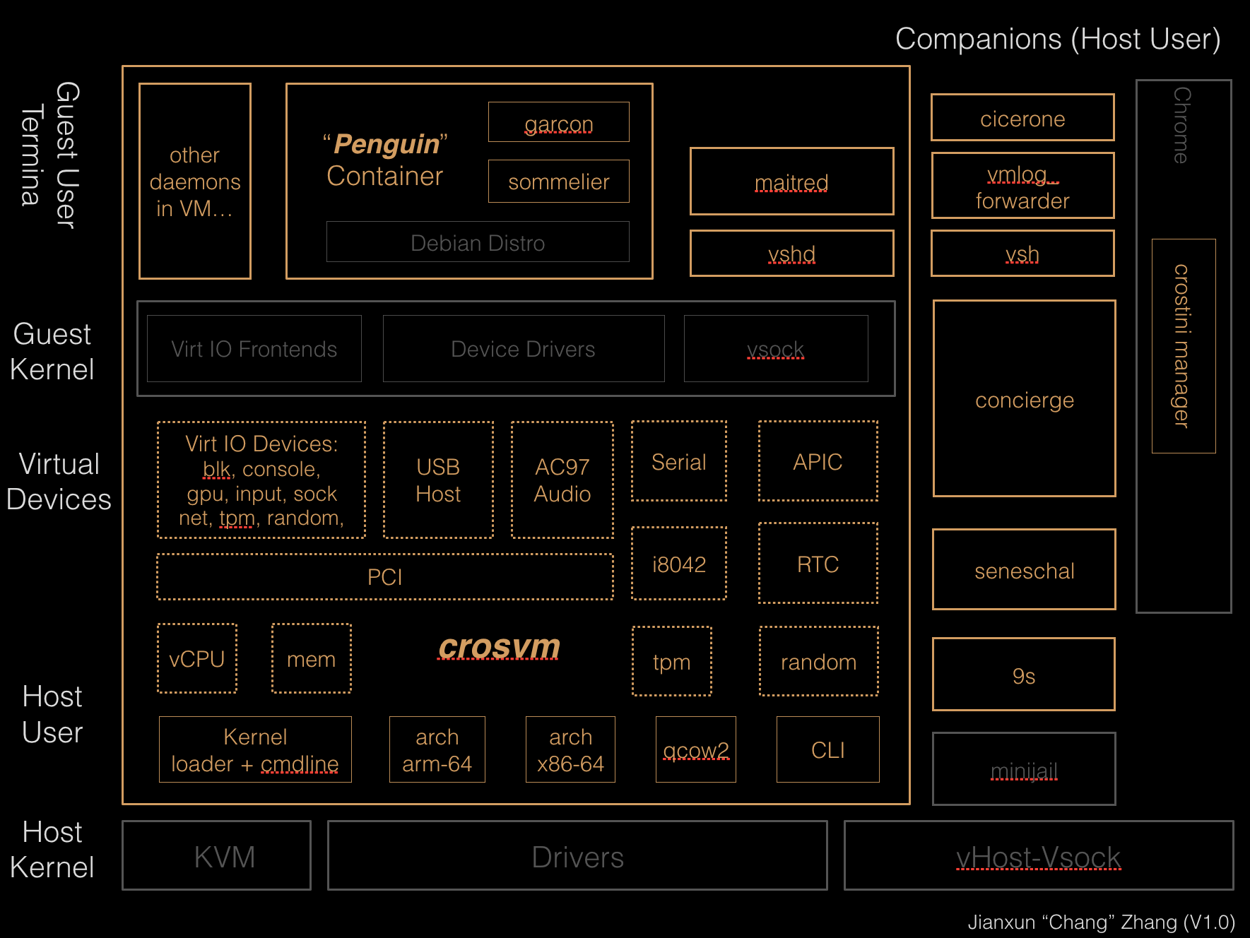
Notes:
Reference:
https://wiki.ith.intel.com/display/ChromeOS/Crostini
https://www.cyberciti.biz/faq/installing-kvm-on-ubuntu-16-04-lts-server/
https://www.hiroom2.com/2016/07/11/ubuntu-16-04-install-kvm-and-run-virtual-machine/

Slide 68
KVMGT on Chromium OS
The KVMGT feature is supposed to have a much better 3D performance in Corstini, compared with Google's virt-gpu solution.

Slide 69
Running Custom Containers Under Chromium OS
Reference
https://chromium.googlesource.com/chromiumos/docs/+/master/containers_and_vms.md#Quickstart
Notes:
Reference:
https://mp.weixin.qq.com/s?__biz=MzI4MzAwNTQ3NQ==&mid=209866190&idx=1&sn=0ee75509eb2fab454009125e0a8c6437&scene=0#rd

Slide 70
Chromium OS UI Framework
Chromium OS UI --> View --> Aura --> Xlib --> X Server // DRM/KMS --> i915 Device Driver
Chromium OS UI --> View --> Aura --> Ozone-gbm // DRM/KMS --> i915 Device Driver
chromium android container wayland
https://www.phoronix.com/scan.php?page=news_item&px=XDC2016-ARC-Wayland
Notes:
Chromium OS GUI:
https://gitai.me/2017/03/18/gui-of-chromeos/
https://www.x.org/wiki/Events/XDC2016/Program/Arcpp_Graphics.pdf
Ozone Reference:
https://software.intel.com/en-us/blogs/2014/10/23/chromium-ozone-gbm-explained
https://chromium.googlesource.com/chromium/src/+/lkgr/docs/ozone_overview.md
初识Wayland（X、Mir）: http://os.51cto.com/art/201011/233447_all.htm
Direct Render Manager: https://wikivisually.com/wiki/Direct_Rendering_Manager
Reference on Computer Gfx: http://www.opengpu.org/forum.php?mod=viewthread&tid=326
要做一個投影，首先是攝影機(camera,或eye point)的位置，攝影機朝向的方向，攝影機的視角(包含上下與左右的開展角度)，攝影機的「上向量」(upvector)，近平面(near)，遠平面(far)。使用頂點(Vertex)組成網眼(Mesh)架構，來記錄三維的資料。一個Vertex可以帶有許多資料，稱作屬性(Attribute)，比如說該點在空間座標系中的座標(Coordinate)、法向量(Normal)、該點的顏色(Color)、紋理座標(Texture coord.)Vertex同時也可以作為貝茲曲面(Bezier surface)或NURBS曲面的control point。由頂點(Vertex)組成的結構稱為Mesh，這些線條說明了Vertex如何連結成為Mesh，我們稱作Primitive，注意Primitive並不是線條而是一個抽像的連結概念。最簡單的Primitive有三種，點、線、三角形。而這就是全部了，因為所有的多邊形都可以拆成三角形，關於這方面我會在之後討論硬體時再詳細的說明。於是Vertex與Primitive組成了一個3D scene，3DComputer Graphics領域中的兩個主題：Modeling與Rendering，分別是決定了從虛擬的場景概念到Vertex與Mesh，以及從Vertex與Mesh到螢幕上的pixel color這兩個階段。

Slide 71
Wayland and Weston
Wayland是一套display server(Wayland compositor)与client间的通信协议。其官网为http://wayland.freedesktop.org/。它们定位于在Linux上替换X图形系统。Wayland基于domain socket实现了一套display server与client间通信的库，并且以XML形式定义了一套可扩展通信协议。这个协议分为Wayland核心协议和扩展协议（位于Weston中）。Weston作为Wayland compositor的参考实现，一般和Wayland同步发布。其它Wayland compositor实现还有如mutter, Kwin, Lipstick, Enlightenment, Clayland等。
Notes:
https://blog.csdn.net/jinzhuojun/article/details/47290707

Slide 72
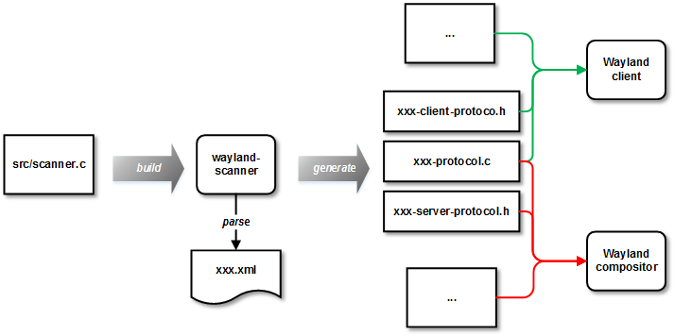
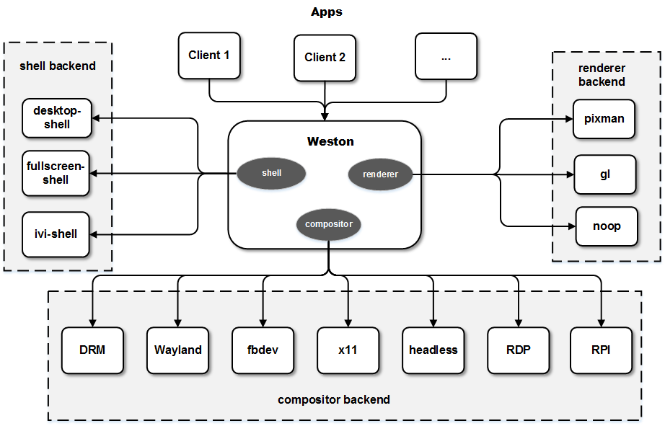
Wayland and WCodebase
Wayland的协议定义在protocol目录，通信协议实现在src目录。它主要编译出三个库，libwayland-client，libwayland-server和libwayland-cursor。第一个为协议的client端实现，第二个为协议的server端实现。第三个是协议中鼠标相关处理实现。编译时会首先编译出wayland-scanner这个可执行文件，它利用expat这个库来解析xml文件，将wayland.xml生成相应的wayland-protocol.c，wayland-client-protocol.h和wayland-server-protocol.h。它们会被Wayland的client和server在编译时用到。同时wayland-scanner也需要在生成Weston中的Wayland扩展协议中起同样作用。Wayland主要依赖于两个库，一个上面提到的expat协议，另一个libffi用于在跨进程过程调用中根据函数描述生成相应calling convention的跳板代码。
Weston的主要实现在src目录下。与Wayland类似，protocol目录下放着Wayland协议定义。在clients目录下是一些client的例子，也包括了desktop-shell和keyboard等核心client的例子，也包含了如simple-egl, simple-shm, simple-touch等针对性的简单用例。Weston启动过程中会分别加载几个backend：shell backend， render backend和compositor backend。它们分别用于窗口管理，合成渲染和合成内容输出。
Notes:
• fbdev：直接输出至linux的framebuffer设备。接口通用。
• headless：和noop-renderer配合使用，可以在没有窗口系统的机子（比如server上）测试逻辑。
• RPI：用于Raspberry Pi平台。
• RDP：合成后通过RDP传输到RDP peer显示，用于远程桌面。
• DRM：Direct redering manager，桌面上一般用这个。
• x11：Wayland compositor作为X server的client。它可以让Wayland client运行在X11上。
• wayland：Wayland composiotr作为server同时，也作为另一个Wayland compositor的client。用于nested compositor。

Slide 73
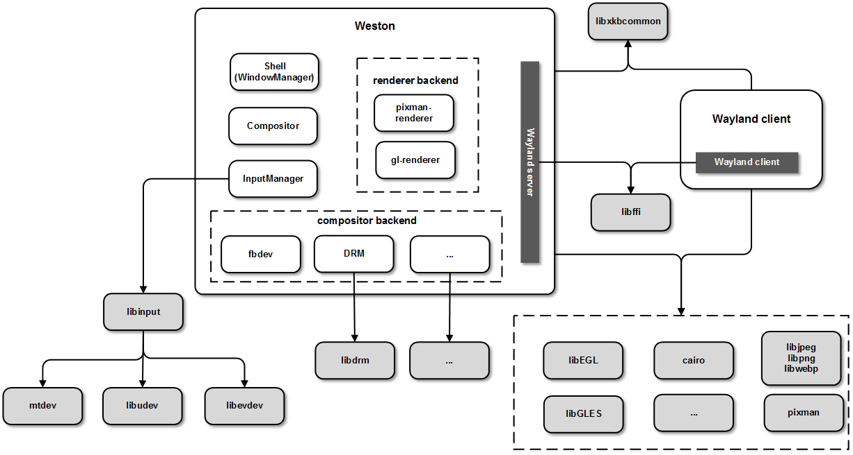
Weston Runtime Support Libs
Notes:
• libEGL, libGLES：本地窗口系统与图形driver的glue layer，mesa提供了开源版本的实现。
• libdrm：封装KMS，GEM等图形相关接口。平台相关。
• libffi：用于在运行时根据调用接口描述生成函数跳板并调用。
• pixman：用于像素操作的库，包括region, box等计算。用了许多平台相关的优化。
• cairo：软件渲染库，类似于skia。也有OpenGL后端。
• libinput：输入处理，依赖于mtdev, libudev, libevdev等库。
• libxkbcommon：主要用于键盘处理。
• libjpeg, libpng, libwebp：用于加载各种图片文件，像壁纸，面板和鼠标等都需要。
--------------------------------------------------------------------------------------
Viz, Mus, aura, blink, ash

Slide 74
Exporting DISPLAY in X Windows
Exporting display in X11 involves two distinct operations
Exporting display on the client using "export DISPLAY" command, ex. export DISPLAY=yourIpAddr:0.0
Allowing server to accept X11 session from the client. This part is accomplished by using xhost + or xhost <ip-from-which X11 session comes(client).
在Linux/Unix類操作系統上, DISPLAY用來設置將圖形顯示到何處. 在終端上輸入printenv查看當前環境變量.
DISPLAY 環境變量格式如下host:NumA.NumB, host指Xserver所在的主機主機名或者ip地址, 圖形將顯示在這一機器上, 可以是啟動了圖形界面的Linux/Unix機器, 也可以是安裝了Exceed, X-Deep/32等Windows平台運行的Xserver的Windows機器. 如果Host為空, 則表示Xserver運行於本機, 並且圖形程序(Xclient)使用unix socket方式連接到Xserver, 而不是TCP方式. 使用TCP方式連接時, NumA為連接的端口減去6000的值, 如果NumA為0, 則表示連接到6000端口; 使用unix socket方式連接時則表示連接的unix socket的路徑, 如果為0, 則表示連接到/tmp/.X11-unix/X0 . NumB則幾乎總是0.
Notes:
Reference:
http://www.softpanorama.org/Xwindows/exporting_display.shtml
https://jerry2yang.wordpress.com/2011/10/05/linux-display0-0/
https://askubuntu.com/questions/432255/what-is-the-display-environment-variable
https://www.smarthomebeginner.com/setup-vnc-server-on-ubuntu-linux/

Slide 75
Chrome OS D-Bus Best Practices
简介
有很多不同的 IPC 实现，因为每一个都定位于解决 特定的明确定义的问题。CORBA 是用于面向对象编程中复杂的 IPC 的一个强大的解决方案。DCOP 是一个 较轻量级的 IPC 框架，功能较少，但是可以很好地集成到 K 桌面环境中。SOAP 和 XML-RPC 设计用于 Web 服务，因而使用 HTTP 作为其传输协议。D-BUS 设计用于桌面应用程序和 OS 通信。DCOP 是一个用于 KDE 的 解决方案，但是它依赖于 Qt，所以不能用于其他桌面环境之中。类似的，Bonobo 是一个用于 GNOME 的 解决方案，但是非常笨重，因为它是基于 CORBA 的。它还依赖于 GObject，所以也不能用于 GNOME 之外。 D-BUS 的目标是将 DCOP 和 Bonobo 替换为简单的 IPC，并集成这两种桌面环境。
D-BUS 的内部工作方式
典型的 D-BUS 设置将由几个总线构成。将有一个持久的 系统总线（system bus），它在 引导时就会启动。这个总线由操作系统和后台进程使用，安全性非常好，以使得任意的应用程序 不能欺骗系统事件。还将有很多 会话总线（session buses），这些总线当用户登录后启动，属于 那个用户私有。
一旦应用程序连接到了一个总线，它们就必须通过添加 匹配器（matchers） 来声明它们希望 收到哪种消息。匹配器为可以基于接口、对象路径和方法进行接收的消息指定一组规则（见后）。
本质上，D-BUS 是一个对等（peer-to-peer）的协议 —— 每个消息都有一个源和一个目的。这些地址 被指定为 对象路径。概念上，所有使用 D-BUS 的应用程序都包括一组 对象，消息发送到 或者发送自特定对象 —— 不是应用程序 —— 这些对象由对象路径来标识。 每个对象都可以支持一个或多个 接口（interfaces）。这些接口看起来类似于 Java 中 的接口或者 C++ 中的纯粹的虚类（pure virtual classes）。
在 D-BUS 中有四种类型的消息：方法调用（method calls）、方法返回（method returns）、信号（signals） 和错误（errors）。
服务（Services） 是 D-BUS 的最高层次抽象。
Notes:
D-BUS Reference: https://dbus.freedesktop.org/doc/dbus-tutorial.html#members
Chromium OS D-BUS: https://chromium.googlesource.com/chromiumos/docs/+/master/dbus_best_practices.md

Slide 76
GPU Top - An Open Source GPU Profiling Tool (1/3)
GPUTop is a tool to help developers understand GPU performance counters and provide graphical and machine readable data for the performance analysis of drivers and applications. GPUTop is compatible with all GPU programming APIs such as OpenGL, OpenCL or Vulkan since it primarily deals with capturing periodic sampled metrics.
GPUTop should be built on two separate computers; the target device running the GPUTop server (Chrome/Chromium OS), and a development machine running the web user interface Linux. GPUTop is only compatible with v4.14+ kernels on the target device.
Build Chromium OS kernel
Complete the setup process for your board through ./build_packages (see Installing GPUTop as a Command Line Interface)
Before you ./build_image , execute the following: emerge-${BOARD} -C linux-sources chromeos-kernel-${VERSION}
Then, execute the following: USE='kernel-4_14 -kernel-${VERSION}' emerge-${BOARD} linux-sources
Update Chromium Device
From ~/trunk/src/scripts, execute the following: ./update_kernel --board=${BOARD} --remote=${DEVICE_IP_ADDRESS}
Accept the prompts asking for verification, and let the developer machine reboot the target device
On reboot, the script should end and define both the previous kernel version and the updated kernel version

Slide 77
GPU Top - An Open Source GPU Profiling Tool (2/3)
Installing GPUTop as a Command Line Interface on Chromium Target
Ensure the most recent version of GPUTop has been properly patched into dev-libs/gputop (v0.0)
Build packages ./build_packages --board={board} and a dev or test image ./build_image --board={board} [dev|test] per usual
Consider running ./build_packages --board={board} | tee build_packages_log.txt and ./build_image --board={board} | tee build_image_log.txt if you encounter issues emerging GPUTop, these files can later be grepped for debugging purposes, i.e. "grep -1 [build_packages_log.txt|build_image_log.txt] gputop"
Run equery-{board} -l gputop to verify GPUTop has emerged to board
If GPUTop fails to emerge to board, consider tracing the errors as detailed in the sub-step 2a
Provided GPUTop has successfully built, flash the image onto a thumb drive cros flash usb:// ../build/image/{board}/latest [dev|test]
Start up the target device, at the log in screen open a shell prompt "ctrl-alt-<F2>"
Install the image with sudo chromeos-install
After restarting the target device, one can open a terminal "ctrl-alt-t" and test GPUTop with gputop-wrapper -m RenderBasic -c GpuCoreClocks,EuActive,L3Misses,GtiL3Throughput,EuFpuBothActive

Slide 78
GPU Top - An Open Source GPU Profiling Tool (3/3)
Using GPUTop as a Command Line Interface on Chromium Target
Run sudo gputop
Execute gputop-wrapper -m <metric set> -c <counters> [-o <log.txt>]
Visit GPUTop Analysis Documentation for details on metric sets and counters
Installing GPUTop as a Web User Interface on Linux
A binary package with installation instructions can be downloaded from https://gitlab.com/Jragoon/gputop-packages:
git clone https://gitlab.com/Jragoon/gputop-packages
cd gputop-packages
Debian: sudo dpkg -i gputop-webui_1.1_amd64.deb
RPM: sudo rpm -i gputop-1.0-x86_64.rpm
Test the Web-UI by running ~/gputop/ui/index.html
Using GPUTop as a Web User Interface on Chromium Target and Linux
On the target device, open port 7890 using iptable -A INPUT -p tcp --dport 7890 -j ACCEPT
Start the GPUTop profiling server on the target Chromium device with sudo gputop
Connect to the gputop profiling server from the development machine running Linux
Run ifconfig on the target Chromium device, record the wlan or en0 inet address
Execute ~/gputop/ui/index.html on the development machine
Replace the address field with the inet address found in sub-step 3a and connect
On the UI, the typical profiling process follows this general process:
Use the Select Metric or the Select metric set from counter button to pick a set of counters to watch
Use the Start Sampling button
Open up the Live counters window

Slide 79
CPU Profiling Tool
 | Runtime overhead when running job | Time to process the data at the end of the profiling job | Speed of the GUI | Multi-thread information | Call graph
Gperftools (C/C++) | 25% | 5-10 minutes | Fast | No | Yes
Valgrind (Python) | 200-300% |  | Fast | No | No
vtune | 25% | Hours... Sometime crashes. | Slow | Yes | No
Gperftools is a set of tools created by google that allows cpu and memory profiling of c/c++ applications.

Slide 80
References
Design Documentations: http://www.chromium.org/developers/design-documents
Chromium OS Graphics Reading List: http://www.chromium.org/chromium-os/chromeos-graphics-reading-list
Chromium OS Specific Design Documentations: http://www.chromium.org/chromium-os/chromiumos-design-docs

Slide 81
Linux Utilities to Manipulate ACPI Reference: https://wiki.ubuntu.com/Kernel/Reference/ACPITricksAndTips
Utilities Installation: sudo apt-get install acpica-tools
acpidump -o ACPI_table.out
acpidump -a ACPI_table.out
iasl -d ssdt1.dat # Output is ssdt1.dsl can be viewed
Utilities Description:
acpidump – dump a system’s ACPI tables to an ASCII file
acpixtract – convert ASCII acpidump output to raw binary table
turbostat – gather performance statistics

Slide 82
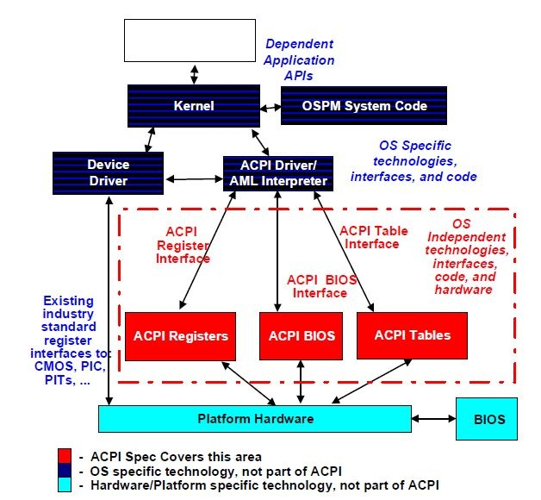
ACPI (1/11)
Overview
Architecture
Notes:
Reference:
https://zhuanlan.zhihu.com/p/26172972
https://sudonull.com/posts/1068-Interrupts-from-external-devices-in-the-x86-system-Part-3-Setting-up-interrupt-routing-in-the-chipse

Slide 83
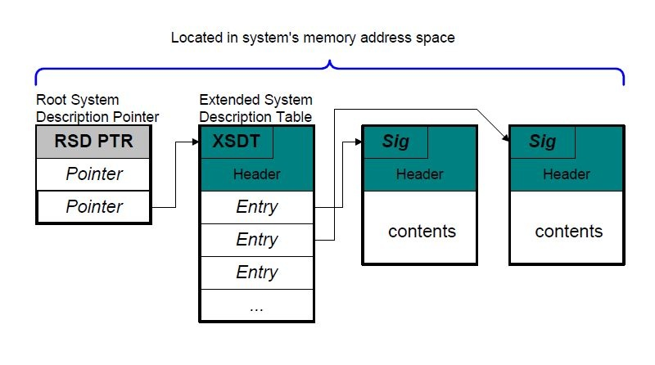
ACPI (2/11)
ACPI Table overview
RSDP (Root System Description Pointer)
locard in the system's memory address and is setup by the platform firmware
contains the address of the XSDT which references other description tables

Slide 84
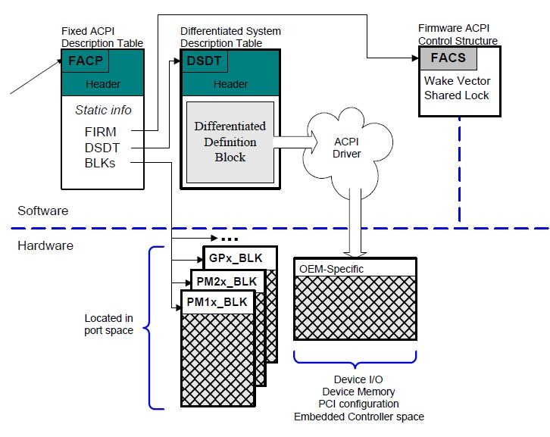
ACPI (3/11)
XSDT always point to other tables
the first table is FADT (Fixed ACPI Description table)
the FADT table always refers to the DSDT (Differentiated System Description Table)
DSDT contains information and descriptions for various system features

Slide 85
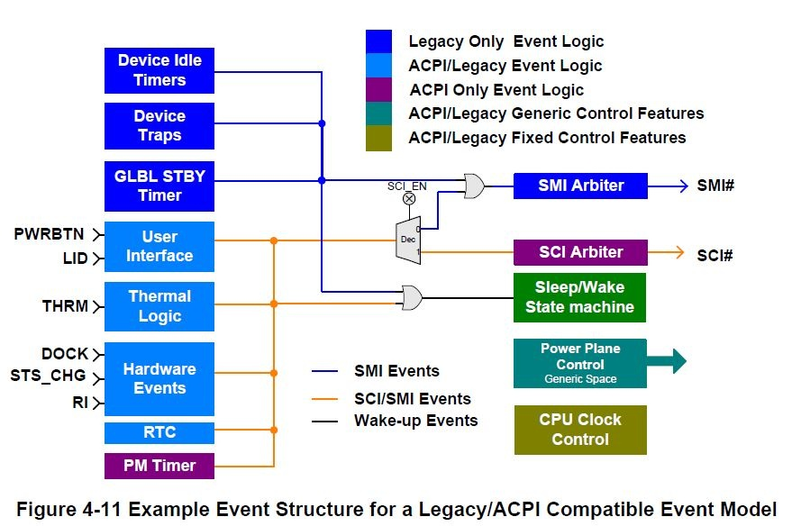
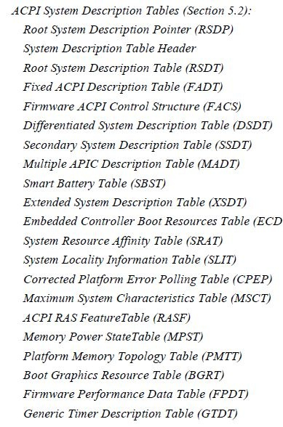
ACPI (4/11) - ACPI Tables List & Event Model

Slide 86
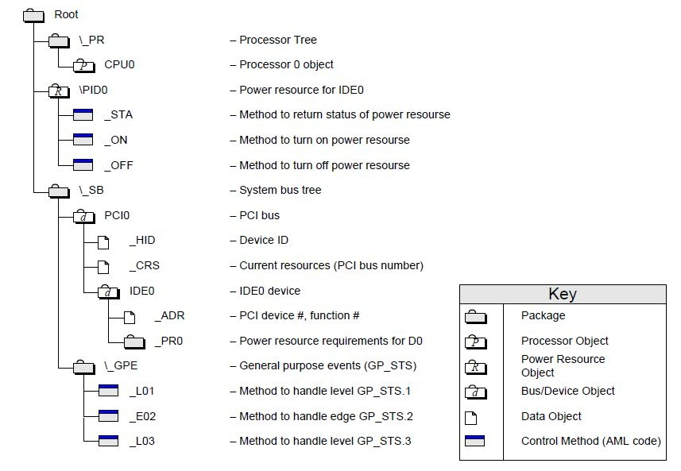
ACPI (5/11) - ACPI Tables Namespace Example

Slide 87
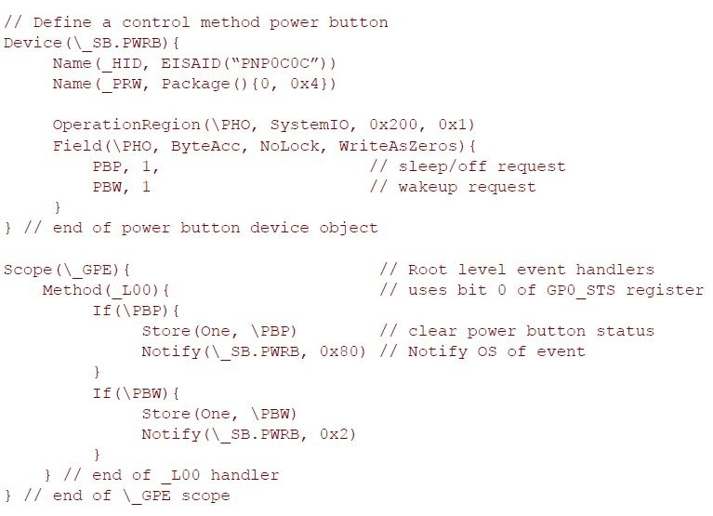
ACPI (6/11) - ACPI Power Button ASL code example

Slide 88
ACPI (7/11) - ACPI based Enumeration
ACPI based enumeration
Following section/code explains how to make an existing platform driver ACPI compatible.
First, we need to create an instance of acpi_device_id structure with the list the ACPI devices supported by this driver. The ACPI ID ( <DEVICE_NAME>) mentioned here should match the name used in _HID or _CID field of ACPI table.
Example:#ifdef CONFIG_ACPI
static struct acpi_device_id acpi_ids[] = {
/* ACPI IDs here */
Unknown macro: { "<DEVICE_NAME>", 0 }
,
{ }
};
MODULE_DEVICE_TABLE(acpi, acpi_ids);
#endif
Add a reference to acpi_device_id instance in the acpi_match_table (member of struct platform_driver ). ACPI framework will load this driver when it encounters a device matching the name of device mentioned in acpi_match_table.
Example: static struct platform_driver < DRIVER_NAME>_driver = {
.probe = < DRIVER_NAME>_probe,
.remove = < DRIVER_NAME>_remove,
.driver =
Unknown macro: { .name = DRIVER_NAME,+#ifdef CONFIG_ACPI+ .acpi_match_table = ACPI_PTR(acpi_ids),+#endif }
,
.id_table = id_table
};
Above two steps will make any existing driver ACPI compatible.

Slide 89
ACPI (8/11) - AML Code
Reources :
BUS : UART1
INTR : 0x46
GPIO :
Unknown macro: { “\SB.GPO0”, 0x34”}
,
Unknown macro: { “\SB.GPO0”, 0x35”}
//
Unknown macro: {relative_path, pin_no}
;
ASL Snapshot Device (BTH0)
{
Name (_HID, "BCM2E1A") // _HID: Hardware ID
Method (_CRS, 0, NotSerialized) // _CRS: Current Resource Settings
{
Name (UBUF, ResourceTemplate ()
Unknown macro: { UartSerialBus (0x0001C200, DataBitsEight, StopBitsOne, 0xFC, LittleEndian, ParityTypeNone, FlowControlNone, 0x0020, 0x0020, "\_SB.URT1", 0x00, ResourceConsumer, , ) Interrupt (ResourceConsumer, Level, ActiveLow, Exclusive, ,, )
Unknown macro: { 0x00000046, }
GpioIo (Exclusive, PullDefault, 0x0000, 0x0000, IoRestrictionOutputOnly,
"
_SB.GPO0", 0x00, ResourceConsumer, ,
)
Unknown macro: { // Pin list 0x0034 }
GpioIo (Exclusive, PullDefault, 0x0000, 0x0000, IoRestrictionOutputOnly,
"
_SB.GPO0", 0x00, ResourceConsumer, ,
)
Unknown macro: { // Pin list 0x0035 }
})
Name (PBUF, ResourceTemplate ()
{
UartSerialBus (0x0001C200, DataBitsEight, StopBitsOne,
0xFC, LittleEndian, ParityTypeNone, FlowControlNone,
0x0020, 0x0020, "
_SB.URT1",
0x00, ResourceConsumer, ,
)
Interrupt (ResourceConsumer, Level, ActiveLow, Exclusive, ,, )
GpioIo (Exclusive, PullDefault, 0x0000, 0x0000, IoRestrictionOutputOnly, "\_SB.GPO0", 0x00, ResourceConsumer, , )
Unknown macro: { // Pin list 0x0035 }
GpioIo (Exclusive, PullDefault, 0x0000, 0x0000, IoRestrictionOutputOnly, "\_SB.GPO0", 0x00, ResourceConsumer, , )
Unknown macro: { // Pin list 0x0034 }
}
)
If (LEqual (BTHS, One))
Unknown macro: { Return (PBUF) }
Else
Unknown macro: { Return (UBUF) }
}
}
}
Following ASL code is a snapshot from Baytrail ACPI table dump. The main things to note in the ASL dump is,
_HID/_CID – This name should match the <DEVICE> name used in id list of the ACPI driver
_CRS - List of resources owned by the device.
Example:
The ASL code mentioned below can be interpreted as following.Name of device: BTH0
_HID : BCM2E1A

Slide 90
ACPI (9/11) - AML Code
acpi_get_gpio_by_index(dev, index, *info)/**
acpi_get_gpio_by_index() - get a GPIO number from device resources
@dev: pointer to a device to get GPIO from
@index: index of GpioIo/GpioInt resource (starting from %0)
@info: info pointer to fill in (optional)
*
Function goes through ACPI resources for @dev and based on @index looks
up a GpioIo/GpioInt resource, translates it to the Linux GPIO number,
and returns it. @index matches GpioIo/GpioInt resources only so if there
are total %3 GPIO resources, the index goes from %0 to %2.
*
If the GPIO cannot be translated or there is an error, negative errno is
returned.
*
Note: if the GPIO resource has multiple entries in the pin list, this
function only returns the first.
*/
Example:bcm2e1a_enable = acpi_get_gpio_by_index(dev, 0, NULL)
The following diff adds ACPI support to BCM2E1A platform driver mentioned in the previous section.--- a/bcm_sample.c
+++ b/bcm_sample.c
@@ -14,17 +14,80 @@
#include <linux/init.h>
#include <linux/module.h>
#include <linux/slab.h>
+#include <linux/acpi.h>
+#include <linux/acpi_gpio.h>
#include <linux/platform_device.h>
BCM2E1A Driver Code
The following methods are useful when dealing with ACPI devices.
ACPI_HANDLE() – This method will return True if the device is enumerated through ACPI framework. This can be used to add ACPI specific handling code in the driver.
Example:In the code mentioned below, bcm_acpi_probe() will get called only if the device is enumerated through ACPI framework.Accessing Resources:
Most of the ACPI resources are decoded by ACPI framework and made it available for device drivers through “struct resources” member of struct platform_device.
Example:IRQ resource of BCM21EA device can be obtained by one of the following method.
1. platform_get_resource(dev, IORESOURCE_IRQ, 0)
2. platform_get_irq(dev, 0)
Only exception to this is GPIO info. Currently Linux kernel does not consider GPIO PIN as resource of the device.So, to extract GPIO information from ACPI tables, we need some additional code.

Slide 91
ACPI (10/11) - AML Code
static int bcm_probe(struct platform_device *pdev)
{
+ int bcm_irq;
+
dev_dbg(&pdev->dev, "BCM2E1A driver probe\n");
+ /*
+ * Get IRQ resource
+ *
+ * It can be done by two methods
+ *
+ * 1. platform_get_resource(dev, IORESOURCE_IRQ, 0)
+ * 2. platform_get_irq(dev, 0)
+ */
+
+ bcm_irq = platform_get_irq(pdev, 0);
+
+ dev_dbg(&pdev->dev, "BCM2E1A irq number: %d\n", bcm_irq);
+
+ /*
+ * If enumarated through ACPI, ACPI_HANDLE() will
+ * return true.
+ * This can be used to handle ACPI specific
+ * enumatration.
+ */
+#ifdef CONFIG_ACPI
+ if (ACPI_HANDLE(&pdev->dev))
Unknown macro: {+ /*+ * acpi specific probe+ */+ return bcm_acpi_probe(pdev);+ }
+#endif
return 0;
}
#define DRIVER_NAME "BCM2E1A"
/* Enabling debug flags */
#define DEBUG
+#ifdef CONFIG_ACPI
+static int bcm_acpi_probe(struct platform_device *pdev)
+{
+ int bt_enable, bt_reset;
+
+ /*
+ * Handle ACPI specific initializations.
+ */
+ dev_dbg(&pdev->dev, "BCM2E1A ACPI specific probe\n");
+
+ /*
+ * Prerequisite for using this API is to
+ * have the GPIO chip registered through
+ * ACPI framework.
+ */
+ bt_reset = acpi_get_gpio_by_index(&pdev->dev, 0, NULL);
+ if (bt_reset < 0)
Unknown macro: {+ dev_err(&pdev->dev,+ "bt_reset acpi_get_gpio_by_index() failedn");+ return -ENODEV;+ }
+ bt_enable = acpi_get_gpio_by_index(&pdev->dev, 1, NULL);
+ if (bt_enable < 0)
Unknown macro: {+ dev_err(&pdev->dev,+ "bt_enable acpi_get_gpio_by_index() failedn");+ return -ENODEV;+ }
+
+ dev_dbg(&pdev->dev, "[%s] success\n", _func_);
+ return 0;
+}
+#endif

Slide 92
ACPI (11/11) - AML Code
ACPI platform device
Currently the kernel is not able to automatically determine from which ACPI device it should make the corresponding platform device. So we need to add the ACPI device explicitly to acpi_platform_device_ids list defined in drivers/acpi/scan.c. This limitation is only for the platform devices, SPI and I2C devices are created automatically as described below.index 5d11b6c..9b06efb 100644
— a/drivers/acpi/scan.c
+++ b/drivers/acpi/scan.c
@@ -35,6 +35,7 @@ static const char *dummy_hid = "device";
static const struct acpi_device_id acpi_platform_device_ids[] = {
Unknown macro: { "PNP0D40" }
,
+
Unknown macro: { "BCM2E1A" }
,
/* Haswell LPSS devices */
Unknown macro: { "INT33C0", 0 }
,
static int bcm_remove(struct platform_device *pdev)
@@ -40,11 +103,23 @@
};
MODULE_DEVICE_TABLE(platform, bcm_id_table);
+#ifdef CONFIG_ACPI
+static struct acpi_device_id bcm_acpi_id[] = {
+ /* ACPI IDs here */
+
Unknown macro: { "BCM2E1A", 0 }
,
+ { }
+};
+MODULE_DEVICE_TABLE(acpi, bcm_acpi_id);
+#endif
+
static struct platform_driver bcm_driver = {
.probe = bcm_probe,
.remove = bcm_remove,
.driver =
Unknown macro: { .name = DRIVER_NAME,+#ifdef CONFIG_ACPI+ .acpi_match_table = ACPI_PTR(bcm_acpi_id),+#endif }
,
.id_table = bcm_id_table
};

Slide 93
ASL in Coreboot/DSDT
ACPI引入了一个NAMESPACE的观念。也就是说所有的OBJECT之间是有等级关系的。各个ACPI OBJECT（类似常量）之间都存在于一个路径下面，其中的根目录就是以符号“\”来表示。然后上下级目录之间用“.”来连接起来。比如\_SB_. FOO.BAR 就表示根目录下的_SB_这个OBJECT下的FOO OBJECT下的BAR OBJECT。因此，在ACPI中，很多操作都是作用在这个NAME SPACE 中的某个OBJECT上面。并由此引入了一系列相关概念。比如SCOPE。
ASL中很多都是如下形式：Device(PCI0)。一般在小括号前面的都是操作符，也就是预先定义好的。Ex. Name (\CNT, 5): The following example creates the name CNT in the root of the namespace that references an integer data object with the value 5. Package就是把一堆Object放在一起，类似一个C语言里的结构体。
初始设备制造厂家（OEM）必须提供一个DSDT给ACPI兼容操作系统。DSDT包含差异定义块，它提供关于基本系统（base system）的执行和配置信息。操作系统总是在系统启动时将DSDT信息插入到ACPI命名空间并且从不移除。基本上，可以把DSDT归结为来描述你的系统配置的。它包括所有ACPI支持的设备的定义并描述它们的兼容性。SSDT是DSDT的延续。多个SSDT可以用来作为平台描述的一部分。在DSDT被加载到ACPI命名空间后，每个RSDT/XSDT列举的SSDT和它唯一的OEM表识别号被加载。这允许OEM在一个表里提供基本支持，同时添加在其他表里添加小的系统选项。DSDT可能只含有设备（device）的基本信息，然后将详细信息放在具有唯一识别号的SSDT中。
Notes:
Reference:
For ASL syntax, ACPI SPEC 4.0
https://lp007819.wordpress.com/2015/01/11/%E8%BD%AC%E8%BD%BD%E4%BF%AE%E5%A4%8D%E5%B8%B8%E8%A7%81acpi%E9%97%AE%E9%A2%98%EF%BC%88dsdt%E7%AD%89%EF%BC%89/

Slide 94
DSDT Configuration in Coral
First use "find ./src/mainboard/google/reef/ -name *.asl" to find out all reef and its variants *.asl files
Then open "./src/mainboard/google/reef/dsdt.asl" that is the APL base platform's DSDT table in which we can see what root asl and base asl are included, such as
/* global NVS and variables */
#include <soc/intel/apollolake/acpi/globalnvs.asl>
/* CPU */
#include <soc/intel/apollolake/acpi/cpu.asl>
Scope (\_SB) {
Device (PCI0)
{
#include <soc/intel/apollolake/acpi/northbridge.asl>
#include <soc/intel/apollolake/acpi/southbridge.asl> /* Include #include "xhci.asl" */
#include <soc/intel/apollolake/acpi/pch_hda.asl>
}
}
/* Chrome OS specific */
#include <vendorcode/google/chromeos/acpi/chromeos.asl>
/* Chipset specific sleep states */
#include <soc/intel/apollolake/acpi/sleepstates.asl>
Inside southbridge.asl, there exist "Name (_PRW, Package() { GPE0A_XHCI_PME_STS, 3 })", this statement should be reflected in
'cat /proc/acpi/wakeup' shows the xhci controller as enabled, as does 'cat /sys/bus/usb/devices/<dev #>/power/wakeup' for all connected devices.
Notes:
Some related devices nodes associated:
/proc/acpi/wakeup
/sys/bus/usb/devices/<dev #>/power/wakeup

Slide 95
Logging on Chromium OS
Chromium OS provides a variety of logs that can help user understand the current state of the machine or what causes a crash within the system.
/dev/pstore
When a crash occurs that induces a reboot console-ramoops captures logs leading up to the reboot. Reference: https://www.kernel.org/doc/html/latest/admin-guide/ramoops.html
dmesg -w
Kernel logs. These live in a limited size FIFO buffer in RAM which overflows and "wraps around" after some time. Before that happens the logging daemon copies kernel logs to disk in /var/log/messages* for non volatile and longer term storage.
tailf /var/log/messages
This is what most people should be looking at most of the time. All logs except browser logs are there. Kernel logs are conveniently interleaved with other, related logs happening at the same time. This can be configured in /etc/rsyslog.chromeos (https://chromium.googlesource.com/chromiumos/platform/init/+/669eea2a46e94b24/rsyslog.chromeos) The very last kernel logs will be missing if the system crashed too fast, then there's a small chance that dmesg -w will catch and show more kernel logs depending on how the system crashes.
/var/log/messages.*
Older versions of /var/log/messages as rotated by /usr/sbin/chromeos-cleanup-logs - which you can call manually to start a new /var/log/messages files without losing anything.
/var/log/ui/ui.LATEST and /var/log/chrome/chrome
Browser logs: https://chromium.googlesource.com/chromium/src/+/master/docs/chrome_os_logging.md
Notes:
Reference:
Collecting and analyzing Linux kernel crashes - Kdump: https://www.dedoimedo.com/computers/kdump.html

Slide 96
Workarounds for Handling Logs
Making kernel suspend/resume logs 8 times smaller
echo 0 > /sys/power/pm_print_times
Or
suspend_stress_test --nopm_print_times
More details in https://chromium-review.googlesource.com/c/chromiumos/platform2/+/855644
Handling Large Log Files
When running Autotest over many iteration, size of log files (especially /var/log/messages) can take up a lot of disk space , since log rotation happens every 86400 seconds (24 hours). it is common to see a slow down in Autotest and ultimately a failure due to host machine storage being taken up. To avoid such a disaster, a few workaround could be done:
base_infosys.py
diff --git a/client/bin/base_sysinfo.py b/client/bin/base_sysinfo.py
index 5f3487ec3..d4f488a7f 100644
--- a/client/bin/base_sysinfo.py
+++ b/client/bin/base_sysinfo.py
@@ -35,7 +35,6 @@ _DEFAULT_FILES_TO_LOG_PER_BOOT = [
'/proc/interrupts',
'/proc/partitions',
'/var/log/bios_info.txt',
- '/var/log/messages',
'/var/log/storage_info.txt',
] + list(constants.LOG_PSTORE_DIRS)
_DEFAULT_FILES_TO_LOG_BEFORE_ITERATION = [
lines 1-12/12 (END)
On the Chrome OS device, edit /usr/sbin/chromeos-cleanup-logs by changing as the right panel shown, After that, edit the value of "86400" in /etc/init/log-rotate.conf. This value represent the interval in seconds in which the "periodic_scheduler" init script calls "chromeos-cleanup-logs" to clean up the logs.
diff --git a/init/chromeos-cleanup-logs b/init/chromeos-cleanup-logs
index cc9a62539..9dfa11d1a 100755
--- a/init/chromeos-cleanup-logs
+++ b/init/chromeos-cleanup-logs
@@ -10,7 +10,7 @@
CLEANUP_PAUSED_FILE="/var/lib/cleanup_logs_paused"
NUM_DAYS_TO_PRESERVE=7
-MAX_SUBDIR_SIZE=100 # MB
+MAX_SUBDIR_SIZE=10 # MB or whatever size you want to keep the log directory at
# Threshold for additional histogram reporting (in 1KB blocks), 1GB in total.
ADDITIONAL_REPORTING_THRESHOLD_BLOCKS=1048576
SHADOW="/home/.shadow"
# Copyright (c) 2014 The Chromium OS Authors. All rights reserved.
# Use of this source code is governed by a BSD-style license that can be
# found in the LICENSE file.
description "Rotate the system logs"
author "chromium-os-dev@chromium.org"
start on starting system-services
stop on stopping system-services
exec periodic_scheduler 86400 600 cleanup_logs /usr/sbin/chromeos-cleanup-logs

Slide 97
Serial Port Utilization in Chromium OS
Original Message
Serial Debugging HOWTO - http://www.chromium.org/chromium-os/how-tos-and-troubleshooting/serial-debugging-howto
Controlling Enabled Consoles - http://www.chromium.org/chromium-os/developer-guide/using-serial-tty
Enabling Serial Port
To enable the serial console by default https://chromium-review.googlesource.com/c/454119/2/overlay-coral/profiles/base/make.defaults
Building phase (TTY stands for ttyS?)
USE="pcserial tty_console_$TTY" cros_workon_make --install sys-kernel/chromeos-kernel-3_18
Or. USE="pcserial tty_console_$TTY" \
./build_packages --board=$BOARD
./build_image --board=$BOARD --enable_serial="${TTY},115200n8,keep" --loglevel=7 --boot_args="my_build_123 i915.this=that drm.debug=XX etc." --noenable_rootfs_verification test
Troubleshooting
dmesg is endlessly reporting console-$TTY respawns.
Ensure your board's kernel has been built with the pcserial USE flag. You can verify by checking that /dev/$TTY is present on the target's filesystem.
agetty is not behaving the way I want it to.
You can remount the rootfs read-write and edit /etc/init/console-$TTY.conf
Can't see system logs from device with UEFI BIOS.
Make sure that, in the BIOS settings menu, 'Intel Advanced Menu' -> 'PCH-IO Configuration' -> 'Serial IRQ Mode' is set to 'Continuous'.

Slide 98
Logging on Chrome OS
Helpful Chrome OS Logs
Chrome OS provides a variety of logs that can help user understand the current state of the machine or what causes a crash within the system.
/dev/pstore/ (console ramoops)
When a crash occurs that induces a reboot console-ramoops captures logs leading up to the reboot. DRAM needs to be "refreshed" regularly otherwise it loses its content; console-ramoops works only because rebooting is usually fast enough not to lose DRAM content. EFI pstore is an alternative Persistent STORE that can be used on RVPs.
dmesg -w
Kernel logs. These live in a limited size FIFO buffer in RAM which overflows and "wraps around" after some time. Before that happens the logging daemon copies kernel logs to disk in /var/log/messages* for non volatile and longer term storage.
tailf /var/log/messages
This is what most people should be looking at most of the time. All logs except browser logs are there. Kernel logs are conveniently interleaved with other, related logs happening at the same time. This can be configured in /etc/rsyslog.chromeos (see also below) The very last kernel logs will be missing if the system crashed too fast, then there's a small chance that dmesg -w will catch and show more kernel logs depending on how the system crashes.
/var/log/messages.*
Older versions of /var/log/messages as rotated by /usr/sbin/chromeos-cleanup-logs - which you can call manually to start a new /var/log/messages files without losing anything.
/var/log/ui/ui.LATEST and /var/log/chrome/chrome
Browser logs: https://chromium.googlesource.com/chromium/src/+/master/docs/chrome_os_logging.md
generate_logs collects all system logs and bundles them into a tarball. TODO: verify this is the command run when a customer uses Report a problem or send feedback
See also Serial Port Utilization

Slide 99
Execute System Suspend-Resume Stress
Making kernel suspend/resume logs 8 times smaller
echo 0 > /sys/power/pm_print_times
Or
suspend_stress_test --nopm_print_times
More details in https://chromium-review.googlesource.com/c/chromiumos/platform2/+/855644

Slide 100
Handling Large Log Files
base_sysinfo.py
diff --git a/client/bin/base_sysinfo.py b/client/bin/base_sysinfo.py
index 5f3487ec3..d4f488a7f 100644
--- a/client/bin/base_sysinfo.py
+++ b/client/bin/base_sysinfo.py
@@ -35,7 +35,6 @@ _DEFAULT_FILES_TO_LOG_PER_BOOT = [
'/proc/interrupts',
'/proc/partitions',
'/var/log/bios_info.txt',
- '/var/log/messages',
'/var/log/storage_info.txt',
] + list(constants.LOG_PSTORE_DIRS)
_DEFAULT_FILES_TO_LOG_BEFORE_ITERATION = [
lines 1-12/12 (END)
When running Autotest over many iteration, size of log files (especially /var/log/messages) can take up a lot of disk space , since log rotation happens every 86400 seconds (24 hours). it is common to see a slow down in Autotest and ultimately a failure due to host machine storage being taken up. To avoid such a disaster, a few workaround could be done:
1. If log is NOT concern, one can do the following to keep Autotest from filling up the development machine as the script on right.
2. If logs are a concern, we can increase the frequency of when log rotates happens by editing a few config files:
On the Chrome OS device, edit /usr/sbin/chromeos-cleanup-logs by changing as the right. After that, edit the value of "86400" in /etc/init/log-rotate.conf. This value represent the interval in seconds in which the "periodic_scheduler" init script calls "chromeos-cleanup-logs" to clean up the logs.
chromeos-cleanup-logs
diff --git a/init/chromeos-cleanup-logs b/init/chromeos-cleanup-logs
index cc9a62539..9dfa11d1a 100755
--- a/init/chromeos-cleanup-logs
+++ b/init/chromeos-cleanup-logs
@@ -10,7 +10,7 @@
CLEANUP_PAUSED_FILE="/var/lib/cleanup_logs_paused"
NUM_DAYS_TO_PRESERVE=7
-MAX_SUBDIR_SIZE=100 # MB
+MAX_SUBDIR_SIZE=10 # MB or whatever size you want to keep the log directory at
# Threshold for additional histogram reporting (in 1KB blocks), 1GB in total.
ADDITIONAL_REPORTING_THRESHOLD_BLOCKS=1048576
SHADOW="/home/.shadow"
log-rotate.conf
# Copyright (c) 2014 The Chromium OS Authors. All rights reserved.
# Use of this source code is governed by a BSD-style license that can be
# found in the LICENSE file.
description "Rotate the system logs"
author "chromium-os-dev@chromium.org"
start on starting system-services
stop on stopping system-services
exec periodic_scheduler 86400 600 cleanup_logs /usr/sbin/chromeos-cleanup-logs

Slide 101
log_reaper: Utility to extract information from ChromeOS log
The log_reaper is developed to help developers to process and analyze, logs from rsyslogd like /var/log/messages from DUT. At this time it supports
Extract log lines from components you specified, or filter out log lines from components you exclude
Strip volatile elements like timestamps and pids from the header of log. The output will make it much easier when you try to compare two log files in an external diff software
It can run on both host and DUT which is flashed with a dev build with python.
Where It Lives
https://chromium-review.googlesource.com/c/chromiumos/platform/crosutils/+/1401466
Usage
./log_reaper.py --help
Examples
Let's see you have a piece of log like this in a file named "messages":
2018-04-13T11:55:38.863095-07:00 INFO kernel: [ 0.000000] x86/fpu: Supporting XSAVE feature 0x002: 'SSE registers'
2018-04-13T12:04:31.314302-07:00 INFO avahi-daemon[1217]: Registering new address record for 100.115.92.1 on arcbr0.IPv4.
2018-04-13T12:04:38.418000-07:00 INFO sshd[2920]: Connection closed by authenticating user root 127.0.0.1 port 42160 [preauth]
...
To extract logs only from kernel AND sshd:
./log_reaper.py -c kernel:sshd messages

Slide 102
Bluez
Bluez Commands
hciattach - attach serial devices via UART HCI to BlueZ stack
hciattach /dev/ttyS2 Intel 115200 flow
hciconfig - configure Bluetooth devices
hciconfig hci0 reset | up | name XXX | piscan
hcitool - configure Bluetooth connections
hcitool -i hci0 scan | cc 87:55:xx:yy:zz:aa && hcitool con | ...
BLUETOOTHD - Bluetooth daemon
/etc/init.d/bluetooth start
SIMPLE-AGENT - Use for pairing device
RFCOMM - RFCOMM configuration utility
OBEXFTP - Mobile Equipment file transfer tool
OBEXPUSH - Push and Receive Files over the Bluetooth OBEX Push Channel
HCIDUMP - Parse HCI data
DBUS-SEND - Send a message to a message bus
Get your devices
dbus-send --system --type=method_call --print-reply --dest=org.bluez "/" org.bluez.Manager.ListAdapters
Get Properties
dbus-send --system --type=method_call --print-reply --dest=org.bluez "/org/bluez/3858/hci0" org.bluez.Adapter.GetProperties
Remove a device (useful to remove paired devices)
dbus-send --system --type=method_call --print-reply --dest=org.bluez "/org/bluez/2036/hci0" org.bluez.Adapter.RemoveDevice objpath:"/org/bluez/2036/hci0/dev_00_02_72_A6_2C_69"
AD2P - Edit the /etc/asound.conf with the bd address
mplayer -ao alsa:device=bluetooth my-mp3-file.mp3
pcm.bluetooth
type bluetooth
device "xx:xx:xx:xx:xx:xx"
profile "auto"
Notes:
Checking procedures for enabling Bluetooth in Ubuntu env:
1. /etc/init.d/bluetooth --> ps aux | grep blueoothd --> /etc/bluetooth/uart
All of above should be presented.
Reference:
https://forum.khadas.com/t/add-bluetooth-support-for-ubuntu/593
https://hk.saowen.com/a/427f6dbad9d9dc40d9874ee86a404b2b6eda891c5257d3b09feb74f065d8e2e7

Slide 103
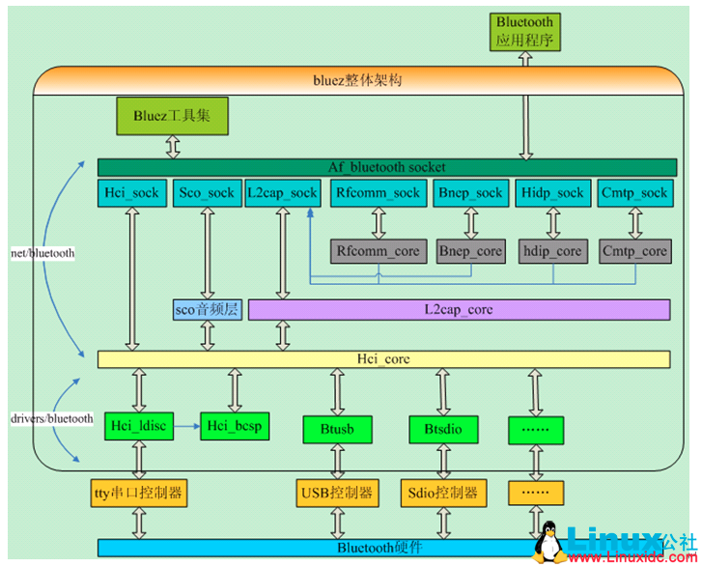
Bluetooth Architecture in Ubuntu
Step 1: Install all necessary packages involved Bluetooth
$ sudo apt update
$ sudo apt upgrade
$ sudo apt install bluetooth blueman bluez bluez-tools rfkill libbluetooth-dev
Step 2: Make sure load ‘hci_uart’ module at boot time:
cat /etc/modules
...
hci_uart
...
Step 3: Download broadcom bluetooth tool brcm_patchram_plus and firmware:
sudo chmod +x /usr/local/bin/brcm_patchram_plus
sudo mv ~/Downloads/bcm43438a*.hcd ~/Downloads/BCM4345C0.hcd /lib/firmware/brcm/
Step 4: Load firmware:
sudo brcm_patchram_plus --patchram /lib/firmware/brcm/BCM4345C0.hcd --enable_hci --bd_addr 11:22:33:44:55:66 --no2bytes --tosleep 1000 /dev/ttyS1
Step 5: Attach HCI adapter:
sudo hciattach /dev/ttyS1 any
Step 6: Test
Notes:
Patch to enable Intel Baytrail HSUART:
https://lists.yoctoproject.org/pipermail/linux-yocto/2013-December/001673.html
https://wiki.ubuntu.com/DebuggingBluetooth

Slide 104
Chromuim OS Running Model
Notes:
Reference:
https://chromium.googlesource.com/chromium/src/+/85639cd097b59c206ad3e910d8c5978bda77fe91/docs/README.md

Slide 105
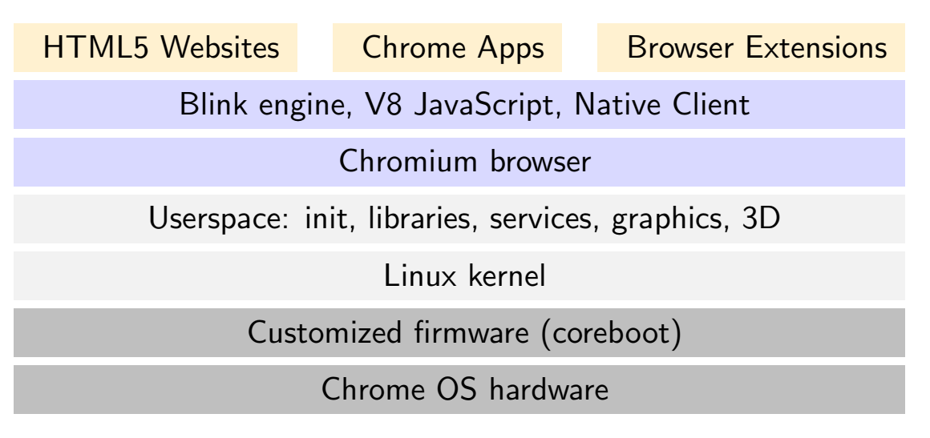
Overview Architecture
Notes:
Python Generic Usage:
print(help('modules')): List all registed modules;
help('moduleName'): Print out detail exposed classes and methods defined in the specified 'moduleName', ex. help('numpy')
help('moduleName.funcName | className'): Print out detail help message of specified defined class or defined func inside module moduleName. ex. help('numpy.isDigital'), help('numpy.DataSource.open')
Reference:
https://zhuanlan.zhihu.com/p/29184240

Slide 106
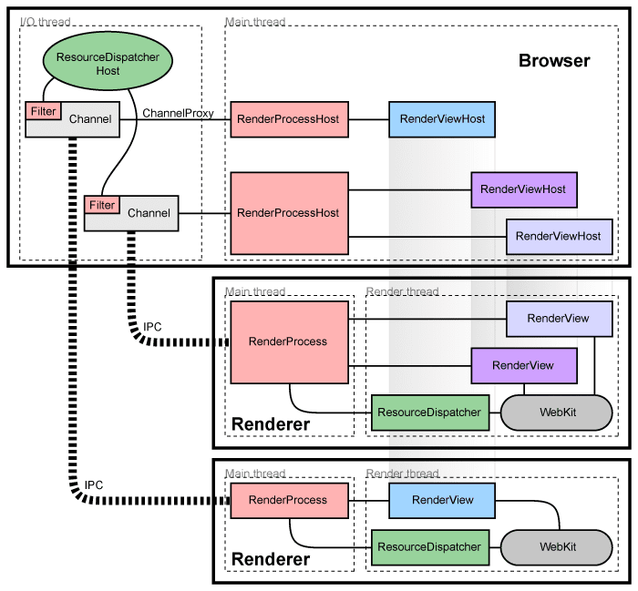
Architecture - Overview
Concepts
“browser process/browser”: Refer to the main process that runs the UI and manages tab and plugin processes.
“render process/renderer”: The tab-specific processes. The renderers use the Blink open-source layout engine for interpreting and laying out HTML.
Managing render processes
Each render process has a global RenderProcess object that manages communication with the parent browser process and maintains global state. The browser maintains a corresponding RenderProcessHost for each RenderProcess instance with the following IPC mechansiam:
IPC in Browser & Renderer: Named pipeline, i.e. socketpair() in Linux
Managing views
RenderView objects belonging to a specific RenderProcess, which correspond to tabs of content, managed by the RenderProcess. Each view (RenderView instance) is given a view ID that is used to differentiate multiple views in the same renderer (RenderProcess instance).
Notes:
Mus Window System: http://frederic-wang.fr/mus-window-system.html

Slide 107
Architecture - Components and Interfaces
In the render process:
The RenderProcess handles IPC with the corresponding RenderProcessHost in the browser. There is exactly one RenderProcess object per render process. This is how all browser ↔ renderer communication happens.
The RenderView object communicates with its corresponding RenderViewHost in the browser process (via the RenderProcess), and our WebKit embedding layer. This object represents the contents of one web page in a tab or popup window
In the browser process:
The Browser object represents a top-level browser window.
The RenderProcessHost object represents the browser side of a single browser ↔ renderer IPC connection. There is one RenderProcessHost in the browser process for each render process.
The RenderViewHost object encapsulates communication with the remote RenderView, and RenderWidgetHost handles the input and painting for RenderWidget in the browser.
Notes:
Inter-process Communication (IPC): https://www.chromium.org/developers/design-documents/inter-process-communication

Slide 108
Architecture - Process Model
Chromium supports four different models that affect how the browser allocates pages into renderer processes.
Process-per-site-instance: Chromium uses a separate OS process for each instance of a web site the user visits;
Process-per-site: One process for all instances of a web site;
Process-per-tab: One process for each group of connected tabs;
Single process: Everything in a single process.
These models differ in whether they reflect the origin of the content, the relationships between tabs, or both.
Sandboxes and Plug-ins
Chromium's renderer processes are executed within a sandboxed process that has limited access to the user's computer, they gain access to permitted resources only through the browser process, which can impose security policies on this access.
Browser plug-ins, such as Flash and Silverlight, are also executed in their own processes, and some plug-ins like Flash even run within Chromium's sandbox.
Notes:
Reference:
Process Models: https://www.chromium.org/developers/design-documents/process-models
Sandboxing Chrome OS system services: https://dev.chromium.org/chromium-os/developer-guide/chromium-os-sandboxing

Slide 109
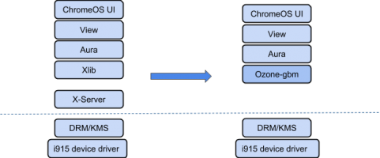
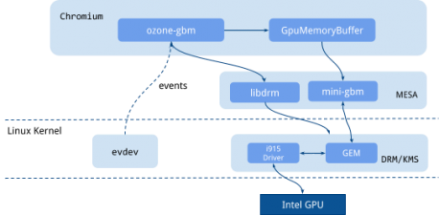
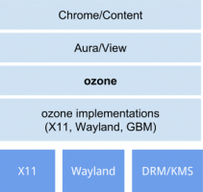
Chromium OS Graphics Stack
Ozone-gbm
Ozone-gbm is one of the Ozone backends that allows ChromeOS to interact directly with DRM/KMS and evdev to remove the X11 dependency.
mini-gbm is a library of user-level APIs used to allocate a buffer directly to the GPU memory accessible by a rendering process. It is easier to enable Intel graphics features such as texture zero-copy, hardware overlay, and video decoding via ozone-gbm. Chrome OS also uses the mode-setting to change the display mode and align events from evdev and painting with vsync signal generated by GPU.
Notes:
Reference:
https://01.org/blogs/joone/2018/using-chrome-os-graphics-stack-intel-based-linux-desktops

Slide 110
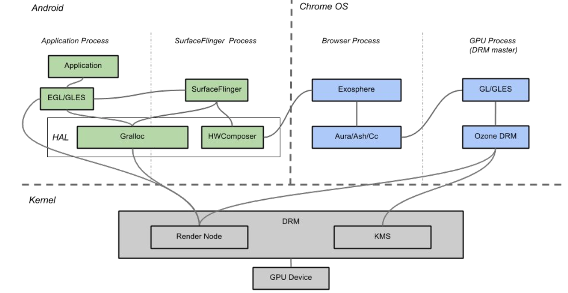
Arc++ Graphics Overview

Slide 111
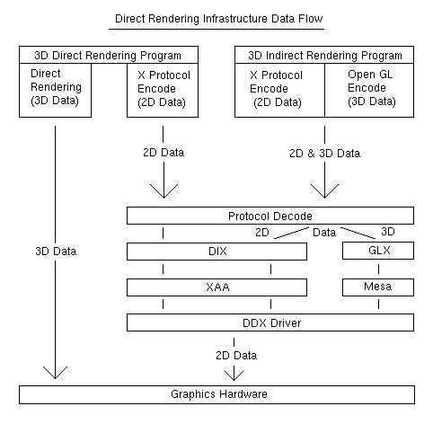
Linux X-Windows System Architecture
3D operation can be divided into two groups:
* 3D client apps communicate through the X server using an OpenGL protocol library such as libglx; this is called "3D Indirect Rendering".
* Bypass the X server entirely and communicate with the graphics hardware directly to gain extra performance; this is called "3D Direct Rendering" and uses the Direct Rendering Infrastructure (DRI).
The X server itself is composed of a "core", "extension modules", and hardware-specific "drivers".
Extension modules add various technologies such as graphics acceleration, video acceleration, font support, compositing, screen resizing, and so forth.
Video and input device drivers contain logic for translating between general X operations and the specific register-level operations particular to the given piece of hardware.
"the video driver", actually for a given video card there are three different kinds of drivers.
Notes:
Reference:
https://wiki.ubuntu.com/X/Architecture
2D DDX driver: The 2D video "Device Dependent X" (DDX) driver is what most ordinary 2D client applications use. It handles selecting the video mode and resolution, provides 2d and video acceleration, and does the initial setup for DRI. Ex. xserver-xorg-video-radeon.
DRI driver: The "Direct Rendering Infrastructure" (DRI) driver is responsible for programming the 3D hardware. Usually DRI drivers use the Mesa state machine. In the DRI, the GLX client-side library loads a DRI driver, named radeon_dri.so.
Kernel DRM driver: The "Direct Rendering Manager" is the kernel-side component of the DRI that allows applications direct access to the graphics hardware. The DRM is responsible for security and handling resource contention. Ex. radeon.ko
Input devices communicate with the X server via the XInput protocol. The Linux kernel provides a generic Linux input driver called evdev. There is a corresponding X driver called xserver-xorg-input-evdev which interfaces with this kernel driver.

Slide 112
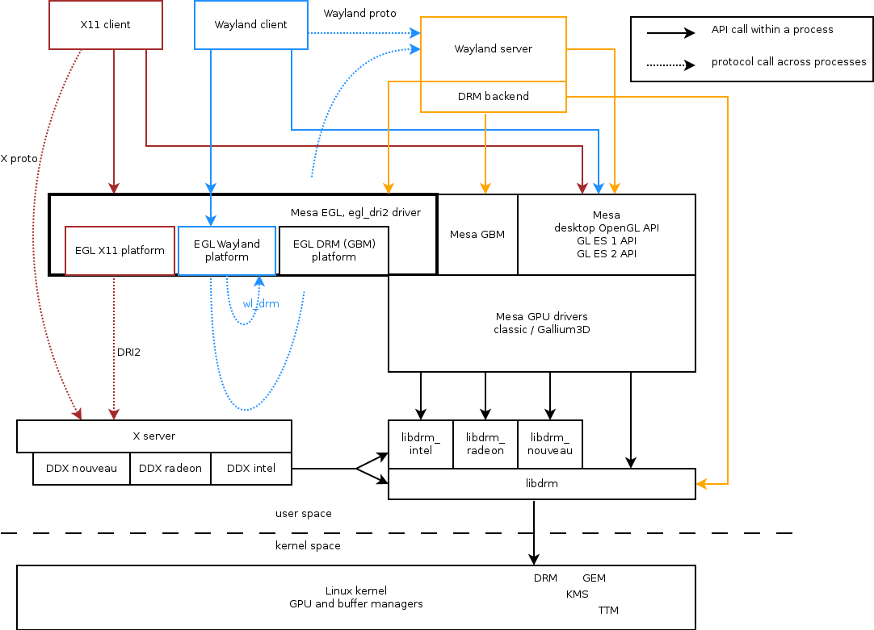
Notes:
https://ppaalanen.blogspot.com/2012/03/what-does-egl-do-in-wayland-stack.html
https://en.wikipedia.org/wiki/Mesa_(computer_graphics)
http://betteros.org/tut/graphics1.php
http://blog.mecheye.net/2012/06/the-linux-graphics-stack/
https://news.ycombinator.com/item?id=15133956
https://technodocbox.com/Windows/73413989-Graphics-stack-update.html

Slide 113
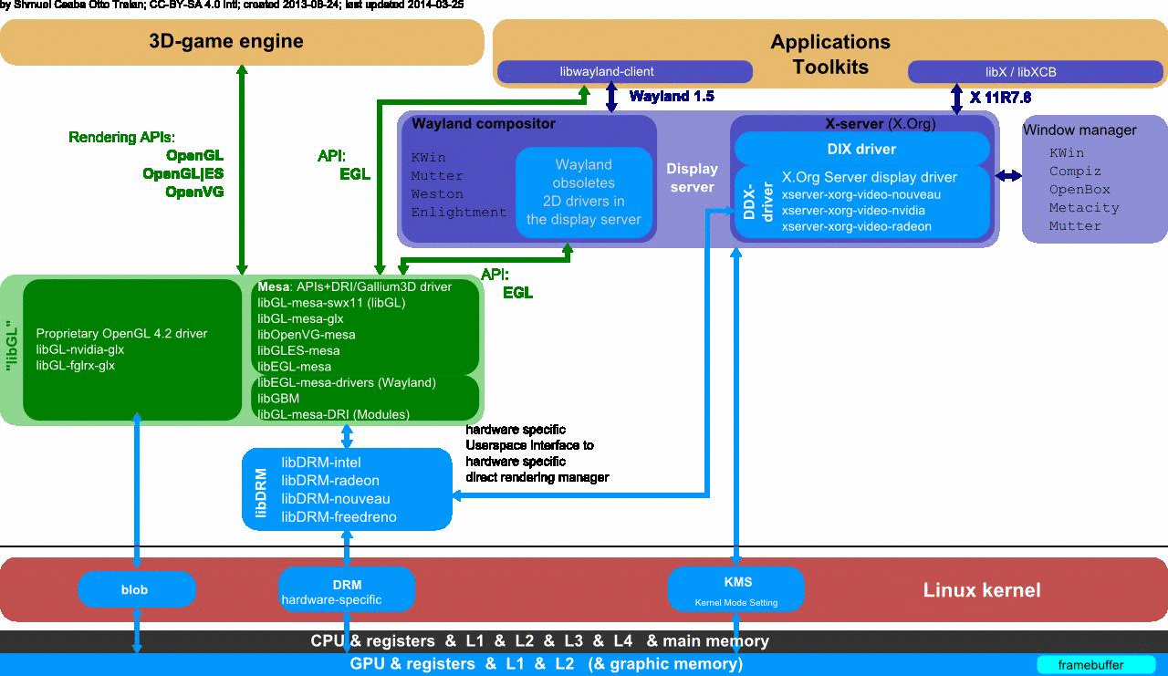
Notes:
https://en.wikipedia.org/wiki/Direct_Rendering_Infrastructure

Slide 114
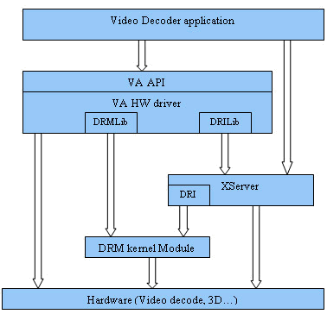
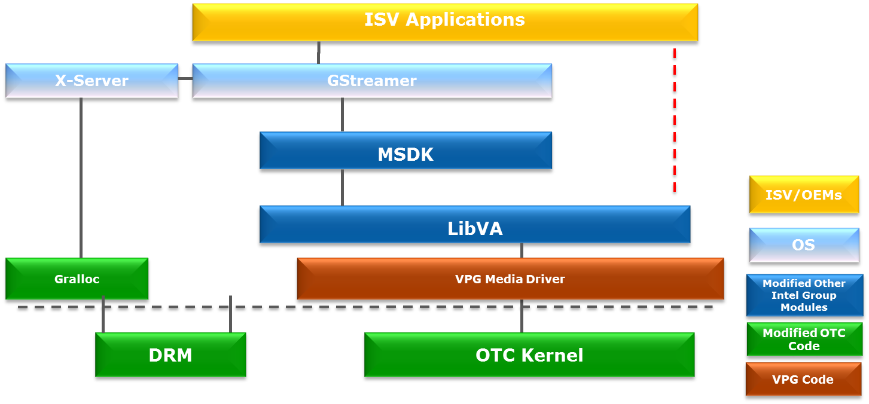
Linux Video Display Stack

Slide 116
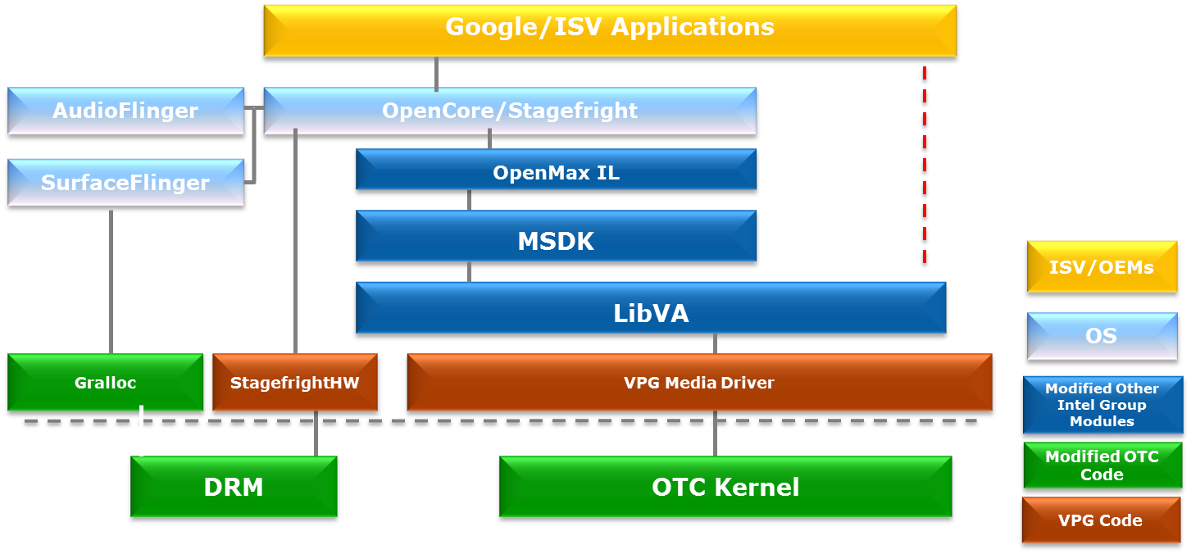
Intel Android Media Driver Stack
The user mode VPG Media Driver consists of the Android/Linux DDI layer (for LibVA) and UMHAL layer which is VPG shared code between all operating systems.

Slide 117
Linux Gfx Stack Overview
Selecting the output-device, resolution, and scan-out buffers is called “modesetting”.
Modern GPUs support two completely different instruction-sets: (a) the “command stream” used for configuring the card, and initiating rendering, and (b) the SIMD “compute stream” used for calculating pixel values.
Modern DRM-based kernel graphics drivers provide access to the GEM/TTM modules that allow user-space programs to allocate and access the buffers mentioned above: for “window backing buffers”, vertex graphs, textures, shader programs, and configuration commands.
Use case under X11 env: Start an X server instance, and a “window manager” application which connects to the X server as a client. The user can then interact with the window manager to launch further graphical applications.
Notes:
https://github.com/ds-hwang/wiki/wiki/KMS-atomic-mode-setting-and-nuclear-page-flip-as-well-as-linux-graphics
http://moi.vonos.net/linux/graphics-stack/

Slide 118
ALSA System on Chip (ASoC) 架构
ALSA System on Chip (ASoC) 架构
machine driver: 负责把platform及codec串起来，做这样区分最大的目的是可以让写platform driver及codec driver只负责platform或codec相关的部分;
codec driver: 负责处理与codec相关的行为;
platform driver: 负责SoC端的行为;
目的: 一个machine driver把对应的platform driver及codec driver串起来就能针对这台平板的各种硬体设定做客制化且正确的设定，platform driver跟codec driver不需要根据不同的产品而做修改，也就是IC厂商只要针对一颗IC写一个driver ，而此driver可以应用在各式各样不同的产品，不同的CPU/Codec也可以做任意搭配。
Notes:
Reference:
https://help.ubuntu.com/community/InstallingANewHardDrive
http://bardliao.pixnet.net/blog/post/43389318-linux-alsa-soc-codec-driver
DPCM: https://www.kernel.org/doc/html/v4.11/sound/soc/dpcm.html

Slide 119
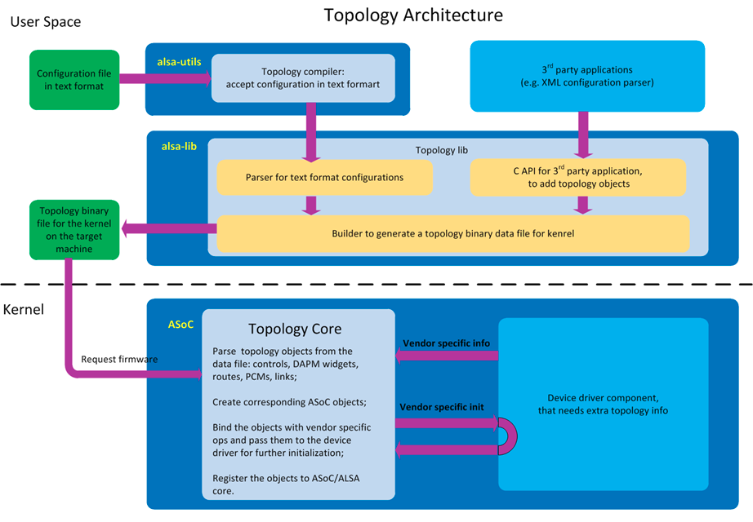
ALSA Topology
ALSA Topology provides a method for audio drivers to load their mixers, routing, PCMs and capabilities from user space at runtime without changing any driver source code. The intention is to write the driver once and do the differentiation in topology.
Topology Objects: The topology objects that can be configured by user space include: controls, widgets, routes, PCMs and configurations for physical DAI & DAI links.
Notes:
Reference:
https://www.alsa-project.org/main/index.php/ALSA_topology

Slide 120
ALSA Codec Driver - 1/10
rt5640_dapm_widgets[]，我们可以说DAPM是整个codec driver的核心，而rt5640_dapm_widgets及rt5640_dapm_routes则组成了DAPM的骨架，甚至可以说codec driver基本上是绕着rt5640_dapm_widgets在运转的，rt5665_dapm_widgets将rt5640 codec所有的元件注册给DAPM，而rt5640_dapm_routes则说明了这些元件之间彼此的连接关系，我们可以说这两个架构将rt5640的内部构造画成了一张地图给音效驱动中的电源管理员，也就是DAPM参考，DAPM将根据这张地图决定那些电源必须被开启，其他没用到的电源必须保持关闭，上层应用程式可以根据需求决定哪些路要开放，而DAPM则负责控制电源；
rt5640_dapm_widgets是由一堆SND_SOC_DAPM_XXX所建构出来的，这些SND_SOC_DAPM_XXX代表的是元件的种类，不同种类的元件都有它的功能，，大部分都能從他的名字看出來他負責的功能，例如_SUPPLY负责供电，_PGA是一个没有开关的连接器等，其中_INPUT，_OUTPUT，_AIF_IN，_AIF_OUT可以当作起点或终点，_MIXER，_MUX，_SWITCH则会影响路径的开放与否，这些元件注册的类别还会影响到DAPM上电的顺序，我们可以从rt5665_dapm_routes更了解这些不同类型的元件的用途，关于SND_SOC_DAPM_XXX的内容可以参考: include/sound/soc-dapm.h。

Slide 121
ALSA Codec Driver - 2/10
rt5640_dapm_routes基本上就是个路网，看的方式很简单，就是
{终点, 开关, 起点}, 随便举个例:
{"OUT MIXL", "DAC L1 Switch", "DAC L1"}, 代表的就是"DAC L1"这个元件透过"DAC L1 Switch"这个开关跟"OUT MIXL"连接，方向是"DAC L1" -> "OUT MIXL"，而中间的"DAC L1 Switch"，DAPM会帮忙建立一个叫做"OUT MIXL DAC L1 Switch"的alsa控制项，使用者可以透过这个控制项打开或关闭这个开关。
命名方式，如果终点的类型是MIXER或SWITCH的话就是终点+开关组合成控制项的名字，我们可以把终点跟开关中间的", "用一个空格取代，就变成了这个控制项名字
如果终点的类型是_MUX的话，命名方式则终点本身就会是一个控制项的名字，中间的开关则是这个控制项的选项之一，例如
{"Stereo ADC L2 Mux", "DMIC1", "DMIC L1"}的控制项为"Stereo ADC L2 Mux"。

Slide 122
ALSA Codec Driver - 3/10
rt5640是使用i2c控制的IC，所以我們註冊一個i2c driver
static struct i2c_driver rt5640_i2c_driver = {
.driver = {
.name = "rt5640",
.acpi_match_table = ACPI_PTR(rt5640_acpi_match),
.of_match_table = of_match_ptr(rt5640_of_match),
},
.probe = rt5640_i2c_probe,
.remove = rt5640_i2c_remove,
.id_table = rt5640_i2c_id,
};
rt5640_i2c_probe看做是对rt5640做初始化的第一个步骤，我们先初始化regmap，建立系统设定rt5640暂存器(register)的介面，然后根据platfrom data的资讯将一些跟客制化的设定写进rt5640，最后，也是最重要的一个步骤，呼叫snd_soc_register_codec，将rt5640注册成一个ALSA架构下的codec driver。
regmap提供了一个API让驱动程式可以读写I2C/SPI等控制介面，并且做了cache可以有效降低透过I/O介面实际存取codec的次数，除了volatile暂存器之外，codec driver在读其他的暂存器的内容时​​都只读cache，这样做可以加快驱动执行的速度。
Notes:
Reference:
Remap Knowledge : http://elinux.org/images/a/a3/Regmap-_The_Power_of_Subsystems_and_Abstractions.pdf

Slide 123
ALSA Codec Driver - 4/10
static const struct regmap_config rt5640_regmap = {
.reg_bits = 8,
.val_bits = 16, // 表示rt5640的暫存器使用8位元地址，有16位元的值，例如0x00暫存器的值為0x0004
.use_single_rw = true, // 表示rt5640一個i2c命令只能讀寫一個暫存器
.max_register = RT5640_VENDOR_ID2 + 1 + (ARRAY_SIZE(rt5640_ranges) * RT5640_PR_SPACING), // 表示rt5640最大的暫存器的地址
.volatile_reg = rt5640_volatile_register, // return true即代表這個暫存器是屬於volatile暫存器，
// volatile暫存器指的是內容隨時會改變的暫存器，codec driver在讀volatile暫存器時會實際透過I/O介面去讀，而不會去讀cache的值
.readable_reg = rt5640_readable_register, // 只有rt5640_readable_register return true的暫存器是可讀的，dump暫存器時只會顯示可讀的暫存器
.cache_type = REGCACHE_RBTREE, // regmap使用的cache type
.reg_defaults = rt5640_reg, // rt5640_reg的內容即為rt5640 codec driver使用的regmap的cache的初始內容
.num_reg_defaults = ARRAY_SIZE(rt5640_reg),
.ranges = rt5640_ranges, // 這個是第二層的暫存器，也就是透過兩個暫存器分別代表第二層暫存器的地址跟值的方式存取的暫存器
.num_ranges = ARRAY_SIZE(rt5640_ranges),
};
Notes:
http://elinux.org/images/a/a3/Regmap-_The_Power_of_Subsystems_and_Abstractions.pdf

Slide 124
ALSA Codec Driver - 5/10
static struct snd_soc_codec_driver soc_codec_dev_rt5640 = {
.probe = rt5640_probe,
.remove = rt5640_remove,
.suspend = rt5640_suspend,
.resume = rt5640_resume,
.set_bias_level = rt5640_set_bias_level,
.idle_bias_off = true,
.component_driver = {
.controls = rt5640_snd_controls,
.num_controls = ARRAY_SIZE(rt5640_snd_controls),
.dapm_widgets = rt5640_dapm_widgets,
.num_dapm_widgets = ARRAY_SIZE(rt5640_dapm_widgets),
.dapm_routes = rt5640_dapm_routes,
.num_dapm_routes = ARRAY_SIZE(rt5640_dapm_routes),
},
};
rt5640_dapm_widgets及rt5640_dapm_routes就是在这里注册到ALSA的。
machine driver利用dai link把platfrom driver跟codec driver串起来，声卡注册成功之后rt5640_probe就会被执行，也就是说rt5640_probe是声卡注册成功之后第一个被执行的codec driver函数，
rt5640_snd_controls也会建立ALSA控制项让上层使用，他跟rt5640_dapm_widgets建立出来的控制项不同的地方在于rt5640_snd_controls的控制项不会影响route的状态，通常是拿来设定音量或是简单的mute/unmute用。
rt5640_set_bias_level则可以让codec driver根据codec整体的power level设置暂存器，ASOC的bias level总共有四层，定义如下:
enum snd_soc_bias_level {
SND_SOC_BIAS_OFF = 0,
SND_SOC_BIAS_STANDBY = 1,
SND_SOC_BIAS_PREPARE = 2,
SND_SOC_BIAS_ON = 3,
};
从OFF到ON的顺序为: OFF -> PREPARE -> ON
从ON到OFF的顺序为: ON -> PREPARE -> STANDBY -> OFF
rt5640_suspend跟rt5640_resume顾名思义就是codec进入suspend/resume会执行的函数。

Slide 125
ALSA Codec Driver - 6/10
呼叫snd_soc_register_codec的时候除了soc_codec_dev_rt5640之外还有一个很重要的参数就是rt5640_dai，rt5640_dai定义了rt5640的I2S介面的一些资讯，
.name = "rt5640-aif1", 表示这个dai的名字，将被使用在machine driver dai link的codec_name中，
.id = RT5640_AIF1, 用来分辨rt5640的不同dai，
.stream_name 用在rt5640_dapm_widgets，将DAI跟dapm的地图做一个连接，
.channels_min .channels_max 顾名思义为这个DAI所支援的最大及最小声道数，
.rates 为这个DAI能支援的sample rate (采样率)
.formats为这个DAI能支援的格式, 当使用者在使用这个DAI播放或录音的时候ALSA将会判断此codec能不能支援
.ops = &rt5640_aif_dai_ops,就是使用这组DAI时codec相对应的设定了
{
.name = "rt5640-aif1",
.id = RT5640_AIF1,
.playback = {
.stream_name = "AIF1 Playback",
.channels_min = 1,
.channels_max = 2,
.rates = RT5640_STEREO_RATES,
.formats = RT5640_FORMATS,
},
.capture = {
.stream_name = "AIF1 Capture",
.channels_min = 1,
.channels_max = 2,
.rates = RT5640_STEREO_RATES,
.formats = RT5640_FORMATS,
},
.ops = &rt5640_aif_dai_ops,
},

Slide 126
ALSA Codec Driver - 7/10
.ops = &rt5640_aif_dai_ops,就是使用这组DAI时codec相对应的设定了，
static const struct snd_soc_dai_ops rt5640_aif_dai_ops = {
.hw_params = rt5640_hw_params,
.set_fmt = rt5640_set_dai_fmt,
.set_sysclk = rt5640_set_dai_sysclk,
.set_pll = rt5640_set_dai_pll,
};
rt5640_hw_params主要是根据上层传下来的资讯(*params)对codec做相对应的设定，
rt5640_set_dai_fmt会按照此DAI的格式(如I2S, PCM...等)设定codec，
rt5640_set_dai_sysclk将告知codec driver sysclk的频率及来源，
rt5640_set_dai_pll提供介面让machine driver设定rt5640的PLL，有时候外部的MCLK频率无法符合rt5640需求的时候需要呼叫此函数使用rt5640的PLL，
以上三个函数的功能都是让machine driver将这些资讯通知codec driver用的，对应的函数分别是，snd_soc_dai_set_fmt, snd_soc_dai_set_sysclk, snd_soc_dai_set_pll

Slide 127
ALSA Codec Driver - 8/10
Usecase Description: 要开始播放/录音的时候上面这些rt5640_aif_dai_ops 内函数会先被执行，将这个DAI的参数设定好，然后DAPM就要开始上电了，前面提到DAPM上电的顺序跟rt5640_dapm_widgets内元件注册的类别有关，这个顺序就定义在soc-dapm.c的dapm_up_seq dapm_down_seq。
注册DAPM元件除了类别外还有一些重要的东西，以MIXER来说明，其他类别的元件也都差不多，就不重复介绍了，
SND_SOC_DAPM_MIXER("SPK MIXL", RT5640_PWR_MIXER, RT5640_PWR_SM_L_BIT, 0, rt5640_spk_l_mix, ARRAY_SIZE(rt5640_spk_l_mix)),
SND_SOC_DAPM_MIXER代表这是个MIXER类别的元件，"SPK MIXL"是这个元件的名字，"SPK MIXL"元件的电源开关是在RT5640_PWR_MIXER暂存器的RT5640_PWR_SM_L_BIT位元做控制rt5640_spk_l_mix则定义"SPK MIXL"在audio route上的开关，rt5640_spo_l_mix内的每个项目都是一个独立的开关，DAPM藉由这些开关决定这条通路的开关状态，并决定这条路径需不需要上电，codec driver只需要把正确的资讯向DAPM注册即可。

Slide 128
ALSA Codec Driver - 9/10
註冊DAPM元件除了類別外還有一些重要的東西，以MIXER來說明，其他類別的元件也都差不多，就不重複。
SND_SOC_DAPM_MIXER("SPK MIXL", RT5640_PWR_MIXER, RT5640_PWR_SM_L_BIT, 0, rt5640_spk_l_mix, ARRAY_SIZE(rt5640_spk_l_mix)),
SND_SOC_DAPM_MIXER代表这是个MIXER类别的元件，"SPK MIXL"是这个元件的名字，"SPK MIXL"元件的电源开关是在RT5640_PWR_MIXER暂存器的RT5640_PWR_SM_L_BIT位元做控制rt5640_spk_l_mix则定义"SPK MIXL"在audio route上的开关，rt5640_spo_l_mix内的每个项目都是一个独立的开关，DAPM藉由这些开关决定这条通路的开关状态，并决定这条路径需不需要上电，codec driver只需要把正确的资讯向DAPM注册即可。
有些元件有註冊event (例如rt5640_lout_event) 註冊event的時候必須同時註冊他觸發的時間點，
DAPM定義了以下幾種時間點，
/* dapm event types */
#define SND_SOC_DAPM_PRE_PMU 0x1 /* before widget power up */
#define SND_SOC_DAPM_POST_PMU 0x2 /* after widget power up */
#define SND_SOC_DAPM_PRE_PMD 0x4 /* before widget power down */
被註冊的event會在相對應的時間點被執行，如果我們希望在開關某個元件的時候須要做一些比較複雜的控制的話就會註冊event來處理。

Slide 129
ALSA Codec Driver - 10/10
rt5640_snd_controls[]内的注册的内容会形成ALSA control让上层使用，以"Speaker Playback Volume"为例
SOC_DOUBLE_TLV("Speaker Playback Volume", RT5640_SPK_VOL, RT5640_L_VOL_SFT, RT5640_R_VOL_SFT, 39, 1, out_vol_tlv),
"Speaker Playback Volume"是这个control的名字，RT5640_SPK_VOL是控制"Speaker Playback Volume"暂存器的位址，因为"Speaker Playback Volume"是一个DOUBLE的control，所以分别有左右声道的控制起始位元，分别为RT5640_L_VOL_SFT及RT5640_R_VOL_SFT，39代表"Speaker Playback Volume"的最大值，后面的1代表反向，也就是暂存器的值越大音量越小，out_vol_tlv则是显示给使用者看的内容。
static const DECLARE_TLV_DB_SCALE(out_vol_tlv, -4650, 150, 0);
这代表最小值是-46.5dB，每调一格增加1.5dB，最后的0表示"Speaker Playback Volume"设为0时不是mute。

Slide 130
ALSA DAI Link
static const struct snd_soc_pcm_stream dsp_codec_params = {
.formats = SNDRV_PCM_FMTBIT_S24_LE,
.rate_min = 48000,
.rate_max = 48000,
.channels_min = 2,
.channels_max = 2,
};
{
.name = "DSP-CODEC",
.stream_name = "DSP-CODEC",
.cpu_dai_name = "wm0010-sdi2",
.codec_name = "codec-3,
.codec_dai_name = "codec-3-dai_name",
.dai_fmt = SND_SOC_DAIFMT_I2S | SND_SOC_DAIFMT_NB_NF
| SND_SOC_DAIFMT_CBM_CFM,
.ignore_suspend = 1,
.params = &dsp_codec_params,
},
传统上DAI (digital audio interface) link是由CPU + codec所组成，但现在越来越多由codec + codec所组成的DAI link，以CPU -> codec -> smart amp的例子而言，CPU -> codec 这段在上层呼叫pcm open的时候会被打通，codec内部从CPU -> codec到codec -> smart amp之间的路径可以透过alsa control打通，所以剩下codec -> smart amp的部分需要另外处理，用其他方式将codec -> smart amp打通以便触发这个codec to codec dai link的event。最简单的做法就是将codec -> smart amp的后面再串一个DAPM的终点。最簡單的做法就是將codec -> smart amp的後面再串一個DAPM的終點，
在machine driver定義的
SND_SOC_DAPM_MIC
SND_SOC_DAPM_HP
SND_SOC_DAPM_SPK
...
等DAPM元件都是DAPM終點，所以我們可以參考下面的做法
static const struct snd_soc_dapm_widget dapm_widgets[] = {
SND_SOC_DAPM_SPK("Speaker", NULL),
SND_SOC_DAPM_MIC("Mic", NULL),
};
static const struct snd_soc_dapm_route dapm_routes[] = {
{"Speaker", NULL "Your Codec Stream Playback Name"},
{"Your Codec Stream Capture Name", NULL "Mic"},
}; // 将codec -> smart amp的终点建立起来。

Slide 131
Using the NMI Watchdog in Linux - 1
Introduction
To debug on system lockup issues, it is required to enable lockup detector features in Linux kernel for further debugging.
With the help of using lockup detector in Linux kernel, 2 types of lockup can be detected.
Soft Lockup
Softlockups are bugs that cause the kernel to loop in kernel
mode for more than 20 seconds, without giving other tasks a
chance to run. The current stack trace is displayed upon
detection and the system will stay locked up.
Hard Lockup
Hardlockups are bugs that cause the CPU to loop in kernel mode
for more than 10 seconds, without letting other interrupts have a
chance to run. The current stack trace is displayed upon detection
and the system will stay locked up.
For more information, please refer to http://lxr.free-electrons.com/source/Documentation/lockup-watchdogs.txt?v=4.1
Kernel settings
Enabling Lockup detector can be done by adding extra feature in defconfig.
The following features are enabled to test on both MRB and Customer device (LGE HKMC).
defconfig (XXX_x86_64_YYY_defconfig)
CONFIG_LOCKUP_DETECTOR=y
CONFIG_HARDLOCKUP_DETECTOR=y
CONFIG_BOOTPARAM_HARDLOCKUP_PANIC=y
CONFIG_BOOTPARAM_HARDLOCKUP_PANIC_VALUE=1
CONFIG_BOOTPARAM_SOFTLOCKUP_PANIC=y
CONFIG_BOOTPARAM_SOFTLOCKUP_PANIC_VALUE=1
Kernel command-line (optional)
nmi_watchdog=1
Notes:
Reference:
https://thesofproject.github.io/latest/introduction/index.html

Slide 132
Using the NMI Watchdog in Linux - 2
Tips
When lockup is detected by kernel, it will print single call stack which is detected by kernel. But in real world, backtrace for ALL CPU are very helpful to debug deadlock issue.
It is good if customer has enabled KGDB/KDB, KEXEC/KDUMP or Ramdump, but as these kinds of features are limited, need to modify panic() function to get backtrace for all CPU.
all_cpu_backtrace.patch
==================
diff --git a/kernel/panic.c b/kernel/panic.c
index a4f7820..1e77aed 100644
--- a/kernel/panic.c
+++ b/kernel/panic.c
@@ -126,7 +126,11 @@ void panic(const char *fmt, ...)
* unfortunately means it may not be hardened to work in a panic
* situation.
*/
+#if 0
smp_send_stop();
+#else
+ trigger_all_cpu_backtrace();
+#endif
/*
* Run any panic handlers, including those that might need to
Example:
-------------
[ 4714.318870] sched: RT throttling activated
[ 4717.152450] Kernel panic - not syncing: Watchdog detected hard LOCKUP on cpu 2
[ 4717.160535] CPU: 2 PID: 2489 Comm: iAP2Service-2.0 Tainted: P U WC O 4.1.27-abl #1
...
[ 4717.194722] Call Trace:
[ 4717.197452] <NMI> [<ffffffff814cb70e>] dump_stack+0x4d/0x63
[ 4717.203891] [<ffffffff814ca97f>] panic+0xc8/0x201
...
[ 4717.302803] [<ffffffff814cf998>] ? _raw_spin_lock_irqsave+0x2e/0x36
[ 4717.309904] <<EOE>> [<ffffffffa02016c2>] dwc3_gadget_ep_queue+0x2e/0x2a3 [dwc3]
[ 4717.318295] [<ffffffffa017fbec>] giap2_start_rx+0xb1/0x13b [u_iap2]
...
[ 4717.438325] sending NMI to all CPUs:
[ 4727.443031] NMI backtrace for cpu 0
[ 4727.446930] CPU: 0 PID: 3583 Comm: irq/13-dwc3 Tainted: P U WC O 4.1.27-abl #1
...
Notes:
Reference:
https://thesofproject.github.io/latest/introduction/index.html

Slide 133
Using the NMI Watchdog in Linux - 3
Lock detector found out the following analysis.
CPU0 is already deadlock by itself while CPU2 also was trying to acquire the same lock.
In this case, CPU0 root caused this issue and CPU2 is kind of victim of that deadlock on CPU0.
dwc3 thread interrupt handler disabled interrupt and get the spinlock
Somehow (in this case, customer issue) interrupt enabled middle of processing
Unfortunately, dwc3 interrupt triggered on same CPU
dwc3 interrupt trying to get the SAME spinlock - which caused deadlock
CPU2 joined deadlock - Even though CPU2 is victim, lockup detector found out the CPU2 first
Do not rely on only the messages from Lockup detector log,but always try to understand entire system.
Update to validate a working of NMI watchdog.
Build external kernel module to work NMI watchdog if deadlock happens.
Makefile
======
obj-m += panic.o
PWD := $(shell pwd)
all:
$(MAKE) -C $(KDIR) SUBDIRS=$(PWD) modules
$(STRIP) --strip-debug panic.ko
#$(KDIR)/scripts/sign-file "sha512" $(KDIR)/certs/signing_key.pem $(KDIR)/certs/signing_key.x509 panic.ko
clean:
@rm -rf *.mod.*
@rm -rf .*.cmd
@rm -rf Module*.*
@rm -rf module*.*
@rm -rf *.o
@rm -rf *.ko
@rm -rf .tmp_versions
Notes:
Reference:
https://thesofproject.github.io/latest/introduction/index.html

Slide 134
Using the NMI Watchdog in Linux - 4
#include <linux/module.h>
#include <linux/cpu.h>
#include <linux/kthread.h>
#include <linux/delay.h>
#include <linux/kernel_stat.h>
struct panic_thread
{
char *name;
struct task_struct *task;
spinlock_t lock;
} panic_threads[4] = {
{ .name = "Panic/0", .task = NULL, .lock = __SPIN_LOCK_UNLOCKED(&panic_threads[0].lock), },
{ .name = "Panic/1", .task = NULL, .lock = __SPIN_LOCK_UNLOCKED(&panic_threads[1].lock), },
{ .name = "Panic/2", .task = NULL, .lock = __SPIN_LOCK_UNLOCKED(&panic_threads[2].lock), },
{ .name = "Panic/3", .task = NULL, .lock = __SPIN_LOCK_UNLOCKED(&panic_threads[3].lock), },
};
static void panic_print_nmi(void)
{
unsigned int cpu;
int total_nmi = 0;
for_each_present_cpu(cpu)
total_nmi += (&per_cpu(irq_stat, cpu))->__nmi_count;
pr_err("Total NMI: %d\n", total_nmi);
}
static int panic_test_thread(void *data)
{
struct panic_thread *info = (struct panic_thread *)data;
pr_info("IRQ Lock on [%s]\n", info->name);
spin_lock_irq(&info->lock);
while (!kthread_should_stop())
{
// msleep(1000);
// pr_info("Panic thread ping [%s]\n", info->name);
}
pr_info("Stop panic test thread\n");
info->task = NULL;
do_exit(1);
return 0;
}
/* WARM reset hook */
static int panic_test_hook_panic_notifier_call(struct notifier_block *notifier,
unsigned long what, void *data)
{
(void) notifier;
(void) what;
(void) data;
panic_print_nmi();
return NOTIFY_DONE;
}
static struct notifier_block panic_test_hook_panic_notifier = {
.notifier_call = panic_test_hook_panic_notifier_call,
};
Notes:
Reference:
https://thesofproject.github.io/latest/introduction/index.html

Slide 135
Using the NMI Watchdog in Linux - 5
static int __init panic_test_init (void)
{
struct panic_thread *info;
unsigned int cpu;
panic_print_nmi();
atomic_notifier_chain_register(&panic_notifier_list,
&panic_test_hook_panic_notifier);
for_each_present_cpu(cpu) {
if (cpu > 3)
break;
info = &panic_threads[cpu];
info->task = kthread_create(
&panic_test_thread,
info,
info->name);
if (IS_ERR(panic_threads[cpu].task))
pr_err("Unable to create thread\n");
kthread_bind(info->task, cpu);
wake_up_process(info->task);
}
pr_info("Panic test driver added\n");
return 0;
}
static void __exit panic_test_exit(void)
{
unsigned int cpu;
for_each_present_cpu(cpu) {
if (cpu > 3)
break;
if (panic_threads[cpu].task != NULL)
kthread_stop(panic_threads[cpu].task);
}
pr_info("Panic test driver removed\n");
}
module_init(panic_test_init);
module_exit(panic_test_exit);
MODULE_DESCRIPTION("A simple kernel panic test module");
MODULE_AUTHOR("Kyungmin Seo <kyungmin.seo@intel.com>");
MODULE_LICENSE("GPL");
Notes:
Reference:
https://thesofproject.github.io/latest/introduction/index.html

Slide 136
Using the NMI Watchdog in Linux - 6
Build script
========
#!/bin/bash
# Toolchain
source /opt/poky/oecore-x86_64/environment-setup-corei7-64-poky-linux
unset CC
export CC="x86_64-poky-linux-gcc -fuse-ld=bfd LD=x86_64-poky-linux-ld.bfd"
# global values for Kernel build
export ARCH=x86_64
export CROSS_COMPILE="x86_64-poky-linux-"
export KDIR=/home/user/yocto/ec18/kernel/out/kernel_obj
set -e
make clean
make
set +e
Insert module to make deadlock.
$ insmod panic.ko
Check if NMI watchdog happens as you expected.
[24540.751653] NMI watchdog: Watchdog detected hard LOCKUP on cpu 1
[24540.759003] Kernel panic - not syncing: Hard LOCKUP
[24540.763879] CPU: 1 PID: 27619 Comm: Panic/1 Tainted: G U W O 4.4.19-quilt-2e5dc0ac-g4a0eaa5-dirty #3
[24540.773785] 0000000000000000 ffff88017fc85b00 ffffffff8138e8c5 ffffffff81f957ba
[24540.781227] ffff88017fc85b90 ffff88017fc85b80 ffffffff81177b7d 0000000000000008
[24540.788666] ffff88017fc85b90 ffff88017fc85b28 00000000000000bc ffffffff81fb667c
[24540.796108] Call Trace:
[24540.798552] <NMI> [<ffffffff8138e8c5>] dump_stack+0x67/0x92
[24540.804308] [<ffffffff81177b7d>] panic+0xc5/0x1eb
[24540.809097] [<ffffffff811315cf>] watchdog_overflow_callback+0x14f/0x150
[24540.815794] [<ffffffff8117124c>] __perf_event_overflow+0x9c/0x1e0
[24540.821968] [<ffffffff81171da4>] perf_event_overflow+0x14/0x20
[24540.827883] [<ffffffff810208bf>] intel_pmu_handle_irq+0x1cf/0x450
[24540.834060] [<ffffffff8110ec82>] ? __module_text_address+0x12/0x60
[24540.840322] [<ffffffff811130ef>] ? is_module_text_address+0x2f/0x50
[24540.846672] [<ffffffff8139a8dc>] ? vsnprintf+0x24c/0x510
[24540.852066] [<ffffffff8100ffff>] ? __fpu__restore_sig+0x10f/0x490
[24540.858242] [<ffffffff81395537>] ? seq_buf_vprintf+0x37/0x90
[24540.863985] [<ffffffff81392fbf>] ? nmi_vprintk+0x4f/0x80
[24540.869377] [<ffffffff8144035f>] ? acpi_idle_enter_bm+0xb/0x112
[24540.875379] [<ffffffff8144035f>] ? acpi_idle_enter_bm+0xb/0x112
.....................
[24540.959685] <<EOE>> [<ffffffffa016302c>] ? panic_test_thread+0x2c/0x50 [panic]
[24540.967089] [<ffffffff810b73ad>] kthread+0xed/0x110
[24540.972051] [<ffffffff810b72c0>] ? kthread_create_on_node+0x190/0x190
[24540.978575] [<ffffffff81a570ef>] ret_from_fork+0x3f/0x70
[24540.983970] [<ffffffff810b72c0>] ? kthread_create_on_node+0x190/0x190
[24542.156125] Shutting down cpus with NMI
Notes:
Reference:
https://thesofproject.github.io/latest/introduction/index.html

Slide 137
Dynamic Set Mux Pins Function for Debug Purpose - 1
Steps:
1) Download and patch 0001-enable-pinmux-change-via-debugfs.patch
patch -p1 < 0001-enable-pinmux-change-via-debugfs.patch
2) make sure Kconfig of debugfs is enabled and rebuild kernel
3) echo <pin offset> <pin function> > /sys/kernel/debug/pinctrl/INT3452:0<group id>/pinmux-pins
replace the parameter in red to real values
For example, if need to enable MCLK2 signal output on MRB (which by default it not):
1) figure out that the GPIO_84 AVS_I2S2_MCLK belongs to group 01 and offset 48 , and PMode M1 for MCLK2 function
2) run:
echo 48 1 > /sys/kernel/debug/pinctrl/INT3452:01/pinmux-pins
Note:
1) before changing please make sure that the action will not damage your hardware.
2) the configuration will get lost after reboot (of course)

Slide 138
Dynamic Set Mux Pins Function for Debug Purpose - 2
From 97dcf658034ae9da0c1b01b20782759a64e19edd Mon Sep 17 00:00:00 2001
From: max <max@ubs>
Date: Thu, 1 Dec 2016 15:41:56 +0800
Subject: [PATCH] enable pinmux change via debugfs
---
drivers/pinctrl/intel/pinctrl-intel.c | 50 ++++++++++++++++++++++-------------
drivers/pinctrl/pinmux.c | 42 +++++++++++++++++++++++++++++
2 files changed, 74 insertions(+), 18 deletions(-)
diff --git a/drivers/pinctrl/intel/pinctrl-intel.c b/drivers/pinctrl/intel/pinctrl-intel.c
index e39302d..5ed1c29 100644
--- a/drivers/pinctrl/intel/pinctrl-intel.c
+++ b/drivers/pinctrl/intel/pinctrl-intel.c
@@ -319,36 +319,50 @@ static int intel_pinmux_set_mux(struct pinctrl_dev *pctldev, unsigned function,
unsigned group)
{
struct intel_pinctrl *pctrl = pinctrl_dev_get_drvdata(pctldev);
- const struct intel_pingroup *grp = &pctrl->soc->groups[group];
+// const struct intel_pingroup *grp = &pctrl->soc->groups[group];
+ unsigned pin = group;
unsigned long flags;
int i;
spin_lock_irqsave(&pctrl->lock, flags);
-
- /*
- * All pins in the groups needs to be accessible and writable
- * before we can enable the mux for this group.
- */
- for (i = 0; i < grp->npins; i++) {
- if (!intel_pad_usable(pctrl, grp->pins[i])) {
- spin_unlock_irqrestore(&pctrl->lock, flags);
- return -EBUSY;
- }
- }
-
- /* Now enable the mux setting for each pin in the group */
- for (i = 0; i < grp->npins; i++) {
+ do {
void __iomem *padcfg0;
u32 value;
- padcfg0 = intel_get_padcfg(pctrl, grp->pins[i], PADCFG0);
+ padcfg0 = intel_get_padcfg(pctrl, pin, PADCFG0);
value = readl(padcfg0);
+ pr_info("====> PADCFG0=%x\n", padcfg0);
value &= ~PADCFG0_PMODE_MASK;
- value |= grp->mode << PADCFG0_PMODE_SHIFT;
+ value |= function << PADCFG0_PMODE_SHIFT;
+ pr_info("<==== PADCFG0=%x\n", padcfg0);
writel(value, padcfg0);
- }
+ } while (0);
+ /*
+ * All pins in the groups needs to be accessible and writable
+ * before we can enable the mux for this group.
+ */

Slide 139
Dynamic Set Mux Pins Function for Debug Purpose - 3
+// for (i = 0; i < grp->npins; i++) {
+// if (!intel_pad_usable(pctrl, grp->pins[i])) {
+// spin_unlock_irqrestore(&pctrl->lock, flags);
+// return -EBUSY;
+// }
+// }
+
+ /* Now enable the mux setting for each pin in the group */
+// for (i = 0; i < grp->npins; i++) {
+// void __iomem *padcfg0;
+// u32 value;
+//
+// padcfg0 = intel_get_padcfg(pctrl, grp->pins[i], PADCFG0);
+// value = readl(padcfg0);
+//
+// value &= ~PADCFG0_PMODE_MASK;
+// value |= grp->mode << PADCFG0_PMODE_SHIFT;
+//
+// writel(value, padcfg0);
+// }
spin_unlock_irqrestore(&pctrl->lock, flags);
diff --git a/drivers/pinctrl/pinmux.c b/drivers/pinctrl/pinmux.c
index 29984b3..2521608 100644
--- a/drivers/pinctrl/pinmux.c
+++ b/drivers/pinctrl/pinmux.c
@@ -25,6 +25,7 @@
#include <linux/sysfs.h>
#include <linux/debugfs.h>
#include <linux/seq_file.h>
+#include <linux/uaccess.h>
#include <linux/pinctrl/machine.h>
#include <linux/pinctrl/pinmux.h>
#include "core.h"
@@ -691,9 +692,50 @@ static const struct file_operations pinmux_functions_ops = {
.release = single_release,
};
+static ssize_t pinmux_dbg_config_write(struct file *file,
+ const char __user *user_buf, size_t count, loff_t *ppos)
+{
+ struct pinctrl_maps *maps_node;
+ const struct pinctrl_map *map;
+ const struct pinctrl_map *found = NULL;
+ struct pinctrl_dev *pctldev;
+ const struct pinmux_ops *pmxops = NULL;
+
+ char buf[128];
+ char *b = &buf[0];
+ int buf_size;
+ char *token;
+ int i;
+ unsigned pin, mode;

Slide 140
Dynamic Set Mux Pins Function for Debug Purpose - 4
+
+ /* Get userspace string and assure termination */
+ buf_size = min(count, sizeof(buf) - 1);
+ if (copy_from_user(buf, user_buf, buf_size))
+ return -EFAULT;
+ buf[buf_size] = 0;
+ sscanf(buf, "%u %u", &pin, &mode);
+ pr_info("request set pin%d to mode%d\n", pin, mode);
+
+ mutex_lock(&pinctrl_maps_mutex);
+
+ pctldev = file->f_inode->i_private;
+// get_pinctrl_dev_from_devname(pctl);
+ if (pctldev)
+ pmxops = pctldev->desc->pmxops;
+
+ if (pmxops && pmxops->set_mux) {
+ pmxops->set_mux(pctldev, mode, pin);
+ }
+
+exit:
+ mutex_unlock(&pinctrl_maps_mutex);
+
+ return count;
+}
static const struct file_operations pinmux_pins_ops = {
.open = pinmux_pins_open,
.read = seq_read,
+ .write = pinmux_dbg_config_write,
.llseek = seq_lseek,
.release = single_release,
};
--
1.9.1

Slide 141



Manipulate PCI Device Registers via MMIO
PCI configuration space
PCI configuration space indicates base address registers, so we are able to read/write mmio registers in the address.
PCI configuration space from Wikipedia
To see pci configuration space, use "lspci -x" command.
Devmem2
Linux provides mmap and unmap to manipulate mmio registers in user space. devmem2 is very popular open source tool to read/write them.
Link : http://free-electrons.com/pub/mirror/devmem2.c
Cross compile to run on MRB
Easy to compile for MRB
$ source <environment file> (ex. $ source /opt/poky/oecore-x86_64/environment-setup-corei7-64-poky-linux $ $CC devmem2.c -o devmem2
Example to change USB port status and control register.
Check PCI device ID and Bus:Device:Function in EDS vol.1. xHCI controller is allocated in 00:0x15:00
Get base address register (offset is 0x10).
Base address register value is 0xb3600000.

Slide 142





Manipulate PCI Device Registers via MMIO
PORTSCx registers are defined in EDS chapter 2 like below.
Before connecting USB thumb drive to Port2.
After connecting USB thumb drive to Port2
Disable PP bit to turn off port power, so USB is disconnected.
Enable PP bit to turn on port power, so USB is re-connected.

Slide 143

MIPI-DSI 三种 Video Mode 理解
D- PHY的物理层支持HS(High Speed)和LP(Low Power)两种工作模式
HS模式：低压差分信号 功耗大 高速率（80M -1Gbps） 信号幅值（100mv-300mv）
LP模式：单端信号 功耗小，速率低（< 10Mbps) 信号幅值（0-1.2V）
在高速模式下，通道状态是差分的0或1，定义P比N高时定义为1，P比N低时定义为0，此时线上典型电压为差分200mv
在LP模式下，只用lane0传输数据和时钟，双向数据传输。
链路层的模式分为：Command模式和Video模式。
链路层选择Command模式时，物理层可以为HS模式，也可以为LP模式；
链路层选择Video模式时，物理层只能选择HS模式。
Video模式时，物理层只能选择HS模式，下面是video模式下传递一个些图片像素数据包（长包）。
和command模式不同的是Data Type，这里的Data Type是3Eh,下面有一张Data Type的表。
Notes:
Reference:
https://blog.csdn.net/eliot_shao/article/details/52474348

